Slide 1
Wishes about the Present
We talk about imaginary situations in present or future.
WISH + PAST SIMPLE
WISH+PAST CONTINUOUS
WISH+ COULD + INF
I wish I had a car.
I wish it weren’t raining
I wish I could help you.

Slide 2
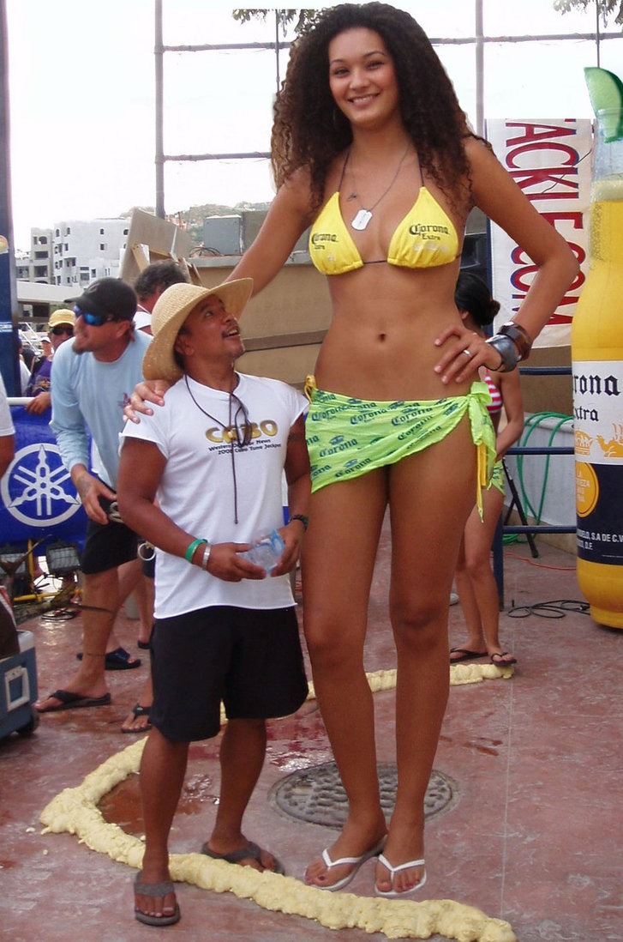
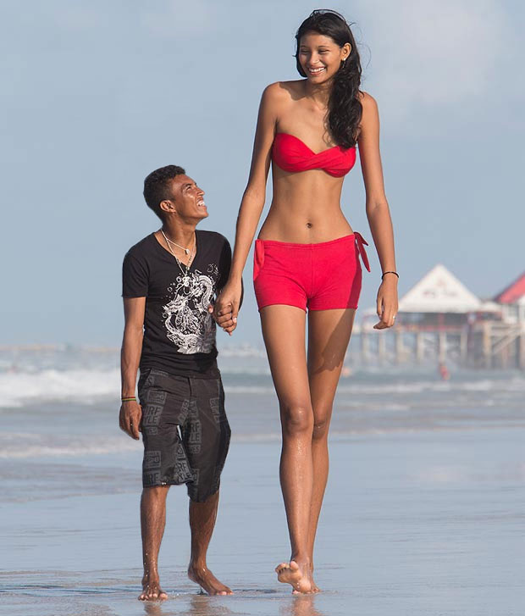
I am not very tall.
I wish………………

Slide 3


I can’t speak English fluently.
I wish ……….

Slide 4
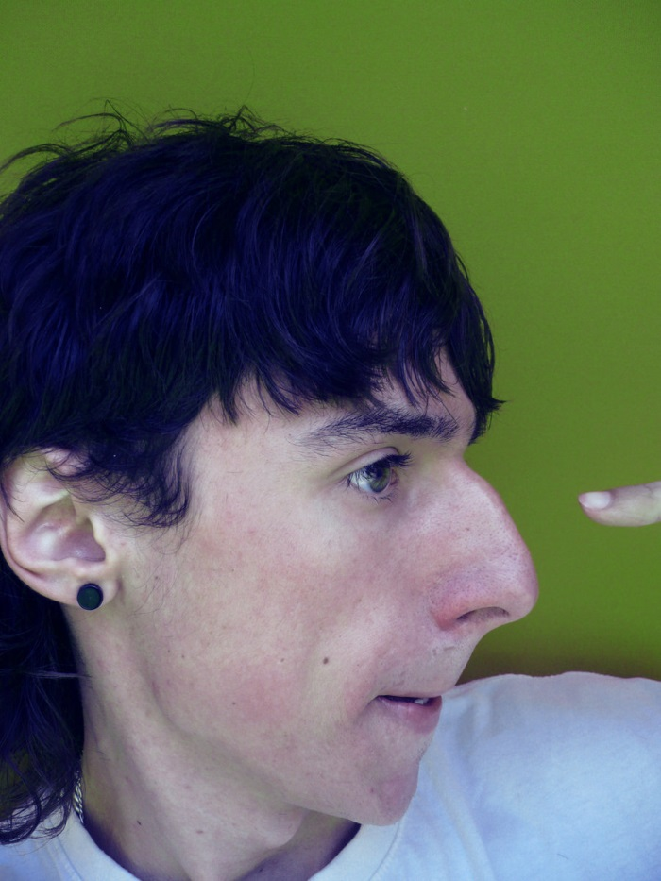
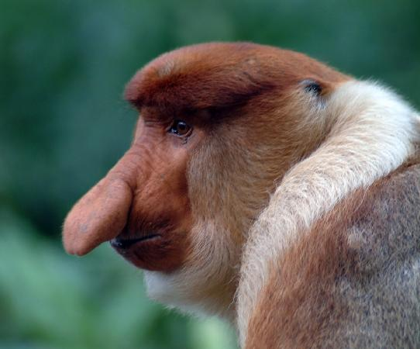
My nose is very big

Slide 5
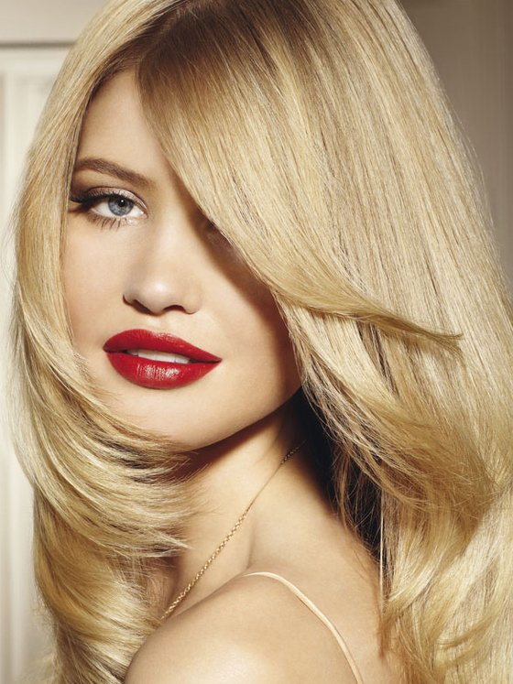
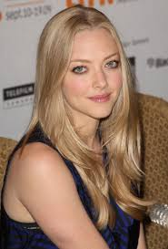

My hair is not blonde.

Slide 6

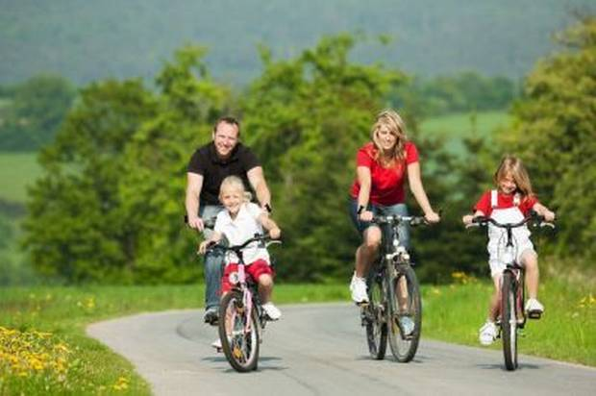

I don’t have enough free time

Slide 7
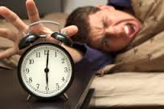
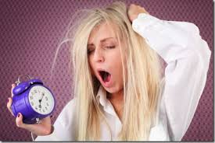

I have to get up early everyday

Slide 8
Wishes that express our annoyance. We hope that attitude will change in the future
WISH + WOULD + INF
I wish he would stop talking about his new car
I wish he would stop calling me at night.
BUT!!! If we talk about ourselves we don’t use WOULD!
1. I wish I had a job.

Slide 9
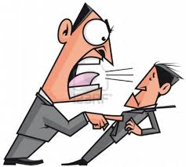
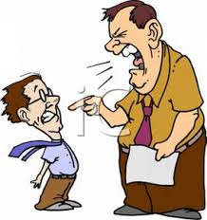

My boss yells at me.
I wish he….

Slide 10
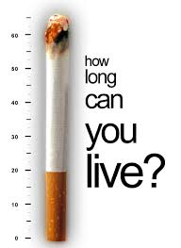

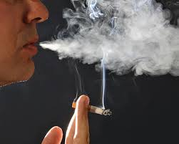
My husband smokes. I want him to give up.

Slide 11


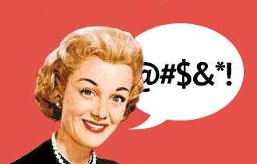
My best friend always swears. I want him to stop it!

Slide 12
I hope
We talk about the things we want to happen in the future. There is a possibility that the situation might happen
I HOPE + subject + verb
I hope she comes
I hope they enjoy themselves.

Slide 13
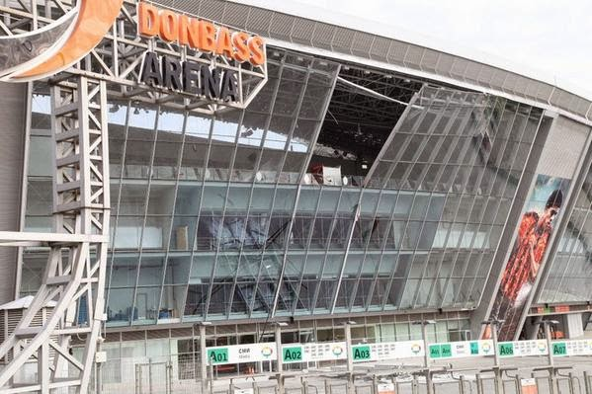
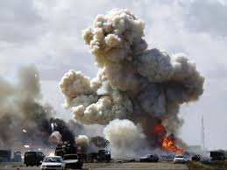
The war might finish soon

Slide 14
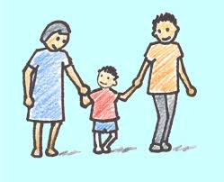
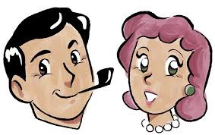
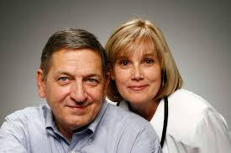
My parents might come to visit me

Slide 15
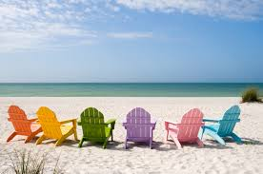


Summer is soon. I want to have a vacation

Slide 16
IT’S TIME….
When we want to express the annoyance that something hasn’t happened yet, we use the following structure:
IT’S TIME + subject + Past Simple
It’s time you learnt how to cook for yourself, Dad!
It’s time he called his parents. They are worried.

Slide 17
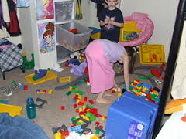
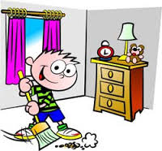
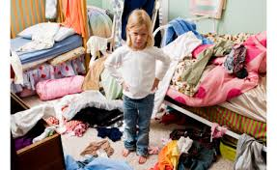
Clean the room/kids

Slide 18
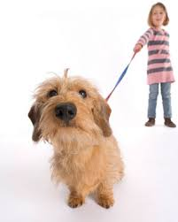
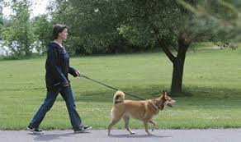

Walk a dog/you

Slide 19
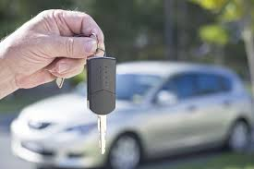
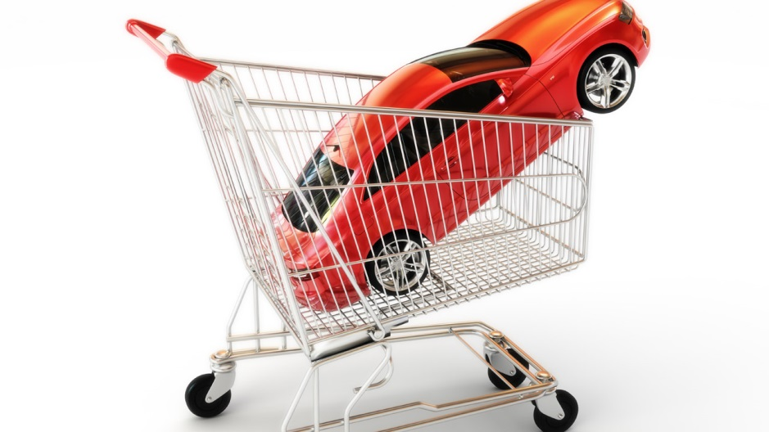
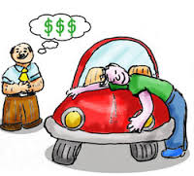
Buy a new car/Suzy

Slide 20
Should have + Past participle
We use this structure when we want to say that we regret about something that had already happened.
1. I shouldn’t have bought the car. I’m broke now.

Slide 21

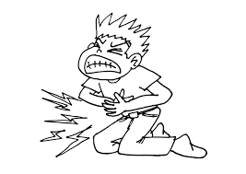
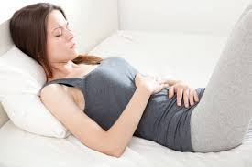
I have a stomachache

Slide 22
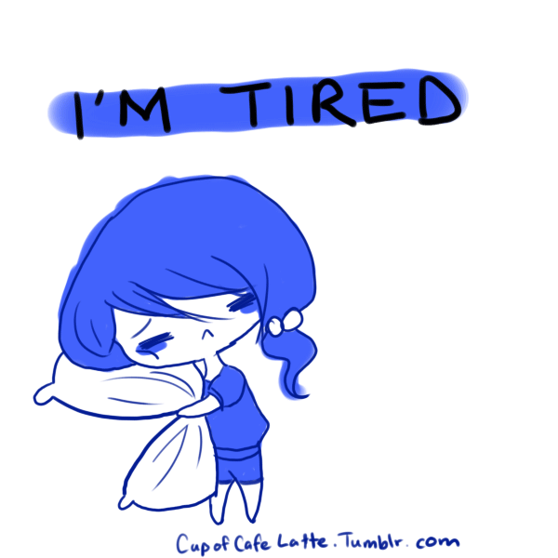
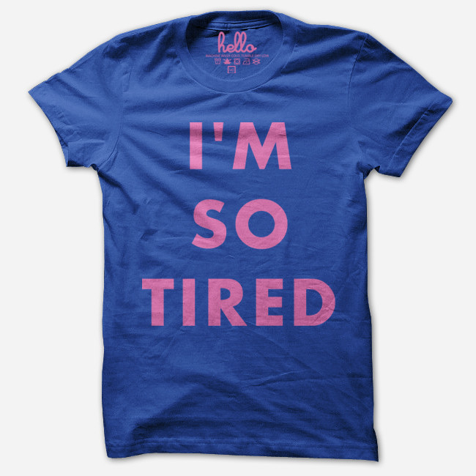
I’m tired

Slide 23
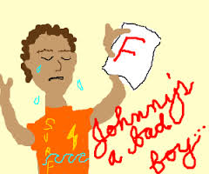
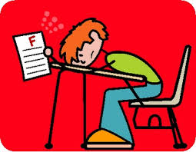
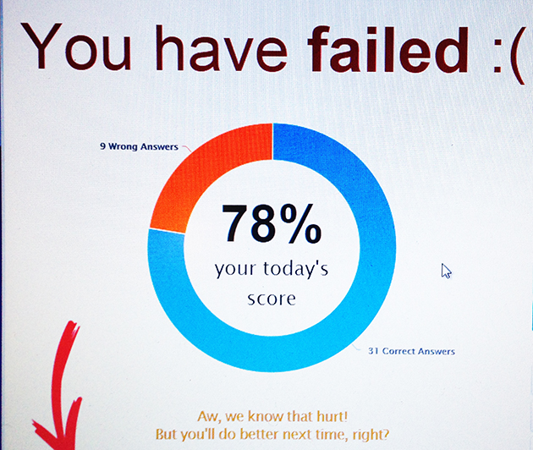
I failed my exams

Slide 24


I have a hangover

Slide 25



I was fired yesterday

Slide 26

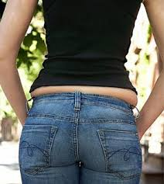
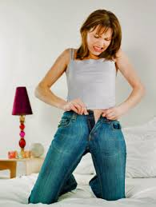
My jeans are too tight for me

Slide 27
Wishes about the past
When we did something in the past and we regret about it in the present we usually use:
WISH + subject + Past Perfect
1. I wish I hadn’t gone to Spain. (But I did and I all my documents were stolen there)

Slide 28
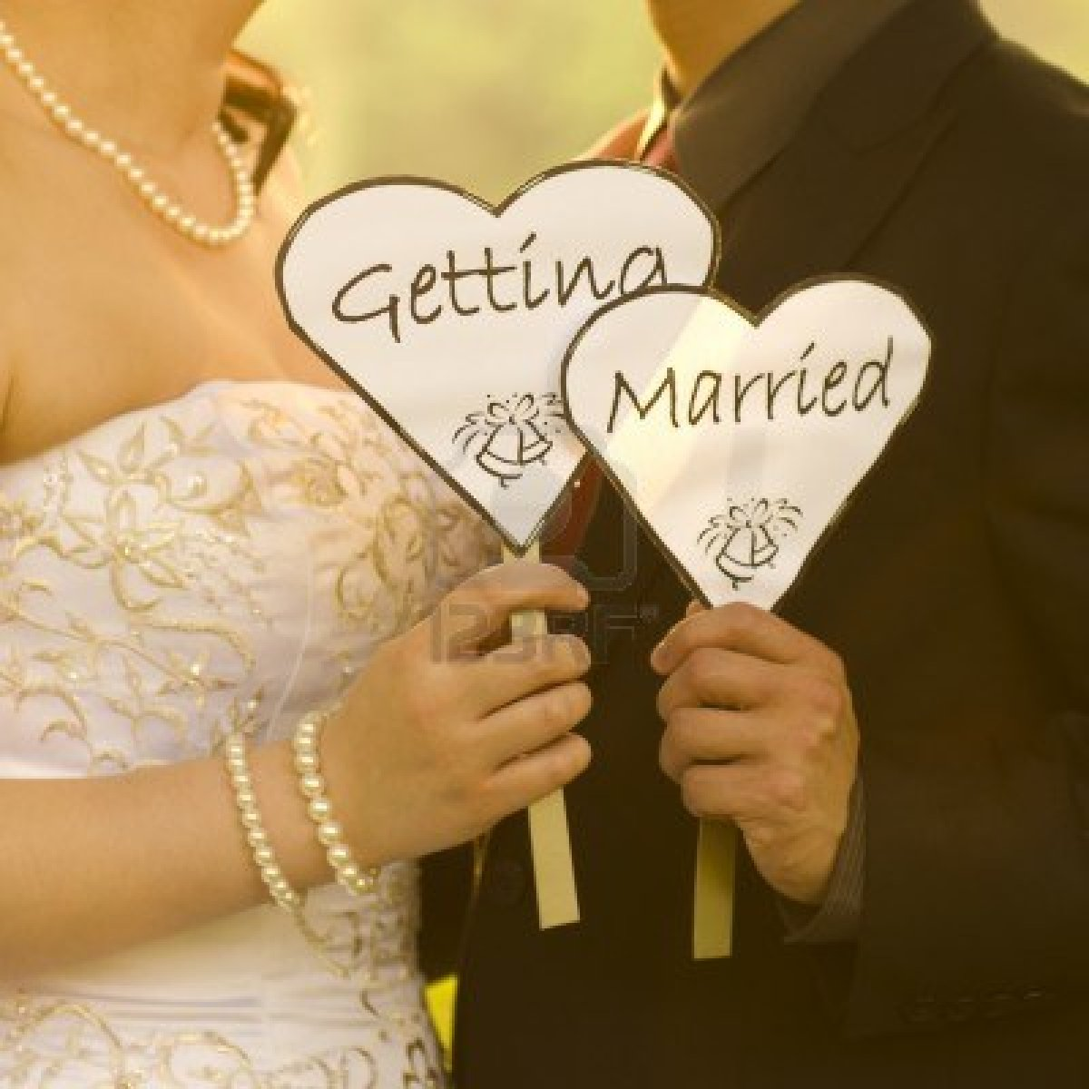

I regret having got married

Slide 29
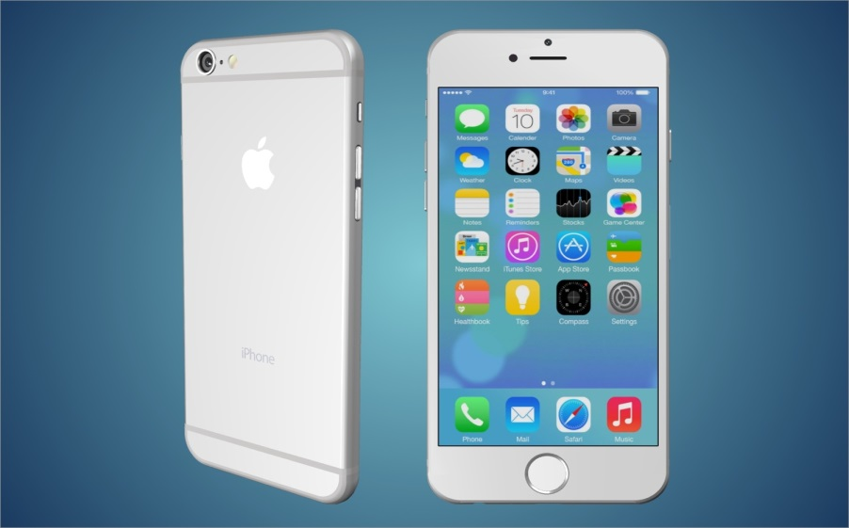
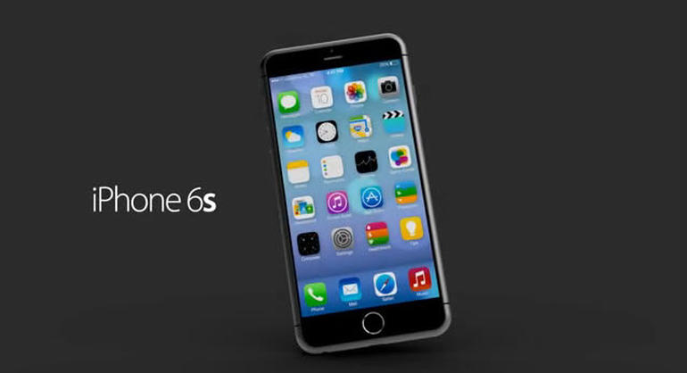
I paid a lot of money for my new iPhone 6 and it broke the next day.

Slide 30

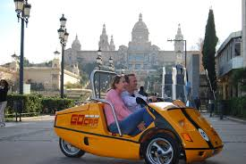
I went by car and it was really a long ride.

