Slide 1
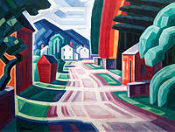
American modernism (1910 – 1950)
The movement of Modernism in American literature.
American poetry of imagism.
American theatre of the 20th century.

Slide 2
American modernism
The name of modernism is referred to as the major artistic movement of reaction to social disintegration.
American modernism came from the conviction that the previous structures of human life had been exposed to their falsehood.
The established literary forms and their parts (exposition, development, climax and resolution) were considered unnatural, not reflecting the changeability of life.

Slide 3
American modernism
A modernist work begins unpredictably without explanations and solutions. It is a set of segments, which are interconnected.
The narrative brings various images and their symbolic representations.
The dynamics of a modernist work is often hidden. The readers are expected to uncover the logical relations of its parts. They must search in a literary work for the meaning.
The theme of a modernist work is often the literary work itself.

Slide 4
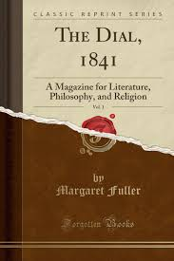
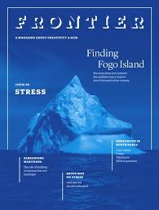
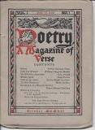
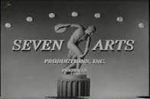
American modernism
Serious authors were published in the “little” magazines of limited circulation for chosen audience
“Poetry: A Magazine of Verse” (1912)
“Little Review” (1914)
“Seven Arts” (1916)
“Dial” (1917)
“Frontier” (1920)

Slide 5


American modernism main publishers
Random House
Harper

Slide 6
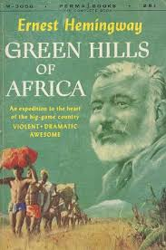
American modernism main principles
Concrete details
Events and images are direct expressions of experience
Allusions as a reference to historical, religious or philosophical aspects pf the past
Language is thoroughly reconsidered to represent the speech of different
people (for example: “The green hills
of Africa” by Ernest Hemingway)

Slide 7
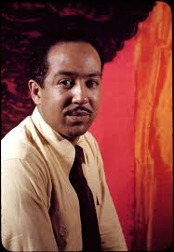
American modernism
Modernist techniques were defined by American poets (for ex.: black poets, following Langston Hughes, turned the black vernacular and used jazz beats as the indication of American).
Black Vernacular, the dialect of
English often spoken by African
Americans in urban and southern
regions, is also known a "African
American Vernacular English
culture.

Slide 8
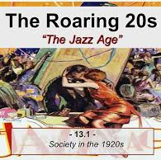
Jazz Age or Roaring Twenties (1920 – 1929)
The Jazz Age was a cultural period and movement that took place in America during the 1920s from which both new styles of music and dance emerged. Largely credited to African Americans employing new musical techniques along with traditional African traditions, jazz soon expanded to America's white middle class.

Slide 9
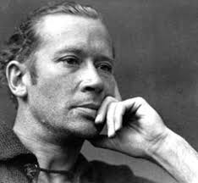
American modernism
Edward Estlin Cummings
(1894 – 1962) –
an innovative poet known for his lack of stylistic and structural conformity
the Cambridge ladies who live in furnished souls
the Cambridge ladies who live in furnished souls
are unbeautiful and have comfortable minds
(also, with the church's protestant blessings
daughters, unscented shapeless spirited)
they believe in Christ and Longfellow, both dead,
are invariably interested in so many things—
at the present writing one still finds
delighted fingers knitting for the is it Poles?
perhaps. While permanent faces coyly bandy
scandal of Mrs. N and Professor D
.... the Cambridge ladies do not care, above
Cambridge if sometimes in its box of
sky lavender and cornerless, the
moon rattles like a fragment of angry candy

Slide 10
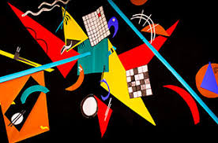
American modernism
American modernist poets (such as Robert Frost, T.S. Eliot, Marianne Moore, Langston Hughes, William Carlos Williams, Edna St. Vincent Millay, Claude McKay, Dorothy Parker and Wallace Stevens) were distinguished from those of the 19th century by their style, which was rich with borrowings from modern French and Italian poetry.

Slide 11
American modernism
Prose
A modernist novel was much shorter as compared to that of the previous century
The writers aimed at intensity and brevity
A short story, which had been previously thought of as a minor genre, was given a new strength
Modernist authors used the first person or one character’s viewpoint, because the truth is not objective, it is worked out from a personal interaction with reality

Slide 12
American modernism
A sense of disillusionment and loss pervades much American modernist fiction. That sense may be centered on specific individuals, or it may be directed toward American society or toward civilization generally. It may generate a nihilistic, destructive impulse, or it may express hope at the prospect of change.
For xample:
F. Scott Fitzgerald skewered the American Dream in The Great Gatsby (1925).
Richard Wright exposed and attacked American racism in Native Son (1940).

Slide 13
American modernism
Zora Neale Hurston told the story of a black woman’s three marriages in Their Eyes Were Watching God (1937).
Ernest Hemingway’s early novels The Sun Also Rises (1926) and A Farewell to Arms (1929) articulated the disillusionment of the Lost Generation.
Willa Cather told hopeful stories of the American frontier, set mostly on the Great Plains, in O Pioneers! (1913) and My Ántonia (1918).

Slide 14
American modernism
William Faulkner used stream-of-consciousness monologues and other formal techniques to break from past literary practice in The Sound and the Fury (1929).
John Steinbeck depicted the difficult lives of migrant workers in Of Mice and Men (1937) and The Grapes of Wrath (1939).

Slide 15
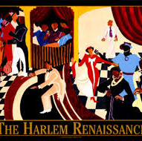
Harlem renaissance (the 1920 – 1930s)
Harlem Renaissance, a blossoming (c. 1918–37) of African American culture, particularly in the creative arts, and the most influential movement in African American literary history.

Slide 16
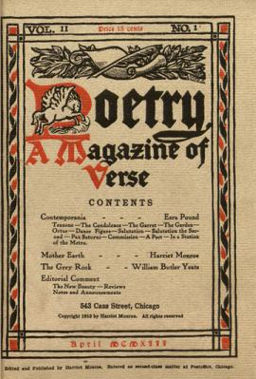
American modernism
The Harlem Renaissance produced a group
of poets, among them Countee Cullen,
Langston Hughes, Claude McKay and Alice
Dunbar Nelson.
Harriet Monroe founded Poetry magazine
in Chicago in 1912 and made it the most
important organ for poetry not just in the
United States but for the English-speaking
world.
During the 1920s Edna St. Vincent Millay,
Marianne Moore and E.E. Cummings expressed a spirit of revolution and experimentation in their poetry.

Slide 17
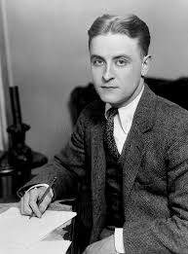
American modernism
American short-story writer and novelist famous for his depictions of the Jazz Age (the 1920s), his most brilliant novel being The Great Gatsby (1925).
A symbol of the clash between material prosperity and moral devastation
Francis Scott Fitzgerald
(1896 – 1940)

Slide 18
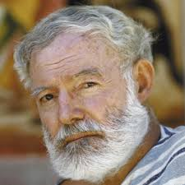
American modernism
The Old Man and the Sea, The Sun Also Rises, A Farewell to Arms, For Whom the Bell Tolls, A Moveable Feast, etc.
Ernest Hemingway (1899 – 1961)
American novelist and short-story writer, awarded the Nobel Prize for Literature in 1954.

Slide 19
American modernism
In a famous quote from a 1958 interview with the "Paris Review," novelist Ernest Hemingway used the iceberg as a metaphor to explain how he achieved his style and exactly what details he had omitted from his book, The Old Man and the Sea: “Surely, if a writer stops observing he is finished. But he does not have to observe consciously nor think how it will be useful. Perhaps that would be true at the beginning. But later everything he sees goes into the great reserve of things he knows or has seen. If it is any use to know it, I always try to write on the principle of the iceberg. There is seven-eighths of it underwater for every part that shows. Anything you know you can eliminate and it only strengthens your iceberg. It is the part that doesn't show. If a writer omits something because he does not know it, then there is a hole in the story …”

Slide 20
American modernism
To write in this elliptical manner, Hemingway suggests, is far more powerful, poetic and evocative, than a literal, all-inclusive record of one's experience could ever be. But at the same time, he cautions, it's still vital to be aware of all aspects of a given experience, even those one eventually chooses to omit when writing; the falsity of writing only pretending such awareness or knowledge will be quickly intuited by readers.

Slide 21
American modernism
What is the purpose of writing this way? What did Hemingway believe was the function of his art?
Hemingway: . . . you make something through your invention that is not a representation but a whole new thing truer than anything true and alive, and … if you make it well enough, you give it immortality.

Slide 22
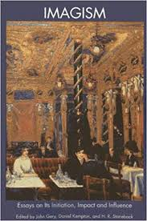
American poetry of imagism
Imagist, any of a group of American and English poets whose poetic program was formulated about 1912 by Ezra Pound—in conjunction with fellow poets Hilda Doolittle, Richard Aldington and Frank Stuart Flint—and was inspired by the critical views of Thomas Ernest Hulme (Томас Ернест Х’юм), in revolt against the careless thinking and Romantic optimism he saw prevailing.

Slide 23
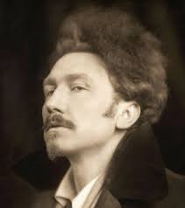
Ezra Pound (1885 – 1972)
in full Ezra Loomis Pound, an American poet and critic, who did more than any other single figure to advance a “modern” movement in English and American literature.

Slide 24
Principles of imagism
The Imagist movement began in 1908, when poet T.E. Hulme formed a group of poets, including Ezra Pound, as the “School of Images.”
The six guiding principles of the imagism:
To use the language of common speech, but to employ always the exact word, not the nearly-exact, nor the merely decorative word.
To create new rhythms—as the expression of new moods—and not to copy old rhythms, which merely echo old moods. We do not insist on “free-verse” as the only method of writing poetry. We fight for it as for a principle of liberty. We believe that the individuality of a poet may often be better expressed in free-verse than in conventional forms. In poetry, a new cadence means a new idea.
To allow absolute freedom in the choice of subject. We believe passionately in the artistic value of modern life.
To present an image (hence the name: “Imagist”). We are not a school of painters, but we believe that poetry should render particulars exactly and not deal in vague generalities.
To produce poetry that is hard and clear, never blurred nor indefinite.
Finally, most of us believe that concentration is of the very essence of poetry.

Slide 25
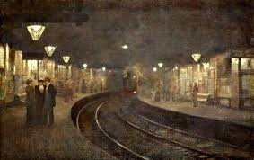
The best example of a classic imagist work
In a station of the Metro by Ezra Pound.
The apparition of these faces in the crowd:
Petals on a wet, black bough.
In this quick poem, Pound describes watching faces appear in a metro station. It is unclear whether he is writing from the vantage point of a passenger on the train itself or on the platform. The setting is Paris, France, and as he describes these faces as a "crowd," meaning the station is quite busy.

Slide 26
in a Station of the Metro Analysis
On their own, each of the two sentence fragments that make up this work have almost no real meaning. The relationship between the two moments is what creates meaning in this work. The real engine of this work is the metaphor likening faces in a crows to petals on a wet, black bough (referring to the main branch on a tree).
With only fourteen words used throughout the poem, it stands to reason that each one was chosen specifically for one particular conveyed image. For example, the word “apparition” in the first line suggests the nature of travelling in a crowd — it is a fleeting action, so much so that people seem like ghosts to the observer. In one moment, there is a face, as clear as can be, and in the next it is gone, and likely will never be remembered by the mind. They are apparitions, in one place for one moment, and then gone forever in the next.

Slide 27
in a Station of the Metro Analysis
In the following image, the observer views “petals on a wet, black bough”, which is to say they are looking at the leaves of a tree, likely following rainfall. In this image, the reader is presented with the idea of small, fleeting and weak elements of beauty within the natural world.
It is difficult to describe the feeling of appreciation of a transient natural phenomenon, which is likely why Pound chose this particular image — to stand in for a feeling that can’t be easily described.

Slide 28
in a Station of the Metro Analysis
The first image of the poem is entirely constructed by humans, and the second one is entirely a phenomenon of the natural world.
The relationship between the two ideas is an abstract one, but by pairing them together, Pound seems to be suggesting that there is that specific kind of beauty in the station of a metro, and that the fleeting apparitions of people drifting through is no different than the wilting nature of a petal stuck to a wet tree.
The petal weathers, the petal is rained on, and eventually, that petal wilts and dies, just like each person entering and leaving the view of the author.

Slide 29
in a Station of the Metro Analysis
As for the meaning of this poem. There are parallels and similarities and noticeable differences between the two images, and these can be defined in several ways.
To some, the poem might say more in its structure, as a verbless imagist poem of fourteen words than with those fourteen words.
To others, it is the definition of an unusual emotion, one that does not have a correlating word in the English Dictionary. As with most poetry, it tends to be the eye of the reader that gives it its true definition.

Slide 30
American theatre in the 20th century
Drama came to prominence for the first time in the United States in the early 20th century. Playwrights drew inspiration from European theater but created plays that were uniquely and enduringly American.
Since the 17th century American Puritanism suppressed any entertaining art, including theatrical performances.
American Puritans believed that the stage had not been destined for the improvement of humanity.
But performances, based on the Bible plots, were very popular.

Slide 31
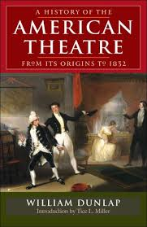
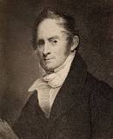
American theatre in the 20th century
During the Revolutionary War the first professional American playwright William Dunlap (1766 – 1839) wrote “The History of American Theatre” (1832).

Slide 32
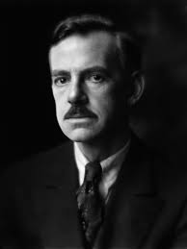
American theatre in the 20th century
Eugene O’Neill (1888 – 1953) was the foremost American playwright of the period.
His play Long Day’s Journey into Night (written 1939–41, performed 1956) was the high point of more than 20 years of creativity that began in 1920 with the play Beyond the Horizon and concluded with the play The Iceman Cometh (written 1939, performed 1946).

Slide 33
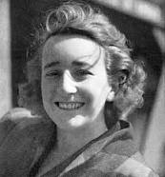
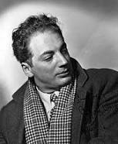


American theatre in the 20th century
During the 1930s Lillian Hellman, Clifford Odets and Langston Hughes wrote plays that exposed injustice in America.
Thornton Wilder presented a realistic (and enormously influential) vision of small-town America in the play Our Town, first produced in 1938.

Slide 34
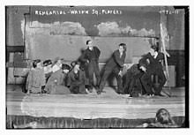
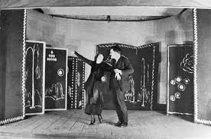
American theatre in the 20th century
In 1915 two acting companies were formed in Greenwich Village, New York.
The Washington Square Players was a Manhattan, New York City theatrical production company that existed from 1914 to 1918.
Provincetown Players, theatrical organization that began performing in 1915 in Provincetown, Mass., U.S., founded by a nontheatrical group of writers and artists whose common aim was the production of new and experimental plays.

Slide 35
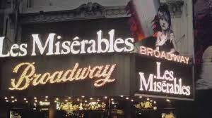
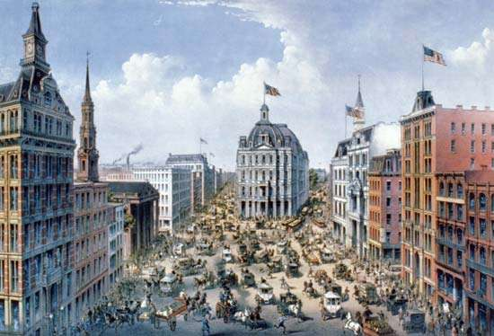
American theatre in the 20th century
Broadway
Broadway, the street running the length of Manhattan in New York City, has been associated with American theatrical activity since 1735, when the first theatre opened on the street.
By the end of the 20th century, the word Broadway had come to refer to a theatrical district in New York (which included Broadway itself as well as the side streets from Times Square to 53rd Street), a category (a theatre with more than 500 seats), and a sensibility (commercial theatre run strictly for profit). Throughout the century, however, the word was most closely associated with the American musical.

Slide 36
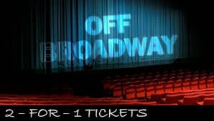
American theatre in the 20th century
Off-Broadway, in the theatre of the United States, small professional productions that have served since the mid-20th century as New York City’s alternative to the commercially oriented theatres of Broadway.

Slide 37
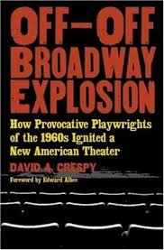
American theatre in the 20th century
Like Broadway, Off-Broadway theatres began to suffer from soaring costs; this stimulated the emergence in the early 1960s of still less expensive and more daring productions, quickly labeled Off-Off-Broadway.

Slide 38
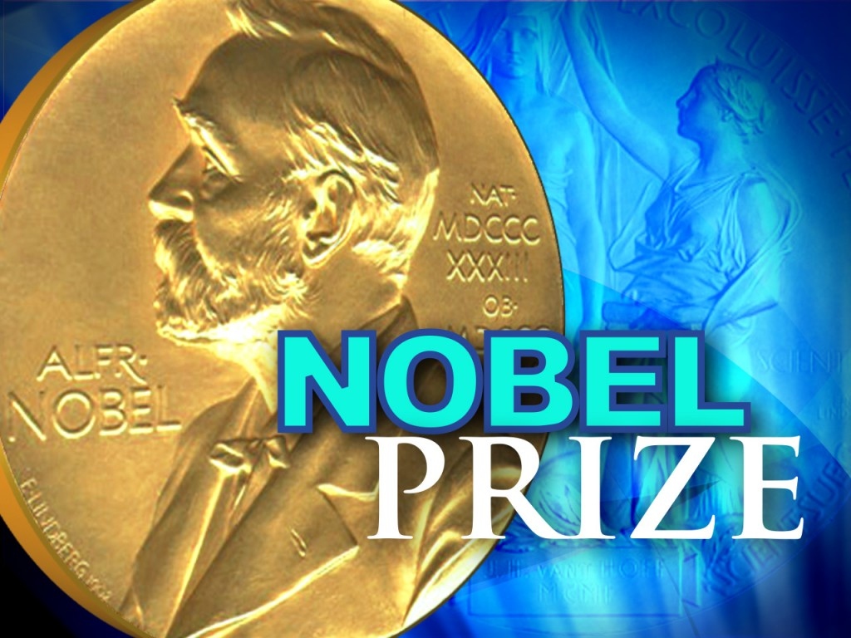
Us Nobel prize winners in literature
1930 Sinclair Lewis.
1936 Eugene O'Neill.
1938 Pearl S. Buck.
1949 William Faulkner.
1954 Ernest Hemingway.
1962 John Steinbeck.
1976 Saul Bellow.
1978 Isaac Bashevis Singer.
1987 Joseph Brodsky.
1993 Toni Morrison.
2016 Bob Dylan.

Slide 39
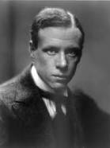
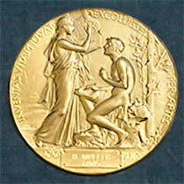
Us Nobel prize winners in literature
Sinclair Lewis (1885 – 1951) was awarded the Nobel Prize in Literature “for his vigorous and graphic art of description and his ability to create, with wit and humor, new types of characters”. Lewis, born in Sauk Center, Minnesota, was the first American to win the distinguished award.

Slide 40
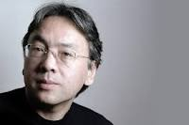
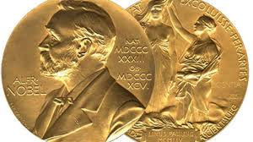
Nobel prize winners in literature 2017
The Nobel Prize in Literature 2017 was awarded to Kazuo Ishiguro (born 8 November 1954) is a British novelist, screenwriter and short-story writer, "who, in novels of great emotional force, has uncovered the abyss beneath our illusory sense of connection with the world."

Slide 41
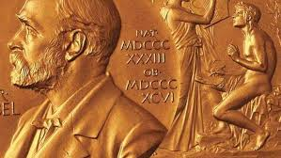
Nobel prize winners in literature 2018, 2019
“The Swedish Academy has decided to postpone the 2018 Nobel Prize in Literature, with the intention of awarding it in 2019.
The last Nobel Prize in Literature winner was Kazuo Ishiguro, who took the honor in 2017. The Swedish Academy will award two literary prizes in 2019, the Nobel Foundation says.

