Slide 1
Social and Territorial Varieties of English.
1. Functional Stylistics and Dialectology.
2. Spread of English. English-Based Pronunciation Standards of English.
3. The main points of difference between RP and GA.
4. Styles of pronunciation.

Slide 2
Functional Stylistics and Dialectology
Dialectology is inseparably connected with sociolinguistics, the latter deals with language variation caused by social difference and differing social needs; it studies the ways language interacts with social reality.
Every national variant of English falls into territorial and regional varieties (dialects) (територіальні або регіональні різновиди).
A dialect (діалект) is a variant of the language that includes differences in grammar, vocabulary, and pronunciation. Thus a dialect includes an accent (вимовний тип/тип вимови), i.e. a way of pronouncing the language.

Slide 3
An accent is a unified entity of pronunciation patterns used for communicative interaction by the members of the same speech community.
Speakers of the same accent typically:
share a relevant social or geographical attribute and
maintain a uniform set of phonological characteristics, despite a certain amount of limited phonetic and lexical-incidental variation between them [V.Yu. Parashchuk].

Slide 4
Sociolinguistics is the branch of linguistics which studies different aspects of language –
phonetics,
lexics,
grammar with reference to their social functions in the society.
Thus, sociolinguistics explains language phenomena in connection with factors outside the language faculty itself in terms of large-scale social structure and in terms of how people use language to communicate with one another.

Slide 5
A language which is a mother tongue of several nations is called a polyethnic language or a nationally heterogeneous language (поліетнічна або національно негомогенна мова), e.g. English, German, Spanish, etc.
In a polyethnic language there can exist a great variety in terms of pronunciation. First of all, a polyethnic language can have national variants/types of pronunciation (національні варіанти/типи вимови).
English is the mother tongue of several nations, thus it has the following national variants of pronunciation: British English, American English, Australian English, New Zealand English. In the case of English there exists a great diversity in the spoken realization of the language and particularly in terms of pronunciation.

Slide 6
The varieties of the language are conditioned by language communities ranging from small groups to nations. Now speaking about the nations we refer to the national variants of the language.
According to the conception of A.D. Shweitzer a national language is a historical category evolving from conditions of economic and political concentration which characterizes the formation of a nation.
In other words national language is the language of a nation, the standard of its form, the language of a nation's literature.

Slide 7
The literary spoken form has its national pronunciation standard.
A "standard" may be defined as "a socially accepted variety of a language established by a codified norm of correctness" [K. Macanalay].
Today all the English-speaking nations have their own national variants of pronunciation and each of them has peculiar features that distinguish it from other varieties of English.
It is generally accepted that for the "English English" it is "Received Pronunciation" or RP; for "The American English" – "General American pronunciation"; for the Australian English – "Educated Australian".

Slide 8
One of the accents in the country can enjoy the status of being "correct", cultivated and accepted by the educated speakers throughout the national community. It is called literary pronunciation (orthoepic pronunciation, літературна/ орфоепічна вимова), the term traditionally used by Ukrainian linguists, or a (national) standard of pronunciation (національний вимовний стандарт), the term traditionally used by American and British scholars.
A standard of pronunciation can be defined as phonetic shaping of spoken form of a national language received by the educated users of that language which at a given time is generally considered correct, statistically relevant and/or enjoys social prestige [V. Yu. Parashchuk].
The term 'standard' is to be interpreted to mean “implicitly considered to represent correct and socially acceptable usage for educated purposes”. The use of the other pronunciation types is applied to certain regions, smaller localities, social, professional, and age groups.

Slide 9
Though every national variant of English has considerable differences in pronunciation, vocabulary and grammar, they all have much in common which gives us ground to speak of one and the same language – the English language.
It is well-known that there are countries with more than one national language, the most common case being the existence of two nation al languages on the same territory. For this Canada will be an example, where two different languages – English and French – form the repertoire of the community. In this case scholars speak about bilingualism in contrast to monolingualism typical of a country with one national language.
Here arises the problem of interference, that is "linguistic disturbance which results from two languages (or dialects), coming into contact in a specific situation" [David Crystal].

Slide 10
Local accents may have many features of pronunciation in common and consequently are grouped into territorial or area accents. In Britain, for example, Yorkshire, Lancashire and Cheshire accents form the group of "Northern accent".
The terms "dialects and accents" should be treated differently when related to different aspects of the language. It is, however, true that there is a great deal of overlap between these terms.
For certain geographical, economic, political and cultural reasons one of the dialects becomes the standard language of the nation and its pronunciation or its accent — the received standard pronunciation. This was the case of London dialect, whose accent became the "RP" ("Received Pronunciation") of Britain [Alfred Charles Gimson].

Slide 11
It has been estimated that the standard pronunciation of a country is not homogeneous. It changes in relation to other languages, and also to geographical, psychological, social and political influences. In England, for example, we distinguish "conservative, general and advanced RP" [Alfred Charles Gimson].
The pressure of Standard English is so strong that many people are bilingual in a sense that they use an imitation of RP with their teachers and lapse into their native local accent when speaking among themselves. In this occasion the term diglossia should be introduced to denote a state of linguistic duality in which the standard literary form of a language and one of its regional dialects are used by the same individual in different social situations. This phenomenon should not be mixed up with bilingualism that is the command of two different languages. In the case of both diglossia and bilingualism the so-called code-switching takes place.

Slide 12
British sociolinguists divide the society into the following classes: upper class, upper middle class, middle middle class, lower middle class, upper working class, middle working class, lower working class. It is well worth to understand that classes are split into different major and minor social groups (professional, educational, cultural, age, sex and so on).
Correspondingly every social community has its own social dialect and social accent. D.A. Shakhbagova defines social dialects as "varieties spoken by a socially limited number of people".
Situational varieties of the language are called functional dialects or functional styles and situational pronunciation varieties — situational accents or phonostyles.
Individual speech of members of the same language community is known as idiolect.

Slide 13
It is common knowledge that between 375 million people now speak English as their first language / mother tongue. It is the national language of Great Britain, the USA, Australia, New Zealand and Canada (part of it).
Thus nowadays two main types of English are spoken in the English-speaking world: English English and American English.
According to British dialectologists (Peter Trudgill, J. Hannah, A. Hughes and others) the following variants of English are referred
to the English-based group: English English, Welsh English, Australian English, New Zealand English;
to the American-based group: United States English, Canadian English. Scottish English and Irish English fall somewhere between.

Slide 14
British English Accents
English English |  | Welsh English | Scottish English |  | Northern Ireland English
Southern | Northern |  | Educated Scottish English | Regional Varieties
1. Southern 2. East Anglia 3. South-West | 1. Northern 2. Yorkshire 3. North West

Slide 15
English English
RP/BBC English implicitly enjoys the status of the national standard of pronunciation in the United Kingdom.
The non-RP accents of England may be grouped like this:
Southern accents.
Southern accents (Greater London, Cockney, Surrey, Kent, Essex, Hertfordshire, Buckinghamshire);
East Anglia accents (Lincolnshire, Norfolk, Suffolk, Cambridgeshire, Bedfordshire, Northamptonshire, Leicestershire);
South-West accents (Gloucestershire, Avon, Somerset, Wiltshire).
2. Northern and Midland accents.
Northern accents (Northumberland, Durham, Cleveland);
Yorkshire accents;
North-West accents (Lancashire, Cheshire);
West Midland (Birmingham, Wolverhampton).

Slide 16
In American English, three main types of literary/cultivated pronunciation are distinguished:
General American (GenAm, GA)/Network English which is also known as Western American and comprises that majority of American accents from Ohio through the Middle West and on to the Pacific coast. These accents do not show marked eastern or southern characteristics [John Wells].
Eastern American including (i) Boston and eastern New England, and (ii) New York City.
Southern American includes accents of lowland south: Virginia, North and South Carolinas, Tennessee, Florida, Georgia, Alabama, Mississippi, Arkansas, Louisiana, Texas, etc.

Slide 17
The opinions as to the US national standard of pronunciation vary. Some scholars hold the view that GenAm/Network English implicitly enjoys the status of the national standard of pronunciation in the USA, others claim that there is no nationwide pronunciation standard. But it is an actual fact that GenAm is widely used by the US media and enjoys intelligibility throughout the country.
In New Zealand, RP is used as pronunciation model for educated speakers.

Slide 18
In Australia, there is no or little geographical variation in pronunciation [The Cambridge Encyclopedia], but a great deal of variation can be classified according to social criteria. Three groups of accents are distinguished with no sharp boundary between them:
Cultivated Australian, used by about 10 percent of the population on which RP continues to exert a considerable pressure;
its opposite extreme, Broad Australian which is used by about 30 percent of the speakers and which appears to be most localized, most clearly identified with the notion of "an Australian twang", most vividly displaying Cockney influence;
General Australian, which is spoken by the mainstream of educated Australian speakers and which may be implicitly treated as Australian pronunciation standard.

Slide 19
The type of educated English pronunciation used in Canada has many similar features with GenAm alongside with specific Canadian traits.
New varieties of English or New Englishes have emerged as the result of the colonial experience: Indian English, Hong Kong English, Singaporean English, West African English, etc. [according to J. B. Pride]. These accents exhibit differences.
The following two accents of English have been under extensive investigation due to their importance, prestige and social advantage in certain geographical areas:
Southern English or RP/BBC English,
General American/GenAm or Network English.

Slide 20
Socio-historical survey of RP/BBC English.
The historical origins of RP go back to the 16th-17th century recommendations that the speech model should be that provided by the educated pronunciation of the court and the capital [according to Alfred Charles Gimson]. Thus, the roots of RP are in London, more particularly the pronunciation of the London region and the Home counties lying around London within 60 miles: Middlesex, Essex, Kent, Surrey.
By the 18th century a prestigious pronunciation model was characterized as the speech "received by the polite circles of society " [A. Ch. Gimson].
By the 19th century London English had increasingly acquired social prestige losing some of its local characteristics. It was finally fixed as the pronunciation of the ruling class.
In the mid-19th century there was an increase in education, in particular, there occurred the rise of public schools (since 1864 Public School Act). These schools became important agencies in the transmission of Southern English as the form with highest prestige. Since that time London English or Southern English was termed as Classroom English, Public School English or Educated English.

Slide 21
What was Southern Educated English at the beginning of the 20th century? It was a social, regionally-defined variety of more or less clearly definable social basis - rather a small group of people who had had public school education (Oxford, Cambridge) [according to Gerhard Leitner].
There was a forceful normalization movement towards the establishment of Educated Southern English as the STANDARD ACCENT. The major motifs of this were:
1) the need for a clearly defined and recognized norm for public and other purposes;
2) the desire to provide adequate descriptions for teaching English both as the mother tongue and a foreign language.
Professor Daniel Jones described this variety as a hoped-for standard pronunciation in the first editions of his books "The Pronunciation of English" and "Outline of English Phonetics".
By 1930, however, any intention of setting up a standard of Spoken English was disclaimed by many phoneticians. The term "Standard Pronunciation" was replaced by "Received Pronunciation", which had been introduced for Southern Educated English by phonetician Ida Ward who defined it as pronunciation which " had lost all easily noticeable local differences" [G. Leitner].
Thus, in the early 20th century the consolidation of Educated Southern English (RP) as a model took place, though variations according to style, age and idiolect were observable in it.

Slide 22
The British Broadcasting Corporation (the BBC) adopted RP for the use by its newsreaders since 1920s. The country's population, for more than half a century, had been exposed through broadcasting to RP. Until the early 70s of the last century it was the only accent demanded in the BBC's announcers [according to John Christopher Wells]. For that reason RP often became identified in the public mind with BBC English.
Before World War 2, RP had a regional base but its occurrence was socially determined - it was characteristic of upper-class speech throughout the country.
The second half of the 20th century witnessed the radical changes in RP's social base:
1) the second great communication leap (= the advent of radio and television) has led to a greater number of speakers, in various layers of society, using RP;
2) the social structure of the British society has lost much of its earlier rigidity;
3) access to higher education has led to a relaxation of view on prestige in pronunciation.
Since post-war years this vast extension of RP's social base has resulted in a dilution of the original concept of RP in the last quarter of the 20th century as compared with its consolidation in the first part of the century [A. Ch. Gimson]. This dilution of RP's concept manifests itself in the admittance of variant pronunciations as of common and acceptable usage. It is fair to mention, however, that only 3-5 % of the population of England speak RP.

Slide 23
British phoneticians estimate that nowadays RP is not homogeneous.
A. Ch. Gimson suggest that it is convenient to distinguish three main types within it:
"the conservative RP forms, used by the older generation, and traditionally, by certain profession or social groups;
the general RP forms, most commonly in use and typified by the pronunciation adopted by the BBC;
the advanced RP forms, mainly used by young people of exclusive social groups — mostly of the upper classes, but also for prestige value, in certain professional circles". This last type of RP reflects the tendencies typical of change in pronunciation. It is the most "effected and exaggerated variety" of the accent. Some of its features may be results of temporary fashion; some are adopted as a norm and described in the latest textbooks.
Many native speakers, especially teachers of English and professors of colleges and universities (particularly from the South and South-East of England) have accents closely resembling RP but not identical to it.
Peter Trudgill and J. Hannah call it Near-RP southern.

Slide 24
The types of standard English pronunciation may be summarized as follows: Conservative RP (Adoptive RP); General RP (Mainstream RP); Advanced RP (U-RP); Near-RP southern.
Three main types of RP are distinguished by A.Ch. Gimson and A. Cruttenden:
1) General RP,
2) Refined RP,
3) Regional RP.
General RP reflects the pronunciation of middle class educated speakers.
Refined RP is defined as an accent reflecting a class distinction associated with upper-class families, and the number of its speakers is declining.
Regional RP is basically RP except for the presence of a few regional characteristics which go unnoticed even by other speakers of RP.

Slide 25
Nowadays British phoneticians refer to an educated accent in London and the south east which is termed Estuary English (англійська вимова в дельті Темзи) [according to Paul Coggle and David Rosewarne].
Estuary English is said to "be adopted by those wishing to avoid the stigma of RP as "posh" and by upwardly mobile speakers of local dialect.
It is often characterized among younger speakers as having “street credibility” or streetcred, i.e. as being fashionable [A. Ch. Gimson].

Slide 26
In Professor Wells's opinion, "EFL teachers working within a British-oriented environment should continue to use RP (...) as their pronunciation model. But this model must be revised and updated from time to time".
A speaker's experiences of languages may typically embrace a first language, a second language, and a foreign language [according to John Laver].
A first language (LI) is the speaker's native language (NL) / mother tongue (MT), whose learning normally begins in the speaker's earliest experience of language acquisition as a very small child.
A second language (L2) is any other language that the speaker learns to control, at any time, to a level of near native-like proficiency. Typically immigrants acquire it in LI's natural environment.
A foreign language (FL) is any language spoken by the speaker to less than L2 level.

Slide 27
In case of English teaching and learning different terms applicable to different groups of non-native speakers are in use:
ELT – English Language Teaching,- i.e. teaching English to learners of all types;
TEFL – Teaching English as a Foreign Language, - where learners are neither native speakers, nor immigrants;
TESL – Teaching English as a Second Language, - where learners addressed are often immigrants to an English-speaking culture;
TESOL – Teaching English to Speakers of Other Languages, - which is slightly more neutral term encompassing both TESL and TEFL, but avoiding the labels such as 'second' or 'foreign' (mainly used in American English).

Slide 28
A lingua franca is a language used as a means of communication by speakers who do not have a native language in common [P. Trudgill, J. Hannah].
Originally it was a special case when a foreign language was used as the medium of linguistic communication in some area, e.g. for trade purposes (literally 'language of the Franks', the Arabic term of the day for all Europeans).
The largest world lingua francas in use today include English and Mandarin Chinese.

Slide 29
A pidgin language is the language used for the purpose of communication between speakers of mutually unintelligible languages (usually in the Third World) which has been developed out of the mixture of the languages of the communities concerned (e.g. Papua New Guinea Pidgin English, Chinese Pidgin = Tok Pisin).
Such languages are linguistically simplified, i.e. they typically have a limited vocabulary, a reduced grammatical structure and a narrow range of functions compared to the languages from which they derive.
The origin of the term Pidgin is thought to be "a Chinese corruption of English business" [according to “The Oxford English Dictionary”]. The citations from OED suggest that the spelling pigeon was commoner than pidgin in the 19th century, when European traders were active on the South China Coast, and appears to be the origin of the expression That's not my pigeon (= That's not my business /concern).
Tom McArthur [1998] states that... "for over a century, pidgin has been used... as a label for any hybrid language used in ports and on ships, and in garrisons, markets, mines, and the like". It is only in the later twentieth century that it has acquired the neutral, technical sense of' a contact language which draws on elements from two or more languages [The Oxford Companion to the English Language 1992: 778].

Slide 30
A Creole is a second stage in the process of the pidgin development, i.e. it is a pidgin language which has become the mother tongue of a community when within a multilingual community, increasing number of people begin to use a pidgin as their principal means of communication [according to “The Cambridge Encyclopedia”].
This causes a major expansion of the grammar and vocabulary, and the range of the situations where the language is used.
When the children of the speakers of a pidgin become to use it as their mother tongue, that language becomes known as a creole. In other words, a Creole is the first language of the children of Pidgin speakers.
There are considered to be between six and twelve million people still using pidgin languages, and between ten and seventeen million using Creoles [according to George Yule].
English-based Creoles are used in Jamaica and Sierra Leone.

Slide 31
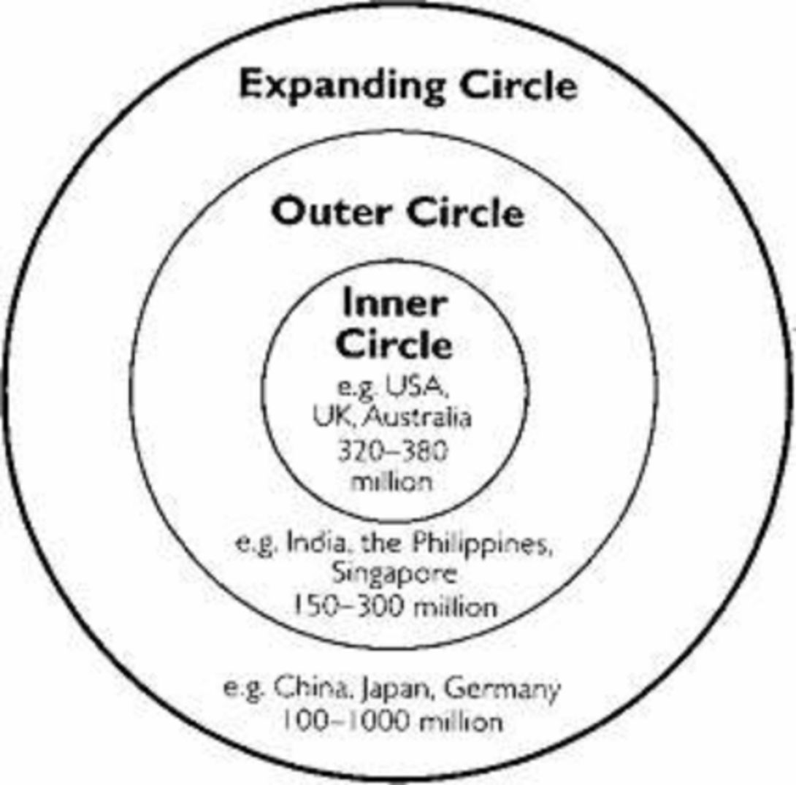
The spread of English throughout the world has been visualized as three concentric circles, representing different ways in which the language has been acquired and is currently used [according to Braj Bihari Kachru, an Indian linguist]:

Slide 32
Prospective EFL teachers and users should be aware of the existing variety of social shapes of English. The phonemic system of a language is always in a process of evolution. It is the most fleeting [A. Ch. Gimson] as compared with vocabulary and grammar. The route and the rate of the phonetic changes in different languages are not the same, for instance, in English or Ukrainian.
EFL learners should know some general facts about the English phonetic system. There are a number of factors (both intra-linguistic and social) which have accelerated the process of phonetic changes throughout the history of English.

Slide 33
They can be summarized as follows:
1) the rich vocalic system of English, e.g. 20 English vowels vs. 6 Ukrainian ones. And this is a general fact that historically vowels have been subject to more striking changes than consonants. It can be explained by the differences in their production. A consonantal articulation usually involves an approximation of speech organs which can be felt. It tends to be more stable and it is more easily identified and transmitted more exactly from one generation to another [A. Ch. Gimson].
A modification of vowel quality results from very slight changes of the tongue or lip position and there may be a series of variations before a change in quality is evident. Out of monophthongs and diphthongs, the latter are least stable. Figuratively, consonants can be called the skeleton of the sound system, monophthongs are its flesh and diphthongs are its blood.

Slide 34
2) the sweeping systemic changes at the earlier periods of English which shook its sound system to the core (e.g. the Great Vowel Shift, r-vocalization, etc.);
The Great Vowel Shift was a massive sound change affecting the long vowels of English during the fifteenth to eighteenth centuries. Basically, the long vowels shifted upwards; that is, a vowel that used to be pronounced in one place in the mouth would be pronounced in a different place, higher up in the mouth. For ex., the word 'goose,' had two letters “O” to indicate a long [o] sound, [o:] - a good phonetic spelling of the word. However, the vowel [o] had shifted to [u]; thus goose, moose, food, and other similar words that we now spell with double “O” had mismatched spelling and pronunciation.
Vocalisation of [r]. It occurred in the 16th – 17th c. Sound [r] became vocalized (changed to [ə] (schwa)) when stood after vowels at the end of the word. Consequences:
· new diphthongs appeared: [εə], [iə], [uə];
· the vowels before [r] were lengthened (e.g. arm [a:m], for [fo:], etc.);
· triphthongs appeared: [aiə], [auə] (e.g. shower [‘∫auə], shire [‘∫aiə]).

Slide 35
3) the lasting period of a foreign domination in the Middle Ages when the phonological system of English was under a strong influence of an alien phonological system (French);
4) the role of English as an international language (e.g. its contacts with other languages, etc.).
All the above-mentioned factors (both direct and indirect, historical and living) should be kept in mind as accelerators of the phonetic changes in English which are more rapid and complicated than, for instance, in Ukrainian.

Slide 36
It is important to note here that the source (джерело) of the phonetic changes, the form (форма) and the condition (умова) of their realization in language synchrony is variability of the phonetic means (варіювання фонетичних засобів) of a language [Расторгуева Т.А. История английского языка: учебник, 2007] .
Thus, variability is an existential quality of literary pronunciation as of any other component of a language. The appearance of a new shade in the pronunciation of a sound results in the coexistence of free variants in the realization of a phoneme, when there is a choice between permissible variants, open to the speakers [Соколова М.В. Теоретическая фонетика, 1996].
The speech of any community may, therefore, be said to reflect the pronunciation of the previous century and to anticipate that of the next [A. Ch. Gimson].

Slide 37
The qualitative and quantitative distinctions may manifest new 1) allophonic realizations of the same phoneme – free allophonic variation ("вільне" алофонічне варіювання), e.g. as in the example with the diphthong in the word "home" or 2) alternations of different phonemes within the phonemic structures of words - free phonemic variation (вільне фонемне варіювання): a speaker speaking in a single accent is free to choose between two or more pronunciation forms of a particular word [John Laver].
"Free" means that the alternation of certain phonemes within a word or the change of the place of stress do not result in the change of meaning, but in the variant pronunciations of the same word. Permissible variation of the phonetic and accentual structures of words appears to be a striking feature of RP/BBC English and GenAm.

Slide 38
All the pronunciation variants of a word are considered to be literary "correct" from the point of view of educated usage, but the ordering of such variants means that the variant coming first is widely used and very common – it is the main pronunciation variant; the rest, although widely used, are less common than the first form [A. Ch. Gimson], they are alternative variants. In the course of time, the ordering of variants may be changed due to particular tendencies and new developments within the accent.
EFL learners are recommended to memorize the first, more widely used, main variant for the active use, and at the same time they ought to be wary of the other permissible alternative variants of a given word, if there are any.

Slide 39
3. THE MAIN POINTS OF DIFFERENCE BETWEEN RP AND GA
Within the consonant system.
1. The sound [r] is one of the most characteristic of GA pronunciation. In its articulation the tip and the blade of the tongue occupy a retroflex position (they are turned upwards, towards the hard palate). Its pronunciation is accompanied by some slight protrusion of the lips. RP [r] is a cacuminal sonorant, GA [r] is a retroflex sonorant. GA [r] is pronounced not only initially but also before a consonant and in the word final position: form [fɔːrm], bird [bɜːrd], sister ['sɪstər]. In RP [r] never occurs between a vowel and a consonant or between a vowel and silence.
2. The phoneme [l] exists in GA only in the form of its dark variant [ł] and occurs both before vowels and [j] (in which positions clear variants are used in RP) and after a vowel or between a vowel and a consonant (as in RP): GA: look [łʊk], till [tɪł] RP: look [lʊk], till [tɪł].
3. The phoneme [t] in GA is extremely short and voiced. It is intermediate in character between a brief [d] and one-tap alveolar [r]. It can be represented by the phonetic symbol [ţ]. It occurs between a strongly stressed vowel and a weakly stressed one or a sonorant: GA: city ['sɪţɪ], better ['bɛţə] RP: city ['sɪtɪ], better ['betə].

Slide 40
4. When orthographic nt occurs in a similar positions the sound [ţ] is so brief that the impression is that it is omitted: plenty ['płɛn(t)ɪ].
5. Some Americans use the glottal stop [ʔ] instead of [t] before [m, n, r, l, j, w]: certainly ['sɜːʔnłɪ], that one [ðæʔ wən].
6. In GA the optional phoneme [ʍ] (voiceless [w]) or the cluster [hw] are used in words with the initial digraph wh: GA: witch [ʍɪʧ] [whɪʧ] RP: witch [wɪʧ].
7. The phoneme [j] is usually weakened or omitted altogether in GA between a consonant and [u:] as in the word news [nuːz].

Slide 41
Within the vowel system.
1. The GA vowel [ɪ] is a little more open than RP vowel phoneme [ɪ].
2. The GA vowel [e] is a lower front vowel, it almost coincides with [æ].
3. The GA [æ] is longer than in RP and its distribution is different. In GA [æ] is used, in addition to words in which RP uses [æ], also in place of the RP vowel [ɑ:] in most words in which the latter is spelt by the letter ɑ followed by a consonant letter other than r: GA: glass [ɡłæ·s], last [łæ·st] RP: glass [ɡlɑːs], last [lɑːst]. The exception is the stressed vowel in father [ɑː].
4. The GA counterpart of the RP vowel [ɒ] is its unrounded variety [ɑ] (similar to the RP [ɑ:], but short and checked): GA: box [bɑks], clock [kłɑk] RP: box [bɒks], clock [klɒk].
5. The phoneme [ʌ] in GA is pronounced as the central vowel [ə] but stressed. Other linguists say that GA [ʌ] is a little closer than the RP vowel [ʌ].
6. There is no strict division of vowels into long and short in GA.

Slide 42
Within the accentual structure.
In words of French origin GA tends to have stress on the final syllable, while RP has it on the initial:
GA: beret [be'reɪ], ballet [bæ'leɪ] vs. RP: beret ['bereɪ], ballet ['bæleɪ].
2. Some words have first-syllable stress in GA whereas in RP the stress may be elsewhere:
GA: address ['ædres], magazine ['mæɡəzɪn] vs. RP: address [ə'dres], magazine [ˌmæɡə'ziːn].
3. Polysyllabic words ending in -ory, -ary, -ery, -ative, -mony have secondary stress in GA, often called “tertiary”: dictionary ['dɪkʃəˎnərɪ], secretary ['sekrəˎtərɪ].

Slide 43
Within the intonational system.
American English intonation in comparison with British English intonation is unemphatic, or emotionally neutral speech. In sentences where the most common pre-nuclear contour in RP is gradually descending, in GA it is mid-level. The unstressed syllables in GA fall to a lower pitch, in RP unstressed syllables gradually descend. GA intonation produces an impression of level or monotonous melody.
The GA general questions take a falling tone whereas in RP they are pronounced with the rising tone. The rising tone in GA general questions is used to show politeness.
The monotony of GA intonation is explained by the following factors:
− pitch characteristics;
− narrow range of the utterance;
− slow tempo;
− more complicated than RP rhythmical structure of intonation.

Slide 44
4. STYLES OF PRONUNCIATION
Daniel Jones classifies them:
− the rapid familiar style;
− the slower colloquial style;
− the natural style used in addressing a fair-sized audience;
− the acquired style of the stage;
− acquired style used in singing.

Slide 45
The distinctive principle according to professor L.V. Shcherba is the degree of carefulness with which words are pronounced. He differentiates the full style from the colloquial style.
The full style is characterized by a moderately slow tempo and a careful pronunciation. The words are pronounced in their full form, without vowel reduction or loss of consonants and without unnecessary assimilation.
The colloquial style differs from the full style both in tempo and in clearness. It is useful to distinguish two main types of colloquial style: the careful colloquial style (which may have subdivision in tempo) and the careless colloquial style (which differs from the careful colloquial style in the free use of non-obligatory assimilations).

