Slide 1
Native American Literature
Plan:
General Characteristics of Native American literature.
2. Early Twentieth Century. The U.S. government's policies of assimilation.
3. Mid-Twentieth Century. The U.S. government's policy known as “termination”.
4. Late Twentieth Century.
5. Directions for the Twenty-First Century.

Slide 2
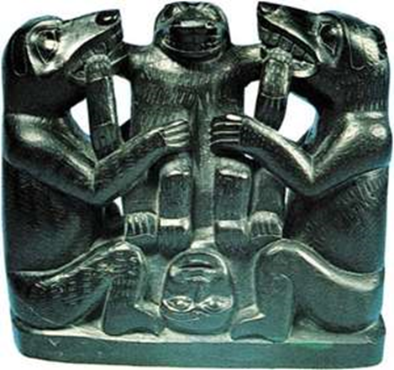
1. General Characteristics
Native American literature, also called Indian literature or American Indian literature, the traditional oral and written literatures of the indigenous peoples of the Americas.
These include ancient hieroglyphic and pictographic writings of Middle America as well as an extensive set of folktales, myths, and oral histories that were transmitted for centuries by storytellers and that live on in the language works of many contemporary American Indian writers.

Slide 3
Folktales have been a part of the social and cultural life of American Indian and Eskimo peoples.
The terms myth and folktale in American Indian oral literature are used interchangeably, because in the Native American view the difference between the two is a matter of time rather than content. If the incidents related happened at a time when the world had not yet assumed its present form, the story may be regarded as a myth; however, even if the same characters appear in the “modern” present, it is considered a folktale. Whereas European fairy tales traditionally begin with the vague allusion “once upon a time,” the American Indian myth often starts with “before the people came” or “when Coyote was a man.” To the Eskimo, it is insignificant whether an incident occurred yesterday or 50 years ago—it is past.

Slide 4
American Indian mythology can be divided into three major cultural regions: North American cultures (from the Eskimos to the Indians along the Mexican border), Central and South American urban cultures, and Caribbean and South American hunting-and-gathering and farming cultures.
Each region exhibits a wide range of development, there are recurrent themes among the cultures, and within each culture the importance of mythology itself varies.

Slide 5
For example, in North America many mythologies (such as “the Dreaming” of the Australian Aborigines) deal with a period in the distant past in which the world was different and people could not be distinguished from animals. These mythologies are related to the concept that all animals have souls or spirits that give them supernatural power. Because humans have subsequently been differentiated from the animals, the animals appear in visions, and in stories they help the hero out of trouble.

Slide 6
2. Early Twentieth Century. The U.S. government's policies of assimilation.
Although literary scholars usually locate the Native American “renaissance” in the late 1960s and 1970s, the early twentieth century was a period of prolific activity by literate Native people in a wide range of genres and fields: autobiography, novel, short fiction, drama, poetry, ethnography, political writing, and publishing.

Slide 7
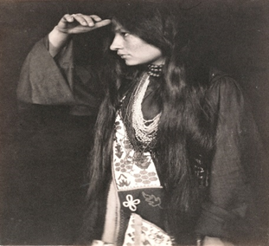
One of the central figures at the turn of the twentieth century was Zitkala-Sa—“Red Bird” in Lakota.
Her first major publication, three autobiographical articles in the Atlantic Monthly during the first three months of 1900, revealed her deep disagreement with her employer's policy. She founded the National Council of American Indians in 1926 and served as its president until she died in 1938.

Slide 8
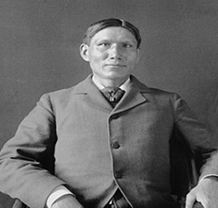
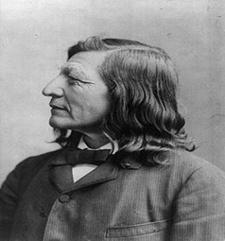
Both wrote autobiographies, published retellings of traditional Sioux stories, and wrote some books intended for young audiences. Eastman was particularly known for his contributions to the early formation of the Boy Scouts and Campfire Girls in the early twentieth century. His Land of the Spotted Eagle (1933) reflects more on Sioux traditions and provides a critique of white people's treatment of Native Americans.
Charles Alexander Eastman
(Santee Sioux)
Luther Standing Bear
(Teton Sioux)

Slide 9
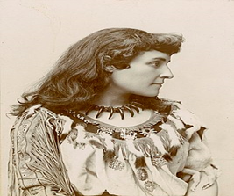
The poet of first importance during this period was E. Pauline Johnson (Mohawk)
Her first volume, The White Wampum (1895), is still one of the most published books of Canadian poetry; she also wrote numerous short stories.

Slide 10
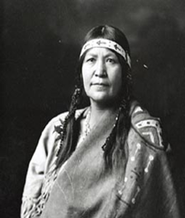
Christine Quintasket (Mourning Dove, or Hum-is hu-ma)
Her style is famous for two narrative genres: the traditional tales of Okanogan culture and the romantic and melodramatic novels popular in Anglo-American culture.

Slide 11
3. Mid-Twentieth Century. The U.S. government's policy known as “termination”.
The middle decades of the twentieth century were characterized by two policies enacted by the U.S. government. The first was the 1934 Wheeler-Howard Indian Reorganization Act; this act ended allotment of lands in severalty—which had resulted in the loss of 60 percent of previously reserved Indian land to non-Indians since 1887— and reestablished the authority of tribal governments. This act seemed a “New Deal” for Indian people. However, in 1953, when popular post–World War II sentiment pointed toward ending government involvement with Native communities, Congress passed House Concurrent Resolution 108, a policy known as “termination” of the government relationship of trusteeship with numerous tribes. Termination led to the loss of reservations and federal recognition for many tribes and to the forced migration of many Indian people to big cities in search of a non–land-based livelihood.

Slide 12

The Cherokee playwright Lynn Riggs chose an urban lifestyle.
His plays and screenplays, however, partake of New Mexico and the Oklahoma of his childhood. Riggs's most famous play Green Grow the Lilacs (1931).

Slide 13
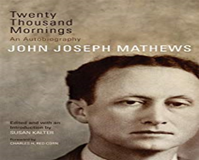
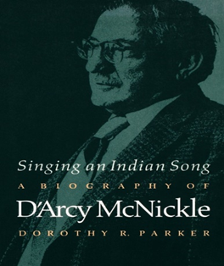
Two novelists who were most important and accomplished during this period were John Joseph Mathews (Osage) and D'Arcy McNickle (Salish).

Slide 14
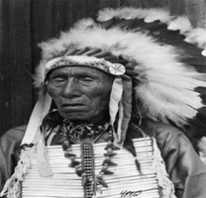
Unique among mid-twentieth-century Native American literature was Black Elk Speaks, a collaborative work narrated by Nicholas Black Elk (Oglala Lakota)
The volume presents special problems to readers looking for Black Elk's voice, since he narrated his visions and experiences in his Native language.

Slide 15
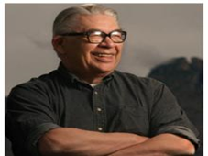
4. Late Twentieth Century
The late twentieth century in Native American letters is marked by a widespread literary flowering across the genres, the “Native American Renaissance,” heralded by the publication of Vine Deloria Jr.'s (Standing Rock Sioux) Custer Died for Your Sins: An Indian Manifesto (1969), the first of his numerous works of philosophy, religious studies, and political and legal critiques of American society.

Slide 16
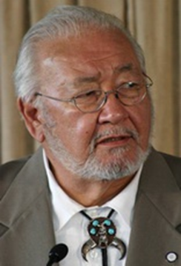
Navarre Scott Momaday
The mainstream literary establishment recognized the talent of N. Scott Momaday (Kiowa); his first novel, House Made of Dawn (1968), received the 1969 Pulitzer Prize in fiction. Momaday's poetry, fiction, and prose memoirs have influenced and inspired two generations of Native American and First Nations (Canadian-Native) writers.

Slide 17
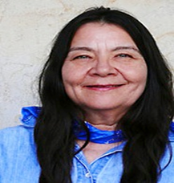
Leslie Marmon Silko
Leslie Marmon Silko,
(born March 5, 1948, Albuquerque, New Mexico, U.S.),
Native American poet and novelist whose work often centres on the dissonance between American Indian and white cultures (for ex.: “The Man To Send Rain Clouds”).

Slide 18
She creates in multiple literary genres including:
poetry (Laguna Woman, 1974; Voices Under One Sky, 1994),
short fiction (Storyteller, 1981; Ocean Story, 2011),
novels (Ceremony, 1977; Almanac of the Dead, 1991; Gardens in the Dunes, 1999),
nonfiction prose (Yellow Woman and a Beauty of the Spirit, The Delicacy and Strength of Lace, 1985; The Turquoise Ledge, 2010)—and using intermedial forms of expression, most notably photography (Rain, with Lee Marmon, 1996; Sacred Water, 1993), video (Running on the Edge of the Rainbow: Laguna Stories and Poems, 1978; Estoy-eh-muut and the Kunideeyahs, 1979), drawing, and painting.

Slide 19
The most frequently discussed aspects of her work:
the role of the oral tradition in her style of storytelling,
her use of mythological and ceremonial contexts,
her exploration of gender and sexuality,
the tension among cultural identities and world views,
her engagement with ecology and environmentalism.

Slide 20
“I was fortunate to be reared by my great-grandmother and others of her generation,” says Leslie Marmon Silko. “They always took an interest in us children and they were always delighted to answer our questions and to tell us stories about the old days.”
Born in Albuquerque, Silko grew up on the Laguna Pueblo reservation in New Mexico.
Silko’s writings reflect her mixed heritage.
While Laguna stories and traditions figure prominently in her work, she focuses on the flexibility of Laguna culture in adapting to outside influences. Much of her work is influenced by the traditional Pueblo sense of time: “The indigenous people of the Americas see time as round, not as a long linear string. If time is round...then something that happened five hundred years ago may be quite immediate and real, whereas something inconsequential that happened an hour ago could be far away. Think of time as an ocean: always moving”.

Slide 21
Laguna Tradition
The Laguna are one of more than twenty groups of Pueblo Indians, most of whom live in northern New Mexico.
The Laguna Pueblo reservation, the setting of the story “The Man To Send Rain Clouds” you are about to read, is located west of Albuquerque.
In traditional Pueblo burial rites, cornmeal plays a significant role. It is associated with praying and is sprinkled on corpses and graves as a blessing, much as holy water is used in the Catholic church.
Another Pueblo tradition is for dead people to be buried with food and water for their journey to their afterlife.

Slide 22
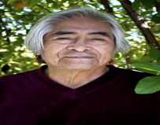
Simon Ortiz
A leading figure in the Native American literary renaissance that emerged in the 1960s, Simon J. Ortiz has published many books of poetry, short fiction, and non-fiction. In general, his writing is concerned with modern man’s alienation from others, from himself, and from his environment—urging humanity to reconnect the wisdom of ancestral spirits and with Mother Earth. His poetry collections include Going for the Rain (1976), A Good Journey (1977), From Sand Creek (1982), Woven Stone (1992), After and Before the Lightning (1994), and Out There Somewhere (2002).

Slide 23

Louise Erdrich
Louise Erdrich, in full Karen Louise Erdrich, (born June 7, 1954, Little Falls, Minnesota, U.S.), American author whose principal subject is the Ojibwa Indians in the northern Midwest. In 2015 Erdrich was a recipient of the U.S. Library of Congress Prize for American Fiction.

Slide 24

5. Directions for the Twenty-First Century
Sherman Alexie (Spokane/Coeur d'Alene) has kept up a pace of producing at least one book a year in his first ten years of writing, and two of his titles have been made into films: The Business of Fancydancing (1992) retained its title, and The Lone Ranger and Tonto Fistfight in Heaven (1993) became Smoke Signals. He has also worked on a screenplay based on his novel Indian Killer (1996).

Slide 25

Greg Sarris
has made the crossover into screenplay with his “novel in stories” Grand Avenue (1994), which is set in the tough Santa Rosa, California neighborhood where Sarris grew up. His biography of Pomo basketmaker Mabel McKay and his 1993 critical text Keeping Slug Woman Alive hold substantial promise for the future.

Slide 26
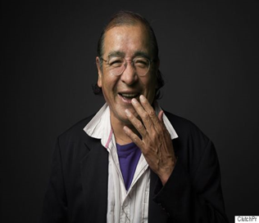
Tomson Highway
Another emerging direction in Native American literature is the proliferation of drama, a genre that flowered sooner in Canada than in the United States, with government support for the work of highly popular playwrights such as Tomson Highway (Cree), author of The Rez Sisters (1988) and Dry Lips Oughta Move to Kapuskasing (1989).

Slide 27
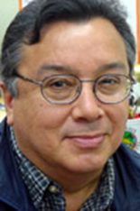
In the United States, the Kiowa/Delaware playwright Hanay Geiogamah has been at work in theater since the early 1970s, publishing (Body Indian, 1972; Foghorn, 1973), directing, producing, and teaching Native American theater.

Slide 28
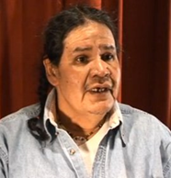
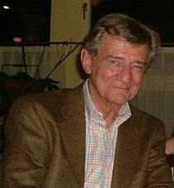
William Yellow Robe Jr. acted, directed, taught, and written forty-two plays including The Independence of Eddie Rose (1986).
The contemporary writer Gerald Vizenor (Ishi and the Wood Ducks, 1994).

Slide 29
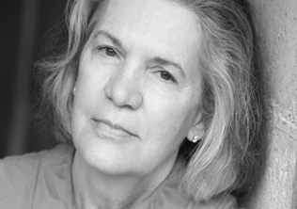
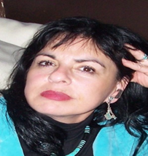
Diane Glancy
(The Truth Teller, 1993).
LeAnne Howe
(Indian Radio Days, 1993).

Slide 30
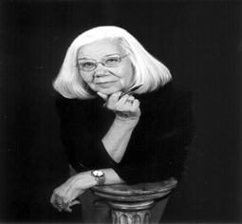
Elizabeth Cook-Lynn
Increasingly it will be important for the field of Native American literary studies to be enriched and interrogated by the perspectives of Native American literary critics such as Paula Gunn Allen, Greg Sarris, Robert Allen Warrior (Osage), and Elizabeth Cook-Lynn (Dakota).
Elizabeth Cook-Lynn has been an arbiter in Native American studies, having founded Wicazo Sa Review and operated it as an entirely Native-edited journal since 1985. She and fellow Native critics, teachers, and publishers like Jeannette Armstrong and Joseph Bruchac will help foster the talent of new writers as well as the ongoing growth of the field.

