Slide 1
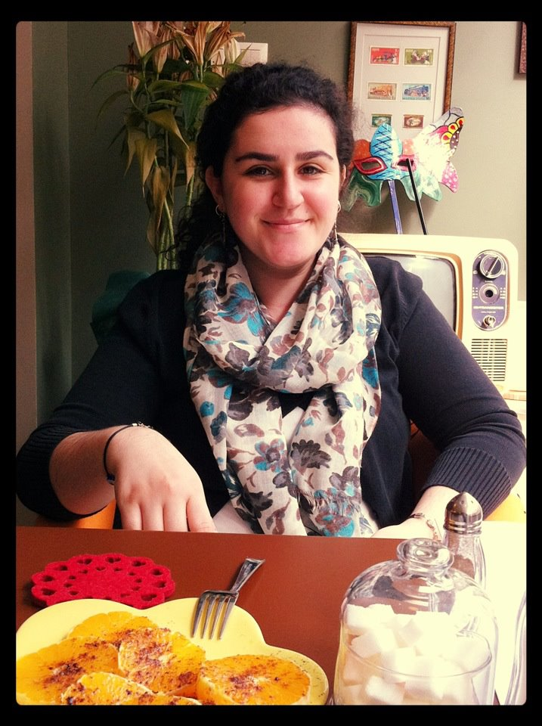
Hello! I’m Miss Dinç. Ask me some questions as in the example and we can know each other much better.

Slide 2
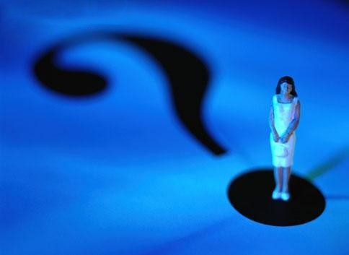
I like questions ☺
You/ be/to Paris
–Have you ever been to abroad?
– Yes, I have. (+)
You/see/a ghost.
- Have you ever seen a ghost?
– No, I haven’t. (-)

Slide 3
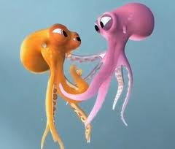
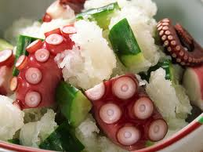
You/eat/an octopus.
Have you ever eaten an octopus?
-Yes, I have eaten an octopus.

Slide 4
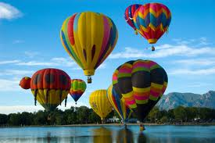
You/travel/by balloon
Have you ever travelled by balloon?
-No, I haven’t travelled by balloon.

Slide 5
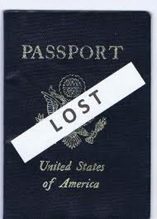
You/lose/passport.
Have you ever lost your passport?
No, I haven’t lost my passport.
No, I have never lost my passport.

Slide 6
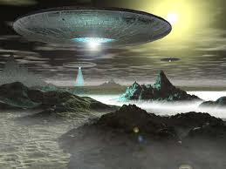
You/see/a UFO
Have you ever seen a UFO?
-Yes, I have seen a UFO.

Slide 7
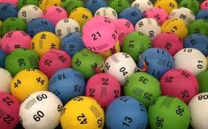
This is your turn! Let’s learn about you ☺
E.g. : I/win/the lottery.
I have won the lottery. (+)
or
I haven’t won the lottery. (-)
I have never won the lottery. (-)

Slide 8
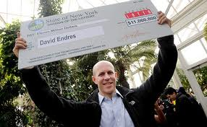
I/win/the lottery.

Slide 9
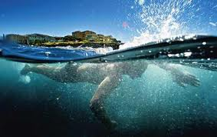
I/swim/in the ocean

Slide 10
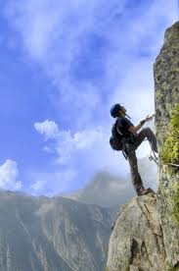
I/climb/a mountain

Slide 11
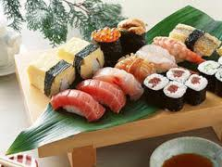
I/try/sushi

Slide 12
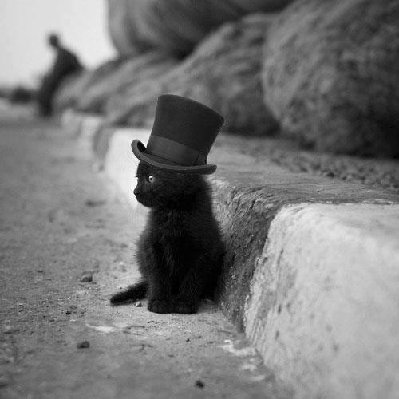
It is nice to meet you. ☺

