Slide 1
Spanish American Literature the writings of both the European explorers of Spanish America and its later inhabitants.
Plan
1. The Colonial Era
2. The Nineteenth Century: Nationalism and Romanticism.
3. Modernismo.
4. Early-Twentieth-Century Trends.
5. Late-Twentieth-Century Literature.
6. Helena Maria Viramontes “The Moth”.

Slide 2
1. The Colonial Era
The history of Spanish Amrican Literature begins with the writings of the explorers, soldiers, and missionaries who participated in the conquest of the New World. Their writings, eyewitness accounts of the discovery, the conquest, the existing civilizations, and the natural wonders of the flora and fauna, form the literature of the early colonial period. These chronicles, letters, histories, religious pieces, and epic poems are the vibrant and fascinating expression of those who fought for church, crown, and gold.

Slide 3
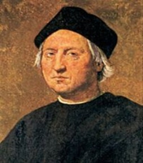
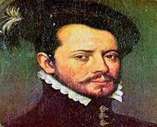
The letters of Christopher Columbus to Ferdinand V and Isabella I and those of Hernán Cortés, the conqueror of Mexico, to Charles V are among the classics of this period. Bernal Díaz del Castillo, one of the soldiers of Cortés, wrote a remarkable history of the conquest of Mexico, and the history by the Dominican friar Bartolomé de Las Casas of the destruction of the Indies made him the "apostle of the Indians" and the author of the "black legend" of Spain.

Slide 4
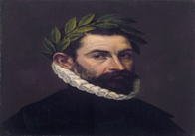
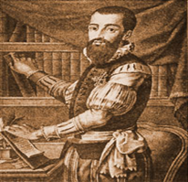
Early poetry includes Chile's epic poem, La Araucana (1569–89; tr. 1945) by Alonso de Ercilla y Zúñiga, a soldier who described the conflict between the Spaniards and the Araucanians of Chile. The epic tradition was continued by Diego de Hajeda and Bernardo de Balbuena. Among the first of those born in the New World to write about it, the Inca Garcilaso de la Vega described the history of the Incas and of Peru.
Alonso de Ercilla y Zúñiga
Garcilaso de la Vega

Slide 5
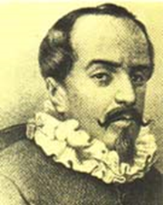
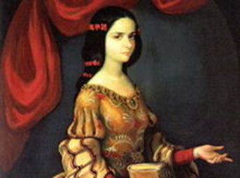
With the growth of Spanish colonial society in America came the concomitant growth of literary circles, especially in the viceregal capitals of Mexico City and Lima. The writings of the time were imitative of 17th-century Spanish literature. Several notable figures were Juan Ruiz de Alarcón, the Mexican-born playwright, generally considered one of the great Spanish dramatists; Juana Inés de la Cruz, Mexican nun, feminist, and intellectual, known for her lyric poetry, plays, and prose; and the Peruvian Juan del Valle y Caviedes, known for his satiric poetry and sharp wit.
Juan Ruiz de Alarcón
Juana Inés de la Cruz

Slide 6
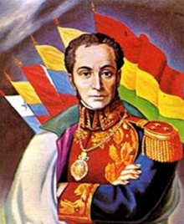
2. The Nineteenth Century: Nationalism and Romanticism.
The colonial period in Spanish American history and letters came to an end with the wars for independence in the early 19th cent. Prose writers and poets, imbued with the ideals of revolution and the nationalism of independence, expressed their thoughts in fiery prose and heroic verse.
Simón Bolívar, the Liberator, is known for his analyses of the political scene as well as for his military exploits.

Slide 7
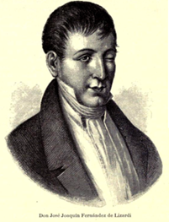
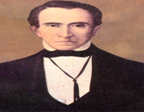
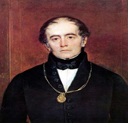
The Mexican José Joaquín Fernández de Lizardi became famous as an ardent propagandist and pamphleteer. Basically a journalist, he is remembered as the author of the first Spanish American novel, The Itching Parrot (1816; tr. 1942), a work in the picaresque genre.
José Joaquín Olmedo celebrated the victories of Bolívar in a heroic poem in the classical style entitled La victoria de Junín: Canto a Bolívar (1825). Andrés Bello, the Venezuelan humanist, educator, and poet, also sang of America in his serene A Georgic of the Tropics (1826; tr. 1954).

Slide 8
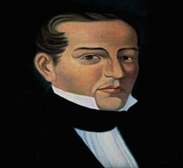
With political independence from Spain achieved, except in the island countries of the Caribbean, cultural independence swept the region, aided by the romantic tenets of freedom, emotional intensity, and individualism. For a while, classic forms coexisted with romanticism as in the poetry of José María Heredia of Cuba. His En el teocalli de Cholula [in the temple-pyramid of Cholula] (1820) is the first Spanish American romantic poem.

Slide 9
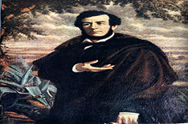
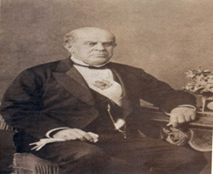
Among the early romanticists were the young intellectuals who fled from the tyranny of Juan Manuel de Rosas in Argentina. Esteban Echeverría expressed himself in the poetic narrative La cautiva [the captive] (1827). Domingo Faustino Sarmiento, also of Argentina, was not only the leading exponent of romanticism but also a prolific writer and educator. His Life in the Argentine Republic in the Days of the Tyrants (1845; tr. 1960), a study of personalism in politics, is among the classics of Spanish American letters.

Slide 10

The emphasis on the national scene, so characteristic of romanticism, gave rise to the gaucho literature of Argentina and Uruguay, an indigenous literary genre. The gaucho, the hero of popular tales and ballads, became the subject of some of the most original verse of the century in the poetry of Rafael Obligado, Estanislao del Campo, and in the classic Martín Fierro (1872–79; tr. 1948) of José Hernández.

Slide 11
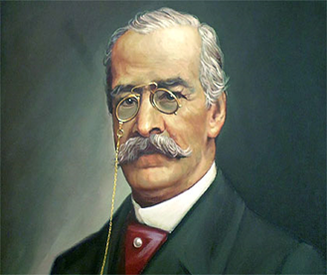
The romanticist's interest in the search for his native roots can be seen in the epic poem Tabaré (1886; tr. 1956) of Juan Zorrilla de San Martín, and in the historical anecdotes and sketches, the Knights of the Cape and 37 Other Selections from Tradiciones peruanas (1872–1910; tr. 1945), of Ricardo Palma.

Slide 12
Several novels of the period reflect the various trends in letters. Amalia (1851–55; tr. 1919), by José Mármol, deals with life in Argentina under Juan Manuel de Rosas; Martín Rivas (1862; tr. 1918), by Alberto Blest Gana of Chile, depicts the life and customs of Chile; María (1867; tr. 1890) is the tragic idyll of Jorge Isaacs of Colombia; and Cumandá (1871), by Ecuador's Juan León Mera, is a romantic portrayal of native life.
This same period produced some of Spanish America's most notable essayists. Juan Montalvo of Ecuador wielded his pen against the tyranny of García Moreno; Eugenio María de Hostos of Puerto Rico championed the cause of the independence and union of the islands of the Antilles; and Manuel González Prada of Peru attacked the entire social and economic system of his country and spoke out in defense of the indigenous peoples.

Slide 13
3. Modernismo.
The writers of Spanish America in the last quarter of the 19th c. broke with the nationalistic expression of the previous generation and immersed themselves in a world of artifice. These were the modernistas, who believed in "art for art's sake" and were influenced by the French Parnassian and symbolist schools. They wrote on rare and exotic themes and experimented with language and meter.

Slide 14
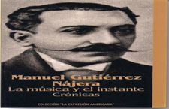
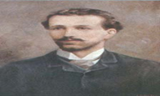
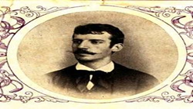
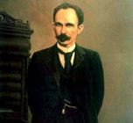
Those who initiated this literary movement, known as modernismo, were the Mexican Manuel Gutiérrez Nájera, the Colombian José Asunción Silva, and the Cubans Julián del Casal and José Martí, the latter known also for his struggle to gain Cuba's independence from Spain. The movement reached its peak with the publication of the Nicaraguan Rubén Darío's Selected Poems (tr. 1965), which influenced writers throughout Spanish America and many in Spain. Among others there were Amado Nervo of Mexico, José Santos Chocano of Peru, Ricardo Jaimes Freyre of Bolivia, Guillermo Valencia of Colombia, Julio Herrera y Reissig and José Enrique Rodó of Uruguay, and Leopoldo Lugones of Argentina.

Slide 15
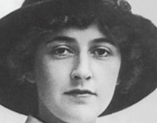
4. Early-Twentieth-Century Trends.
With the passing of modernismo, poetry was influenced by many trends and movements.
Three women poets, Alfonsina Storni, Juana de Ibarbourou, and the Nobel Prize winner Gabriela Mistral,
are known for their impassioned lyrics.

Slide 16
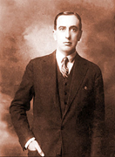
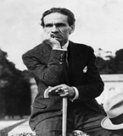
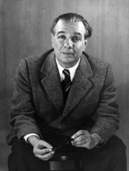
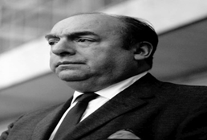
Among the poets of the avant-garde movements in poetry were Vicente Huidobro, César Vallejo of Peru, Jorge Luis Borges of Argentina, and Chile's Pablo Neruda, also a Nobel laureate.

Slide 17
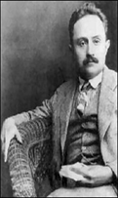
The prose writers largely turned their attention to social themes. Following a tradition perfected by Martí, González Prada, and Rodó, the 20th-century essay reached new heights of intensity in the writings of José Vasconcelos of Mexico, known for his cultural theory as well as his participation in the Mexican Revolution of 1910 and in the educational reform of his country.

Slide 18
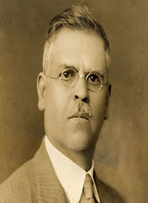
The Mexican Revolution of 1910 produced a subgenre — generally first-hand accounts of aspects of the revolution. The classic work of this genre is The Underdogs (1915; tr. 1963) by Mariano Azuela.

Slide 19
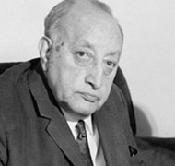
5. Late-Twentieth-Century Literature.
The state of Spanish American letters from the middle to the end of the 20th c. was extremely rich, especially in the novel and poetry. Both genres received great critical acclaim outside the Spanish-speaking world and were widely translated into English and many other languages. Guatemala's Nobel Prize–winning Miguel Angel Asturias combined mythological and social themes in works such as The President (1946; tr. 1963) and The Bejeweled Boy (1961; tr. 1972).

Slide 20

The Argentine Jorge Luis Borges' philosophical allegories (including Ficciones [1944; tr. 1962]) brilliantly combined the real with the fantastic, and his younger compatriot
Julio Cortázar gained renown for Hopscotch (1963; tr. 1966), his masterpiece of experimental fiction.

Slide 21
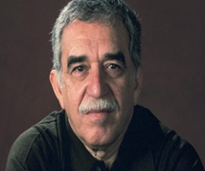
Carlos Fuentes of Mexico is one of the most eminent modern novelists (The Death of Artemio Cruz [1962; tr. 1964, 1991]), along with Mario Vargas Llosa of Peru (The Green House [1966; tr. 1968]), and, most of all, the 1982 Nobel Prize–winner Gabriel García Márquez of Colombia (A Hundred Years of Solitude [1967; tr. 1970]).

Slide 22
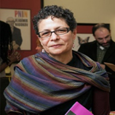
Helena Maria Viramontes
(born February 26, 1954)
is an American fiction writer and professor of English.

Slide 23
Helena María Viramontes was born in East Los Angeles on 26 February 1954. Her family was working class, and her parents spoke Spanish at home. Viramontes received her MFA (a Master of Fine Arts) from University of California-Irvine.
She calls herself a failed poet.
“The Moths and Other Stories” (1985) garnered much critical interest.
“Under the Feet of Jesus” brought more critical acclaim in 1995, and the John Dos Passos Prize in 1996.
Viramontes has received a fellowship from the National Endowment for the Arts, and she won the Luis Leal Award in 2006. One of her recent works “Their Dogs Came with Them” (2007), is less studied, but takes up the themes of urban poverty, history, and racism that her earlier work engages. Her short stories are widely anthologized in texts meant for undergraduates studying Chicano/a and Latino/a literature, women’s studies, and multicultural literature.
Viramontes has been active in community projects, literary editorships, and teaching creative writing. Much of her work draws from her experiences as a child in California dealing with issues of work, racism, and language.
Viramontes is a professor of English and creative writing at Cornell University. She continues to lecture around the country and organize and participate in conferences.

Slide 24
All about Skin: Short Fiction by Women of Color (2014)
by Jina Ortiz (Editor), Rochelle Spencer (Editor),
Helena María Viramontes (Foreword)
features twenty-seven stories by women writers of color whose short fiction has earned them a range of honors, including John Simon Guggenheim Fellowships, the New York Public Library Young Lions Fiction Award, the Flannery O'Connor Award, and inclusion in the Best American Short Stories and O. Henry anthologies.
The prose in this multicultural anthology addresses such themes as racial prejudice, media portrayal of beauty, and family relationships and spans genres from the comic and the surreal to startling realism. It demonstrates the power and range of some of the most exciting women writing short fiction today.

Slide 25

“The Moths”
is a short story written by Helena Maria Viramontes.
It was first published in 1985 in Viramontes’ first book “The Moths and Other Stories”.

Slide 26
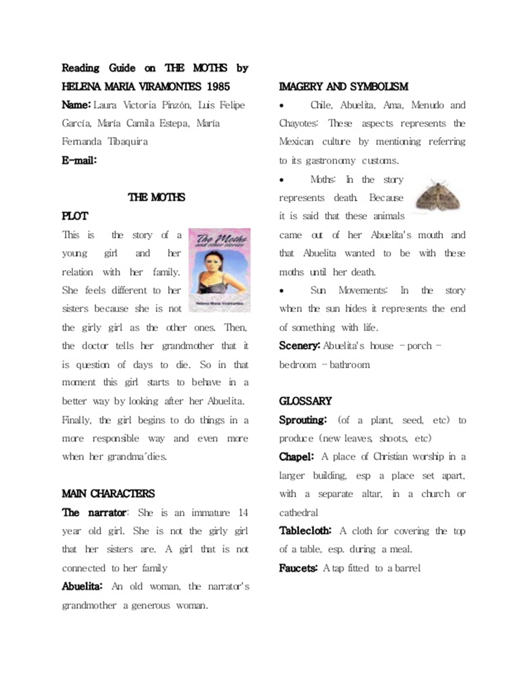

Slide 27
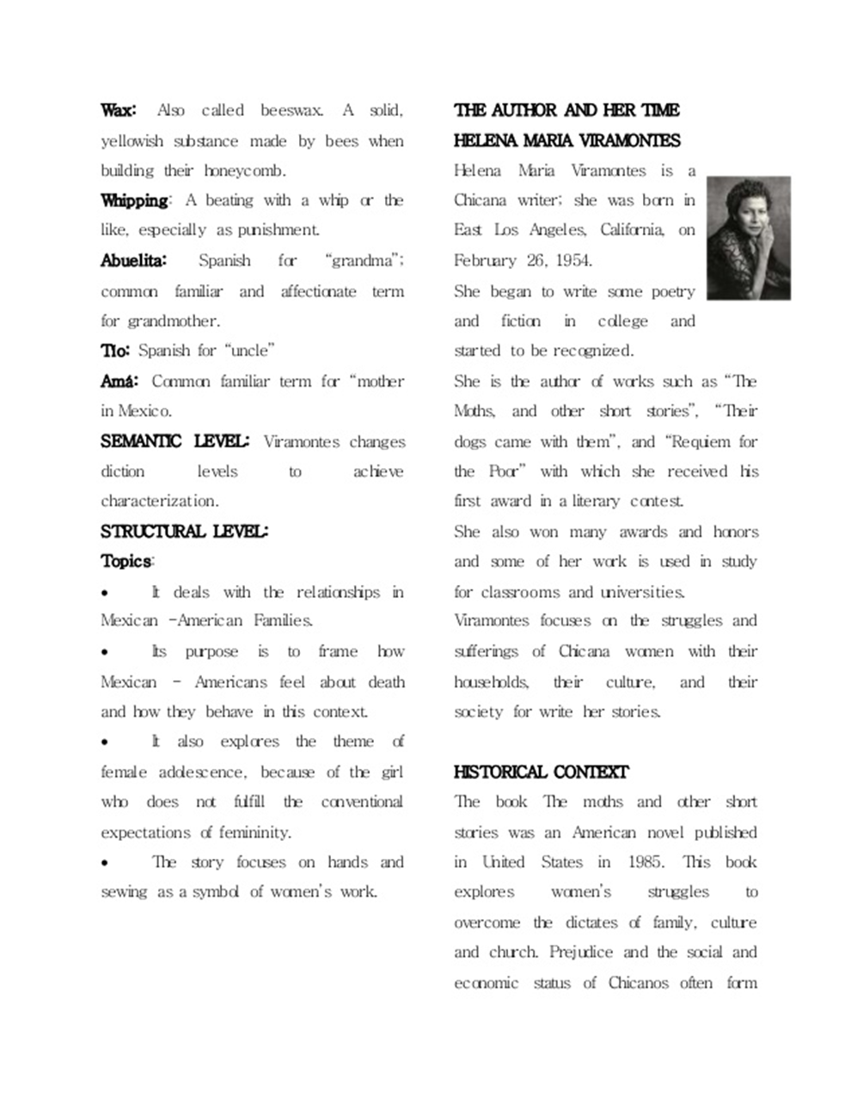

Slide 28
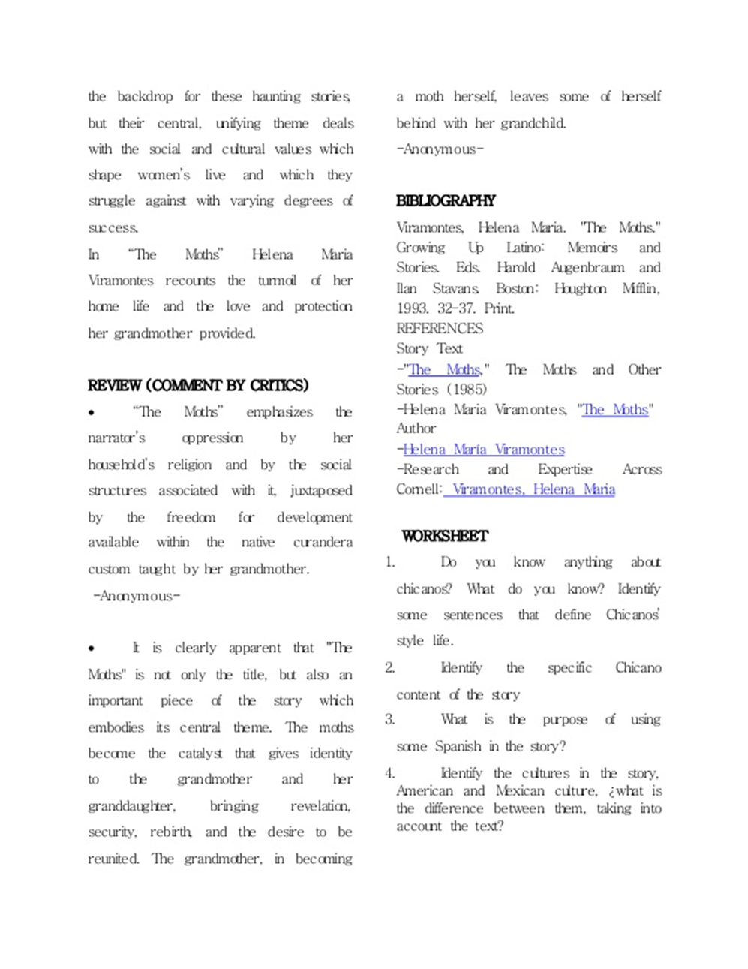

Slide 29
Bibliography
For anthologies in translation, see
H. de Onís, ed., The Golden Land: An Anthology of Latin American Folklore in Literature (1961);
W. K. Jones, ed., Spanish American Literature in Translation: A Selection of Poetry, Fiction and Drama Since 1888 (1963);
Torres-Ríoseco, ed., Short Stories of Latin America (1963);
A. Flores, ed., The Literature of Spanish America: A Critical Anthology (4 vol., 1966–69);
H. Carpentier and J. Brof, ed., Doors and Mirrors: Fiction and Poetry from Spanish America, 1920–70 (1972);
S. Castro-Klaren, S. Molloy, and B. Sarlo, ed., Women's Writing in Latin America: An Anthology (1991).
See also
E. A. Imbert, Spanish-American Literature: A History (2 vol., 2d ed. 1963);
K. Schwartz, A New History of Spanish American Fiction (1972);
D. Gallagher, ed., Modern Latin American Literature (1973);
M. Forster, ed., Tradition and Renewal: Essays on Twentieth-Century Latin American Literature and Culture(1975);
L. Klein, ed., Latin American Literature in the 20th Century: A Guide (1986);
D. W. Foster, ed., Handbook of Latin American Literature (1987);
C. Sole, ed., Latin American Writers (1989).

