Slide 1

New Zealand literature

Slide 2
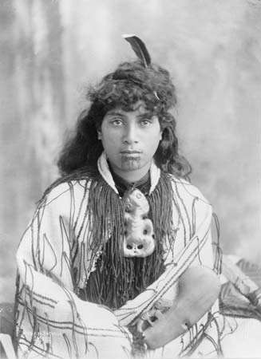
Maori narrative: the oral tradition
The Maori |ˈmaʊri| (the indigenous Polynesian people of New Zealand) developed a mythology to explain and record their own past and the legends of their gods and tribal heroes. As settlement developed through the 19th century, Europeans collected many of these poems and stories and copied them in the Maori language, for example Maori Fairy Tales (1908; by Johannes Carl Andersen) were read to Pakeha ['peikha:] (European) children.

Slide 3
Mervyn McLean and Margaret Orbell distinguished three kinds of waiata (songs):
waiata tangi (laments—for the dead, but also for other kinds of loss or misfortune),
waiata aroha (songs about the nature of love—not only sexual love but also love of place or kin),
waiata whaiaaipo (songs of courtship or praise of the beloved).

Slide 4
In addition, there are
pao (gossip songs),
poi (songs accompanying a dance performed with balls attached to flax strings, swung rhythmically),
oriori (songs composed for young children of chiefly or warrior descent, to help them learn their heritage),
karanga (somewhere between song and chant, performed by women welcoming or farewelling visitors on the marae - tribal meeting place).

Slide 5
Some chants are recited rather than sung. These include
karakia (forms of incantation invoking a power to protect or to assist the chanter),
paatere (chants by women in rebuttal of gossip or slander, asserting the performer’s high lineage and threatening her detractors),
kaioraora (expressions of hatred and abuse of an enemy, promising terrible revenge).
In every aspect of this tradition, the texts, which in pre-European times survived through memorization, were inseparable from gestures and sometimes music. The most widely used modern development of these traditional forms is the waiata-a-ringa (action song), which fits graceful movements to popular European melodies.

Slide 6
Modern Maori literature

Slide 7
Hone Tuwhare, the first Maori poet to make a strong impression in English, had published his first book, No Ordinary Sun (1964).
Witi Ihimaera’s short stories, collected in 1972, “Greenstone, Greenstone” and his novel “Tangi” (1973) seemed finally to establish Maori writers as part of modern New Zealand writing. “The Whale Rider” (1987; film 2002) gained an international readership.
Patricia Grace’s narratives of Maori life — “Mutuwhenua: The Moon Sleeps” (1978), “The Dream Sleepers and Other Stories” (1980), “Potiki” (1986)—were very widely read, especially in schools as part of a broad effort in New Zealand to encourage the study of Maori writing.
Keri Hulme (1983) was a winner of Britain’s Booker Prize in 1985.
In the work of these writers the language is English, the forms (particularly in fiction) are European, and “Maoriness” is partly a matter of subject, partly of sensibility, and partly sympathetic identification.

Slide 8
Pakeha (European) literature

Slide 9
New Zealanders have long been avid readers, but until the mid-20th century most of the literature they consumed was imported from Britain.
Historian and poet Keith Sinclair identified the 1950s as the decade 'when the New Zealand intellect and imagination came alive'.
This flowering of creative and critical talent was not sudden, but the climax of a process that had begun at least two decades before.

Slide 10
By the 1930s a new breed of New Zealand writers was emerging, assisted by the growth of universities and small publishing enterprises.
The New Zealand centennial in 1940 provided a further boost to the local literary scene, and later that decade a state Literary Fund was established.
By the 1950s there was a wider range of outlets for creative writing, including the influential magazine Landfall.
New voices in poetry and drama were generating heated debate over identity and politics, while writers of novels, short stories, children's and popular fiction were also finding new audiences.

Slide 11
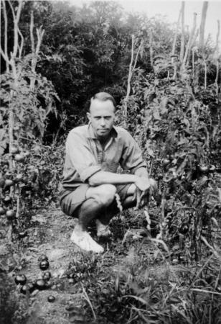
The 1930s: a new departure
The 1930s saw the emergence in New Zealand of a new breed of writers, whose work usually embodied a reaction against established ideas and conventions. Often these writers were influenced by recent trends in literature overseas, notably modernism, and by social and political events such as the Depression. A growing, if narrow, sense of nationalism was expressed, focusing on the dilemma of Pākehā who still looked to England as 'Home', but increasingly identified with New Zealand through ties of kinship and daily experience. Some major literary figures of the 1930s, including short-story writer Frank Sargeson, poets Allen Curnow, A.R.D. Fairburn, Denis Glover and R.A.K. Mason, and Glover's printer associate Bob Lowry, remained active in the 1940s and 1950s.
Frank Sargeson in his garden, Takapuna, Auckland, 1932.

Slide 12
The university influence
During the decade some significant changes occurred in the literary scene. More and more, those engaged in literary pursuits began to be associated with academia, rather than journalism as had previously been the case.
Several magazines publishing new writing were founded by university staff and students; the most prominent of these was Phoenix, an Auckland University College publication. The influential Christchurch periodical, Tomorrow, received strong university support.

Slide 13
The growth of publishing
It became somewhat easier for New Zealand writers to be published.
Several innovative small publishing enterprises, notably the Caxton Press in Christchurch and the Unicorn Press in Auckland, provided alternatives to the mainstream local firms of Whitcombe and Tombs and A.H. & A.W. Reed. The New Zealand Listener, which developed into an important forum for debate and creative writing, was established in 1939. The first Labour government's support for literature and scholarship was shown in funding for a series of historical and critical publications to mark the country's centennial in 1940; this provided recognition as well as employment for a number of writers, historians and critics.

Slide 14
The Second World War and beyond
The war years
In some ways war interrupted the work of New Zealand writers; in others it acted as a stimulant. For those who joined the armed forces, such as Eric McCormick, Bruce Mason and Dan Davin, experience of travel and danger provided creative impetus and a new perspective on their country of birth. From 1941, New Zealand writing gained some international exposure through John Lehmann's monthly publication, Penguin New Writing. New Zealand New Writing, a local version produced between 1942 and 1945, was another vehicle for fresh talent.
The belief that New Zealand culture was worthy of serious comment was behind a burst of critical writing, beginning in 1940 with the publication of Eric McCormick's ground-breaking survey Letters and art in New Zealand. This was closely followed by a wide-ranging series of essays by Monte Holcroft, the first of which was entitled The deepening stream.

Slide 15
Post-war developments
With peace came a sense of renewal and some crucial innovations that helped literature to flourish.
New Zealand universities began to expand rapidly after the war, and once again, they proved havens for writers.
The University of New Zealand began publishing books in 1949. A controversial but significant move, championed by the influential public servant Joe Heenan, was the establishment in 1946 of a government Literary Fund to provide writers with financial assistance.

Slide 16
Poetry
The 1940s and 1950s were favourable times for poets and poetry, and lively communities of poets sprang up in the main centres, particularly Wellington and Auckland. Debate about the nature of poetry sparked some heated exchanges.
Allen Curnow's anthology, A book of New Zealand verse 1923–45, provoked a reaction from emerging poets such as James K. Baxter, Louis Johnson and Kendrick Smithyman, who objected to what they saw as Curnow's insistence on a nationalist agenda for poetry.
They argued that New Zealand poets, now secure in their identity, should express themselves on universal themes in an international context. A related viewpoint was that New Zealand poetry should move on from expressing alienation and isolation and develop a more confident vision of nationhood, inclusive of Māori.

Slide 17
Underlying the positions was a tension between modernist and romantic approaches to poetry.
The debate was advanced by a passionate speech at the 1951 Writers’ Conference in Christchurch by James K. Baxter, who claimed pre-eminence for the Wellington group of poets, which included himself, Alistair Campbell, W.H. Oliver, Louis Johnson and Hubert Witheford. Sparring continued throughout the decade.
Publication opportunities for poets were plentiful: the Year Book of the Arts in New Zealand ran from 1945 until 1951, when it was succeeded by New Zealand Poetry Yearbook. The 1956 Anthology of New Zealand verse, compiled by Robert Chapman and Jonathan Bennett, published many of the younger poets whom Curnow had overlooked in his 1945 anthology, including new women poets such as Mary Stanley. However others, including Ruth France (who used the pen name Paul Henderson), found it difficult to make their voices heard in a male-dominated literary milieu.

Slide 18
Drama
The Depression and the advent of 'talkies' in the late 1920s brought an end to regular tours of New Zealand by British and American professional theatre companies, and thereafter a thriving local amateur dramatic movement emerged.
Isabella Andrews was one of a number of playwrights who achieved success during the 1930s and 1940s through the original play competitions of the New Zealand branch of the British Drama League. In the same period, the rise of left theatre groups provided opportunities for writers with radical political sympathies.

Slide 19

Although prominent figures such as Charles Brasch, James K. Baxter and Frank Sargeson wrote plays, the best-known playwright of the 1950s was Bruce Mason.
He addressed the question of cultural identity by exploring Māori themes and the disintegration of traditional values. With professional theatre in its infancy in New Zealand, Mason pioneered solo performances and also contributed to the development of radio drama.

Slide 20
The novel and the short story
Much fiction of the 1940s and 1950s concentrated on the plight of an isolated individual in a hostile, puritanical society. This theme mirrored the actual struggle of many New Zealand fiction writers to make a living and achieve acceptance.
Among those who produced significant novels were expatriates Dan Davin and James Courage, and younger writers including David Ballantyne, Ruth France and Janet Frame.
Although Frank Sargeson's 'realist' narrative style with its blunt New Zealand idioms dominated, some fiction writers experimented with impressionism to convey the intensity of individual experience. Maurice Duggan transcended realist conventions in his short stories, drawing on a wide range of textual models, while Helen Shaw was one of several women short-story writers who broke free of the prevailing focus on masculine concerns and pursuits.

Slide 21
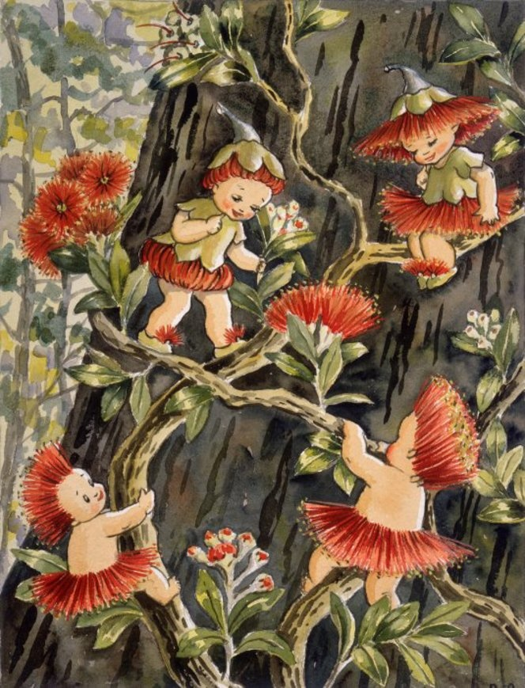
Writing for children
In the 1940s the School Journals produced by the School Publications Branch of the Department of Education changed in character to focus entirely on high-quality fiction. Many writers had their first stories published in the Journals, for which some of the most prominent, including James K. Baxter, Maurice Duggan and Louis Johnson, were editors. However, the best-known children's stories of the 1950s, the Hutu and Kawa series by Avis Acres, achieved their popularity largely through enchanting illustrations.

Slide 22
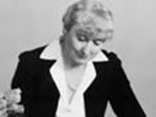
Popular fiction
Thrillers, romances and other popular writing presented an interesting counterpoint to the concerns of 'serious' fiction. Often these genres supported positive stereotypes about New Zealand and New Zealanders and deliberately avoided analysis of social and political issues in a calculated attempt to appeal to both local and international audiences. This tradition, which had taken root in the 1930s with the work of Nelle Scanlan,
Rosemary Rees, Mary Scott and Ngaio Marsh was carried on by romance novelist Essie Summers and crime novelist Elizabeth Messenger.
By the end of the 1950s, the environment for New Zealand literature was much more favourable. The time was ripe for emerging writers to challenge, subvert and transcend the concepts of nationhood which had been formulated in recent decades.

Slide 23
Modern discussions of New Zealand literature have not given much attention up to the 19th century.
It is not surprising, that the most notable 19th-century writing is found not in poetry and fiction but rather in letters, journals and factual accounts, such as
Lady Mary Anne Barker’s Station Life in New Zealand (1870),
Samuel Butler’s A First Year in Canterbury Settlement (1863),
Frederick Maning’s Old New Zealand (1863).

Slide 24
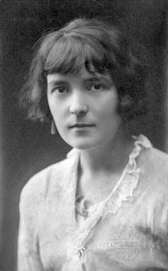
Katherine Mansfield laid the foundations for the development of New Zealand literature.

Slide 25
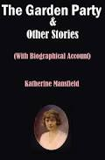
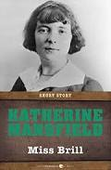
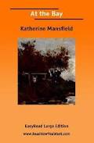
Katherine Mansfield was a New Zealand-born English master of the short story, who evolved a distinctive prose style with many overtones of poetry. Her delicate stories, focused upon psychological conflicts, have an obliqueness of narration and a subtlety of observation that reveal the influence of Anton Chekhov. She, in turn, had much influence on the development of the short story as a form of literature.

Slide 26

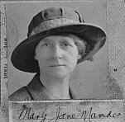
The first important New Zealand novels came from two writers whose scene was northern New Zealand:
William Satchell (The Land of the Lost [1902], The Toll of the Bush [1905], and The Greenstone Door [1914]) and Jane Mander (The Story of a New Zealand River [1920]).

Slide 27
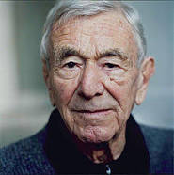
A Book of New Zealand Verse
(1945; rev. ed. 1951), edited by Allen Curnow, is usually held to mark the advent of New Zealand literature’s “postcolonial” phase.

Slide 28
The turn of the 21st century
The short story continued to be an important form for New Zealand writers through the last decades of the 20th century.
One of its best modern exponents was Owen Marshall (The Lynx Hunter, and Other Stories [1987], The Divided World [1989]); Vincent O’Sullivan (Survivals and Other Stories [1985]) was another.

Slide 29

Owen Marshall is a writer who speaks with equal intensity to the unbearable loveliness and malevolence of life.
Owen Marshall is the pen name of Owen Marshall Jones, a short story writer and novelist.
Marshall has been ranked among the very finest, if not the finest, New Zealand’s short story writers, as reported in the New Zealand Book Council short biography of the author.

Slide 30
"Quite simply the most able and the most successful exponent of the short story currently writing in New Zealand”
- Michael King
"New Zealand's best prose writer”
- Vincent O'Sullivan
"I'm an admirer of Owen Marshall's literature, with my favourite stories, chapters, etc.“
- Janet Frame
"I find myself exclaiming over and again with delight at the precision, the beauty,the near perfection of his writing“
- Fiona Kidman
"Marshall is a writer who speaks with equal intensity to the unbearable loveliness and malevolence of life”
- Carolyn Bliss, World Literature Today

Slide 31
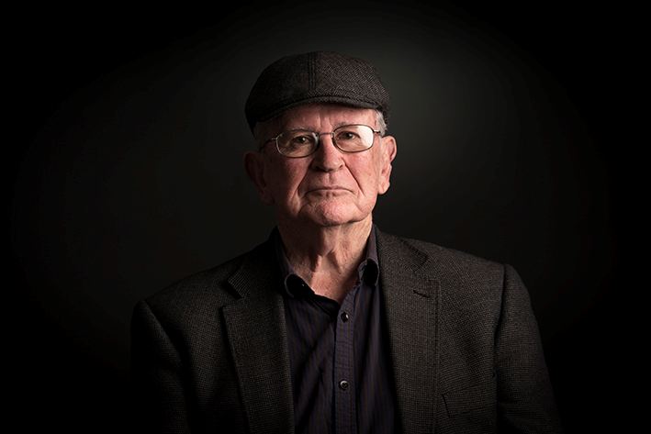
Vincent Gerard O’Sullivan is a New Zealand poet, short story writer, novelist, playwright, critic and editor.
He is the author of two novels — Let the River Stand, which won the 1994 The Montana NZ Book Awards, and Believers to the Bright Coast, which was shortlisted for the 2001 Tasmania Pacific Region Prize — and many plays and collections of short stories and poems.
His poetry collection Seeing You Asked (Victoria University Press 1998) won Best Book of Poetry at the 1999 The Montana NZ Book Awards, the same year that Believers to the Bright Coast was runner up for the Deutz Medal for Fiction.
His 2001 collection of poetry Lucky Table (Victoria University Press) was shortlisted in the poetry section of the 2001 The Montana NZ Book Awards. Nice morning for it, Adam was published to acclaim in 2004 and it won the Poetry category of the 2005 Montana New Zealand Book Awards.

Slide 32
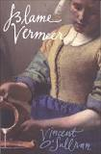
In April 2007 Blame Vermeer was published by Victoria University Press.
A woman of thirty pours the inch or so of milk
left in a jug, sets the jug high on a shelf
inside a small cupboard because the children
from next door are to stay the night, she’ll
not risk their picking at its precious glaze.
She takes her ring from beside the tap,
slips it back onto her third finger.
She hears steps on the path.
Something
will happen after every painting for a long
time yet. It may have been war,
a sudden wrenching of implacable grief,
diseases arrived from the unburied,
children clattering in only days until
they are shunted east.
And the stranger
announcing, ‘There is something here,’ and her hand
on the lip first then the jug’s smooth curving,
it was lifted, so Jug & Woman
may have been the title again as it was and was
how many hundred times in that small
kitchen, its imagined canvas, the deluging back
of ordinariness so lovely, to what can one
compare it? And the steps always arriving.
It will happen next.

Slide 33
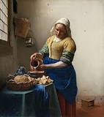
“Blame Vermeer” by Vincent O'Sullivan shows a fragment of the Dutch artist Johannes Vermeer's painting usually known as The Milkmaid (c.1658). This poem is called 'ekphrasis' /ekˈfrəsis/ словесний опис візуального образу: first the painting or work of art, then the words about it; poems about paintings.

Slide 34
Ekphrasis
An ekphrastic poem is a vivid description of a scene or, more commonly, a work of art.
Through the imaginative act of narrating and reflecting on the “action” of a painting or sculpture, the poet may amplify and expand its meaning.

Slide 35
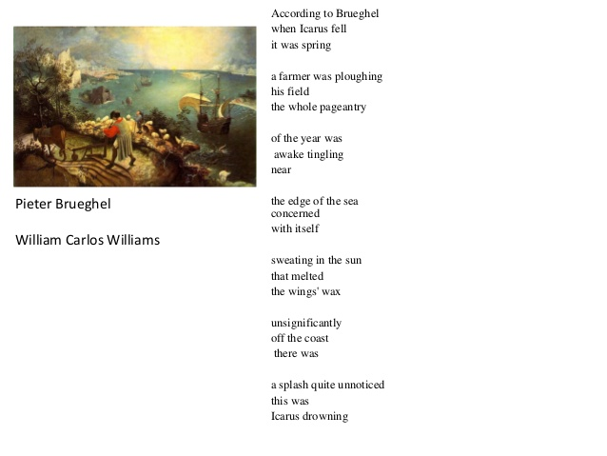
William Carlos Williams’ ekphrastic poems in ”Pictures from Brueghel Pieter Bruegel” (also Brueghel) the Elder (Пи́тер Бре́йгель; c. 1525–1530 - 9 September 1569) was the most significant artist of Dutch and Flemish Renaissance painting.

Slide 36
A notable example is “Ode on a Grecian Urn” in which the poet John Keats speculates on the identity of the lovers who appear to dance and play music, simultaneously frozen in time and in perpetual motion:
What men or gods are these? What maidens loth?
What mad pursuit? What struggle to escape?
What pipes and timbrels? What wild ecstasy?
Heard melodies are sweet, but those unheard
Are sweeter; therefore, ye soft pipes, play on;
Not to the sensual ear, but, more endear’d,
Pipe to the spirit ditties of no tone:
Fair youth, beneath the trees, thou canst not leave
Thy song, nor ever can those trees be bare;
Bold Lover, never, never canst thou kiss,
Though winning near the goal yet, do not grieve;
She cannot fade, though thou hast not thy bliss,
For ever wilt thou love, and she be fair!
Ah, happy, happy boughs! that cannot shed
Your leaves, nor ever bid the Spring adieu;
And, happy melodist, unwearied,
For ever piping songs for ever new. . . .

Slide 37
Ода к греческой вазе
То люди или боги? Все равно...
Погони страх? Борьба упругих тел?
Свирель и бубны? Хороводы дев?
Напевы слушать сладко; а мечтать
О них милей; но пойте вновь, свирели;
Вам не для слуха одного порхать...
Ах, для души теперь они запели:
О юноша! в венке... и не прейдет
Тот гимн - и листья те не опадут;
Пусть ввек не прикоснется поцелуй;
Ты плачешь у меты - она цветет
Всегда прекрасная, но не тоскуй -
Тебе любить в безбрежности минут!
О, этих веток не коснется тлен!
Листы - не унесет вас аквилон!
Счастливый юноша - без перемен
Свирели будет звон и вечный сон;
Любовь твоя блаженна! Вновь и вновь…
Перевод Василия Комаровского

Slide 38
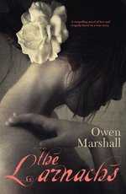
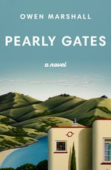
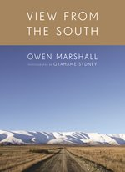
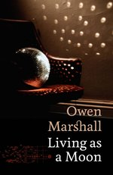

Owen Marshall, described by Vincent O’Sullivan as ‘New Zealand’s best prose writer’, is an award-winning novelist, short story writer, poet and anthologist, who has written or edited 30 books.
Owen Marshall

