Slide 1
POSTMODERNISM IN AMERICAN LITERATURE
(1950 – the early 21st century).
1. The Style of postmodern literature.
2. Postmodern Philosophy.
3. The Theatre of the Absurd, the Beat Generation, and Magic Realism.
4. Postmodern themes and techniques.

Slide 2
1. The Style of postmodern literature.
Postmodern literature is a form of literature which is stylistically and ideologically marked by a reliance on such literary conventions as fragmentation, paradox, unreliable narrators, often unrealistic plots, games, parody, paranoia, dark humor and the author’s self-reference.
Postmodern authors tend to reject meanings in their novels, stories and poems. They highlight the possibility of multiple meanings, or a complete lack of meaning, within a literary work.
Postmodern literature also often rejects the boundaries between 'high' and 'low' forms of art and literature, as well as the distinctions between different genres and forms of writing and storytelling.

Slide 3
Stylistic techniques in postmodern literature are:
Pastiche: The taking of various ideas from previous writings and literary styles and mixing them together to make new styles.
Intertextuality: The acknowledgment of previous literary works within another literary work.
Metafiction: The act of writing about writing or making readers aware of the fictional nature of the very fiction they're reading.
Temporal Distortion: The use of non-linear timelines and narrative techniques in a story.

Slide 4
Stylistic techniques in postmodern literature are:
Minimalism: The use of characters and events which are common and non-exceptional characters.
Maximalism: Disorganized, lengthy, highly detailed writing.
Magical Realism: The introduction of impossible or unrealistic events into a narrative that is otherwise realistic.
Faction: The mixing of actual historical events with fictional events without clearly defining what is factual and what is fictional.
Reader’s Involvement: Often through direct address to the reader and the open acknowledgment of the fictional nature of the events being described.

Slide 5
Many critics and scholars define postmodern literature against the popular literary style that came before it: modernism.
In many ways, postmodern literary styles and ideas serve to reverse, mock and reject the principles of modernist literature.
The postmodern novel, story or poem is often presented as a parody of the modernist literary quest for meaning.
For example, instead of following the standard modernist literary quest for meaning in a world, postmodern literature tends to doubt the possibility of meaning.
Thomas Pynchon's postmodern novel The Crying of Lot 49 is a perfect example of this. In this novel, the protagonist's quest for knowledge and understanding results in confusion and the lack of any sort of clear understanding of the events that transpired.

Slide 6
2. Postmodern Philosophy.
Postmodern literature serves as a reaction to the supposed stylistic and ideological limitations of modernist literature and the radical changes the world underwent after the end of World War II.
While modernist literary writers often depicted the world as fragmented, troubled and on the edge of disaster, which is best displayed in the stories and novels of such modernist authors as Ernest Hemingway, F. Scott Fitzgerald, Gertrude Stein, Virginia Woolf and Thomas Mann, postmodern authors tend to depict the world as having already undergone countless disasters and being beyond understanding.

Slide 7
Postmodern Philosophy.
For many postmodern writers, the various disasters that occurred in the last half of the 20th century left a number of writers with a profound sense of paranoia. They also gave them an awareness of the possibility of utter disaster and apocalypse on the horizon. The notion of meanings and reasons behind any event became seen as impossible.
Postmodern literary writers have also been greatly influenced by various movements and ideas, taken from postmodern philosophy.
Postmodern philosophy tends to conceptualize the world as being impossible to define or understand. Postmodern philosophy argues that knowledge and facts are always relative to particular situations and that it's impossible to attempt to locate any meaning to any idea, concept or event.

Slide 8
Postmodern Philosophy
Postmodern philosophy argues that all belief systems and ideologies are developed for the express purpose of controlling others and maintaining particular political and social systems. Many postmodern writers believe that the world has already fallen apart and that actual, singular meaning does not exist at all, and that literature should serve to reveal the world's paradoxes and ironies.

Slide 9
Examples of Postmodern Literature:
Postmodern literary writers come from all across the world. Postmodern literature is not specific to writers from any particular region or culture. There are thousands of writers and literary works from all around the world which are considered postmodern by critics and scholars. Among the most famous and critically respected works of postmodern literature include the following:

Slide 10

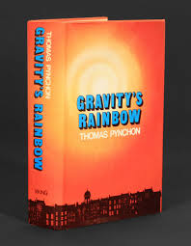
Thomas Pynchon's
“Gravity's Rainbow” (1973)
Thomas Pynchon, (born May 8, 1937), American novelist and short-story writer whose works combine black humour and fantasy to depict human alienation in the chaos of modern society.

Slide 11
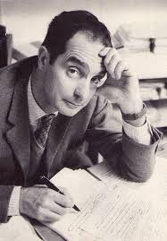
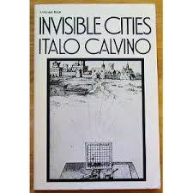
Italo Calvino's
“Invisible Cities” (1972)
Italo Calvino (1923 – 1985)- an Italian journalist, short-story writer, and novelist whose whimsical and imaginative fables made him one of the most important Italian fiction writers in the 20th century.

Slide 12
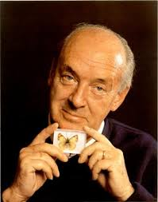
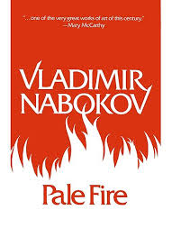
Vladimir Nabokov's
“Pale Fire” (1962)
Vladimir Nabokov (born 1899 – 1977) - Russian-born American novelist and critic, the foremost of the post-1917 émigré authors. He wrote in both Russian and English, and his best works, including Lolita (1955), feature stylish, intricate literary effects.

Slide 13

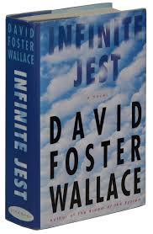
David Foster Wallace's
“Infinite Jest” (1996)
David Foster Wallace (1962 - 2008), American novelist, short-story writer, and essayist whose dense works provide a dark, often satirical analysis of American culture.

Slide 14
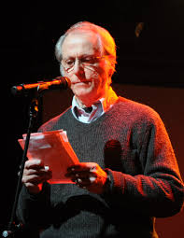
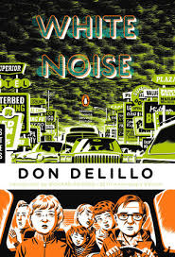
Don DeLillo's
“White Noise” (1985)
Don DeLillo (born November 20, 1936) - an American novelist whose postmodernist works portray the anomie of an America cosseted by material excess and stupefied by empty mass culture and politics.

Slide 15
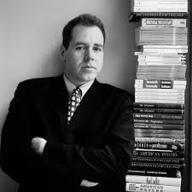
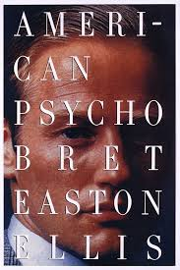
Bret Easton Ellis' “American Psycho” (1991)
Bret Easton Ellis (born March 7, 1964) is an American author, screenwriter, and short story writer.
American Psycho, novel by Bret Easton Ellis, published in 1991. A successful movie version of the novel, starring Christian Bale in the lead role, appeared in 2000.

Slide 16
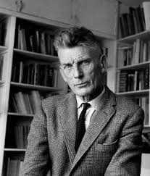
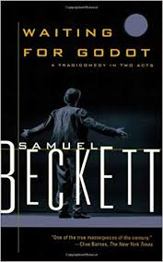
Samuel Beckett's “Waiting for Godot” (published in 1952)
Samuel Becket (1906 – 1989), author, critic, and playwright, winner of the Nobel Prize for Literature in 1969. He wrote in both French and English and is perhaps best known for his plays, especially En attendant Godot (1952; Waiting for Godot).

Slide 17

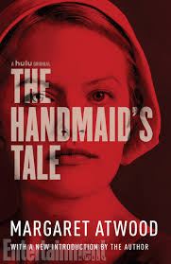
Margaret Atwood's
“The Handmaid's Tale” (1985; film 1990; opera 2000)
Margaret Atwood (born November 18, 1939), Canadian writer best known for her prose fiction and for her feminist perspective.

Slide 18
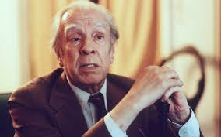
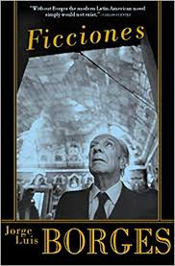
Jorge Luis Borges's “Ficciones” (published in English‎: ‎1962)
Jorge Luis Borges (1899 - 1986) – an Argentine poet, essayist, and short-story writer whose works have become classics of 20th-century world literature.
His best fantastic stories were collected in Ficciones (1944, revised 1956; “Fictions” Eng. trans. Ficciones) and the volume of English translations titled The Aleph and Other Stories, 1933–1969 (1970).

Slide 19

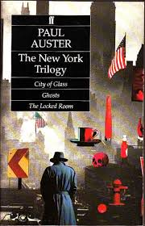
Paul Auster's
“The New York Trilogy” (1987)
Paul Auster (born February 3, 1947) – an American novelist, essayist, translator, and poet whose complex mystery novels are often concerned with the search for identity and personal meaning.
He gained renown for a series of experimental detective stories published collectively as The New York Trilogy (1987). It comprises City of Glass (1985), about a crime novelist who becomes entangled in a mystery that causes him to assume various identities; Ghosts (1986), about a private eye known as Blue who is investigating a man named Black for a client named White; and The Locked Room (1986), the story of an author who, while researching the life of a missing writer for a biography, gradually assumes the identity of that writer.

Slide 20

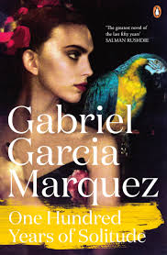
Gabriel Garcia Marquez's “One Hundred Years of Solitude” (1967)
Gabriel García Márquez (1927 - 2014), Colombian novelist and one of the greatest writers of the 20th century, who was awarded the Nobel Prize for Literature in 1982, mostly for his masterpiece Cien años de soledad (1967; One Hundred Years of Solitude).

Slide 21
3. The Theatre of the Absurd, the Beat Generation, and Magic Realism.
Postmodernist literature is based on such developments as the Theatre of the Absurd, the Beat Generation and Magic Realism.
Some key figures (Samuel Beckett, William S. Burroughs, Jorge Luis Borges, Julio Cortázar and Gabriel García Márquez) are cited as significant contributors to the postmodern aesthetic.

Slide 22
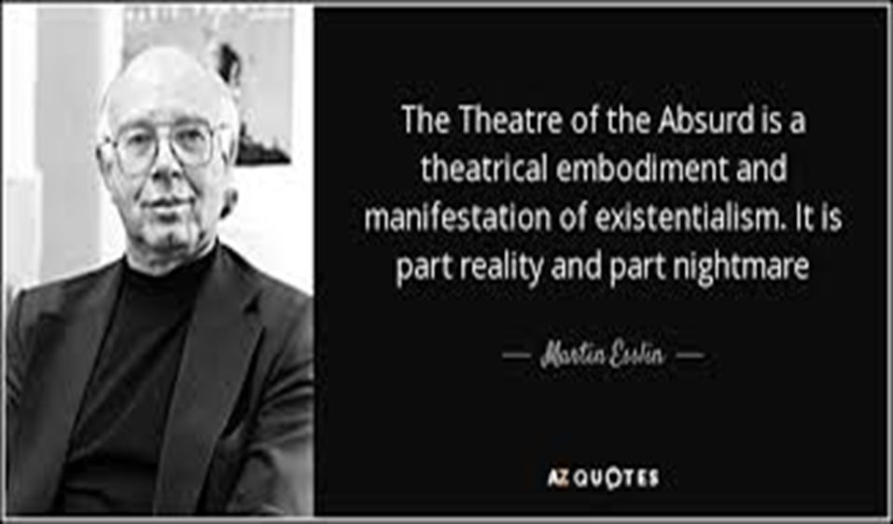
Theatre of the Absurd
The term "Theatre of the Absurd" was introduced by Martin Esslin to describe a tendency in theatre in the 1950s.

Slide 23

One of the most important Postmodern Absurdist is Samuel Beckett (1906 – 1989)
The work of Samuel Beckett is often seen as marking the shift from modernism to postmodernism in literature. He had close ties with modernism because of his friendship with James Joyce; however, his work helped shape the development of literature away from modernism. Joyce celebrated the possibility of language; Beckett focused on the poverty of language and man as a failure.
Beckett's experiments with narrative form and with the disintegration of narration and character in fiction and drama won him the Nobel Prize for Literature in 1969.

Slide 24

The Beat Generation
"The Beat Generation" is a name introduced by Jack Kerouac to develop ideas of "spontaneous prose".
"Beat Generation" is often used more broadly to refer to several groups of post-war American writers from the Black Mountain poets, the New York School and the San Francisco Renaissance.
Jack Kerouac (1922 - 1969) – an American novelist, poet and leader of the Beat movement whose most famous book “On the Road” (1957) had broad cultural influence before it was recognized for its literary merits. On the Road captured the spirit of its time as no other work of the 20th century had since F. Scott Fitzgerald’s The Great Gatsby (1925).

Slide 25
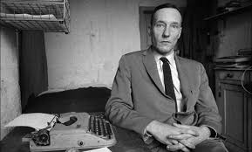
William S. Burroughs
(1914 – 1997)
One writer, associated with the Beat Generation, who appears most often on lists of postmodern writers, is William S. Burroughs.
Burroughs published the novel “Naked Lunch” in Paris in 1959 and in America in 1961, which is considered the first truly postmodern novel because it is
1) fragmentary, with no central narrative line;
2) it employs pastiche to fold in elements from popular genres such as detective fiction and science fiction;
3) it's full of parody, paradox, and playfulness;
4) creation of the "cut-up" technique in which words and phrases are cut from a newspaper or other publication and rearranged to form a new message.

Slide 26

Magic Realism
Magic Realism is a technique popular among Latin American writers in which supernatural elements are treated as common (a famous example being the practical-minded treatment of an apparently angelic figure in Gabriel García Márquez's "A Very Old Man with Enormous Wings".

Slide 27
4. Postmodern themes and techniques.
1) Irony, playfulness, black humor.
The irony, along with black humor and the general concept of "play" are among the most recognizable aspects of postmodernism.
Several postmodern novelists were called black humorists: John Barth, Joseph Heller, William Gaddis, Kurt Vonnegut, Bruce Jay Friedman, etc.
It's common for postmodernists to treat serious subjects in a playful and humorous way: for example, the way Heller, Vonnegut, and Pynchon address the events of World War II.
A good example of postmodern irony and black humor is found in the stories of Donald Barthelme; "The School", for example, is about the ironic death of plants, animals, and people connected to the children in one class, but the repetition of death is treated only as a joke and the narrator remains emotionally distant throughout.

Slide 28
Postmodern themes and techniques
2) Intertextuality.
It is the relationship between one text (a novel for example) and another or one text within the structure of literary history. Intertextuality in postmodern literature can be a reference or parallel to another literary work, an extended discussion of a work, or the adoption of a style.
In postmodern literature this commonly manifests as references to fairy tales – as in works by Margaret Atwood, Donald Barthelme and many other – or in references to popular genres such as sci-fi and detective fiction.

Slide 29
Postmodern themes and techniques
3) Pastiche |pəˈstiːʃ|.
Pastiche means to combine or bring together multiple elements. It can be a combination of multiple genres to create a unique narrative or to comment on situations in postmodernity: for example, William S. Burroughs uses science fiction, detective fiction, westerns; Margaret Atwood uses science fiction and fairy tales; Umberto Eco uses detective fiction, fairy tales, and science fiction, and so on.
Pastiche can also refer to compositional technique, for example the cut-up technique employed by Burroughs.

Slide 30
Postmodern themes and techniques
4) Metafiction.
Metafiction is writing about writing or making the fictionality of fiction apparent to the reader. It is often employed to undermine the authority of the author, for unexpected narrative shifts, to advance a story in a unique way, for emotional distance, or to comment on the act of storytelling.
For example, Kurt Vonnegut commonly used this technique: the first chapter of his 1969 novel “Slaughterhouse Five” is about the process of writing the novel and calls attention to his own presence throughout the novel.

Slide 31
Postmodern themes and techniques
5) Fabulation .
Fabulation challenges some traditional notions of literature - the traditional structure of a novel or role of the narrator, for example - and integrates other traditional notions of storytelling, including fantastical elements, such as magic and myth, or elements from popular genres such as science fiction.
The term was coined by Robert Scholes in his book “The Fabulators”.
A good example of fabulation is Salman Rushdie´s “Haroun and the Sea of Stories” (1990).

Slide 32
Postmodern themes and techniques
6) Temporal distortion or Distortions in time.
This technique is represented by fragmentation and non-linear narratives and it is used for irony.

Slide 33
Postmodern themes and techniques
7) Magic realism.
Literary work marked by the use of figures and objects depicted in a surrealistic manner. The themes and subjects are often imaginary, fantastic and with a dream-like quality. The characteristic features of this fiction are the mingling of the realistic and the fantastic time shifts, labyrinthine narratives and plots, the use of dreams, myths and fairy stories.
A fusion of fabulism with magic realism is apparent in such early 21st century American short stories as Kevin Brockmeier's "The Ceiling”.

Slide 34
Postmodern themes and techniques
8) Technoculture and hyperreality.
Fredric Jameson (an American literary critic and political theorist) called postmodernism the "cultural logic of late capitalism". "Late capitalism" implies that society has moved past the industrial age and into the information age. Postmodernity was defined by a shift into hyperreality in which simulations have replaced the real life.
Many works of fiction have dealt with this aspect of postmodernity with characteristic irony and pastiche. For example, Don DeLillo's novel “White Noise” presents characters who are bombarded with a "white noise" of television, product brand names, and clichés.
The cyberpunk fiction of William Gibson, Neal Stephenson, and many others use science fiction techniques to address this postmodern, hyperreal information bombardment. Steampunk - a subgenre of science fiction popularized in novels and comics by such writers as Alan Moore and James Blaylock, demonstrates postmodern pastiche, temporal distortion, and a focus on technoculture with its mix of futuristic technology and Victorian culture.

Slide 35
Postmodern themes and techniques
9) Paranoia.
It is demonstrated most effectively in Joseph Heller's novel “Catch-22” and the work of Thomas Pynchon.
The sense of paranoia is the belief that there's an ordering system behind the chaos of the world. For the postmodernist, no ordering system exists, so a search for order is fruitless and absurd.

Slide 36
Postmodern themes and techniques
10) Maximalism.
The postmodern position is that the style of a novel must be appropriate to what it depicts and represents, and points back to such examples in previous ages as “Gargantua” by François Rabelais and the “Odyssey” of Homer.

Slide 37
Postmodern themes and techniques
11) Minimalism.
Literary minimalism can be characterized as a focus on a surface description where readers are expected to take an active role in the creation of a story. The characters in minimalist stories and novels tend to be unexceptional. Generally, the short stories are "slice of life" stories.
Minimalism, the opposite of maximalism, is a representation of only the most basic and necessary pieces, specific by economy with words.
Minimalist authors hesitate to use adjectives, adverbs, or meaningless details. Instead of providing every minute detail, the author provides a general context and then allows the reader's imagination to shape the story.
Literary minimalism is most commonly associated with Samuel Beckett’s works.

