Slide 1
African American literature
Plan.
1. Antebellum Literature.
• Slave narratives.
• Prose, drama, and poetry.
• Oral tradition.
2. The Civil War and Reconstruction.
3. The Late 19th and Early 20th Centuries.
• The novel as social analysis.
• The rise of the New Negro.
• The Harlem Renaissance.
• The Advent of Urban Realism.
• African American Theatre.
4. The Literature of Civil Rights.
5. The Black Arts movement.
6. Reconceptualizing Blackness.
7. Renaissance in The 1970s.
8. The Turn Of The 21st Century.

Slide 2
African American literature –
body of literature written by Americans of African descent.
Although since 1970 African American writers have earned widespread critical acclaim, this literature has been recognized internationally as well as nationally since its inception in the late 18th century.

Slide 3
Antebellum |ˌæntiˈbeləm| Literature
(existing before the American Civil War)
African Americans launched their literature in North America during the second half of the 18th century, joining the war of words between England and its rebellious colonies with a special sense of mission.
The earliest African American writers sought to demonstrate that the proposition “all men are created equal” in the Declaration of Independence required that black Americans be extended the same human rights as those claimed by white Americans.
African-born Phillis Wheatley, enslaved in Boston, dedicated her Poems on Various Subjects, Religious and Moral (1773), the first African American book, to proving that “Negros, black as Cain,” were not inferior to whites in matters of the spirit and thus could “join th’ angelic train” as spiritual equals to whites.

Slide 4
In 1789 Olaudah Equiano published his two-volume autobiography, The Interesting Narrative of the Life of Olaudah Equiano; or, Gustavus Vassa, the African, Written by Himself.
As the prophet of literary black nationalism in the United States, David Walker wrote his incendiary Appeal, in Four Articles; Together with a Preamble, to the Coloured Citizens of the World (1829) to warn white America of impending racial violence if slavery were not abolished.
Maria W. Stewart, the first African American woman political writer, issued her Productions of Mrs. Maria W. Stewart in 1835, in which she encouraged black women in the North to take a more outspoken role in civil rights agitation and black community building.

Slide 5
Slave narratives
The fugitive slave narrative dominated the literary landscape of antebellum black America.
The Narrative of the Life of Frederick Douglass, an American Slave, Written by Himself (1845) gained the most attention, establishing Frederick Douglass as the leading African American man of letters of his time.
Harriet Jacobs’s Incidents in the Life of a Slave Girl (1861), the first autobiography by a formerly enslaved African American woman, describes her experience of the exploitation that made slavery especially oppressive for black women.

Slide 6
Prose, drama, and poetry
Through the slave narrative, African Americans entered the world of prose and dramatic literature.
In 1853 William Wells Brown, an internationally known fugitive slave narrator, authored the first black American novel, Clotel; or, The President’s Daughter.
Five years later Brown also published the first African American play, The Escape; or, A Leap for Freedom, based on scenes and themes familiar to readers of fugitive slave narratives.
In the late 1850s Martin R. Delany, a black journalist and physician who would later serve as a major in the Union army during the Civil War, wrote Blake; or, The Huts of America (serially published in 1859), a novel whose hero plots a slave revolt in the South.
James M. Whitfield, the author of a volume of spirited protest poetry entitled America and Other Poems(1853), helped ensure that the 1850s would become the first African American literary renaissance.

Slide 7
Oral tradition
Behind the achievements of individual African American writers during the antislavery era lies the communal consciousness of millions of slaves, whose oral tradition in song and story has given form and substance to much subsequent literature by black Americans. When slaves sang “I thank God I’m free at last,” only they knew whether they were referring to freedom from sin or from slavery.
A second great fund of Southern black folklore, the beast fables that originated in Africa testified to the slaves’ commonsense understanding of human psychology and everyday justice.
The slaves selected for special celebration trickster figures, most notably Brer Rabbit, because of their facility in combating stronger antagonists through wit, guile, and the skillful adoption of deceptive masks.

Slide 8
The Civil War and Reconstruction
With the outbreak of the Civil War, many African Americans deployed their pens and their voices to convince President Abraham Lincoln that the nation was engaged in nothing less than a war to end slavery, which black men should be allowed to fight.
The short-lived era of Reconstruction in the United States (1865–77) elicited an unprecedented optimism from African American writers.

Slide 9
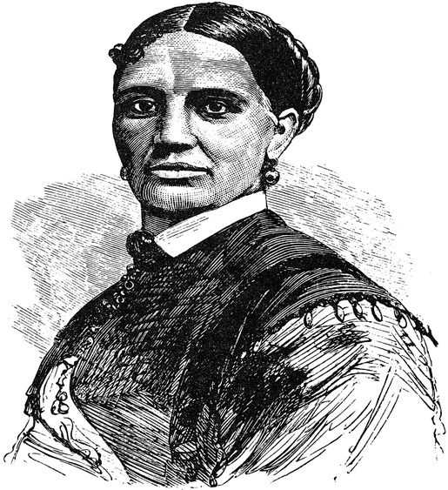
Elizabeth Keckley, who rose from slavery in St. Louis, articulated in her autobiography, Behind the Scenes; or, Thirty Years a Slave and Four Years in the White House (1868), a spirit of sectional reconciliation espoused by many other leading African Americans of the Reconstruction era.

Slide 10
The Late 19th And Early 20th Centuries
As educational opportunity expanded among African Americans after the war, a self-conscious black middle class with serious literary ambitions emerged in the later 19th century.
In the mid-1880s Oberlin College graduate Anna Julia Cooper, a distinguished teacher and the author of A Voice from the South (1892), began a speaking and writing career that highlighted the centrality of educated black women in the reform movements in black communities of the post-Reconstruction era.
African American poetry developed along two paths after 1880. The traditionalists were led by Albery Allson Whitman, who made his fame among black readers with two book-length epic poems, Not a Man, and Yet a Man (1877) and The Rape of Florida (1884), the latter written in Spenserian stanzas.
On August 25, 1893, Whitman shared the platform for African American literature with a 21-year-old poet Paul Laurence Dunbar, who had just that year published his first volume of poetry, Oak and Ivy. Though not the first black American to write poetry in so-called Negro dialect, Dunbar was the most successful, both critically and financially.

Slide 11
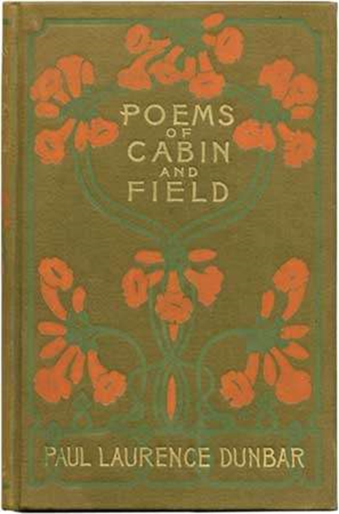
The cover of Dodd, Mead and Company's 1899 illustrated edition of Paul Laurence Dunbar's Poems of Cabin and Field. Between the Covers Rare Books, Merchantville, NJ

Slide 12
The novel as social analysis
In the hands of Sutton E. Griggs, and Charles W. Chesnutt, the novel became an instrument of social analysis and direct confrontation with the prejudices, stereotypes, and racial mythologies that allowed whites to ignore worsening social conditions for blacks in the last decades of the 19th century.
For ex.: based on the Wilmington, North Carolina, racial massacre of 1898, Chesnutt’s The Marrow of Tradition (1901) was reviewed extensively throughout the United States as a timely study of troubling contemporary issues.

Slide 13
As segregation regimes took hold in the South in the 1890s with the approval of the rest of the country, many African Americans found a champion in
Booker T. Washington
and adopted his self-help autobiography, Up from Slavery (1901), as their guidebook to improved fortunes.
Washington portrayed his own life in such a way as to suggest that even the most disadvantaged of black people could attain dignity and prosperity in the South by proving themselves valuable, productive members of society deserving of fair and equal treatment before the law. A classic American success story, Up from Slavery solidified Washington’s reputation as the most eminent African American of the new century.

Slide 14
The rise of the New Negro. The Harlem Renaissance.
The phenomenon known as the Harlem Renaissance represented the flowering in literature and art of the New Negro movement of the 1920s, epitomized in The New Negro (1925), an anthology edited by Alain Locke that featured the early work of some of the most gifted Harlem Renaissance writers, including the poets Countee Cullen, Langston Hughes, and Claude McKay and the novelists Rudolph Fisher, Zora Neale Hurston, and Jean Toomer.

Slide 15
The “New Negro,” Alain Locke announced, differed from the “Old Negro” in self-confidence, which led New Negro writers to question traditional “white” aesthetic standards, propaganda, and to cultivate personal self-expression, racial pride, and literary experimentation.

Slide 16
Claude McKay is generally regarded as the first major poet of the Harlem Renaissance. His best poetry, including sonnets ranging from “If We Must Die” (1919) to the self-portrait “Outcast,” was collected in Harlem Shadows (1922), which some critics have called the first great literary achievement of the Harlem Renaissance.
Langston Hughes earned his greatest praise for his experimental jazz and blues poetry in The Weary Blues (1926) and Fine Clothes to the Jew (1927).
Countee Cullen sought success through writing in traditional forms and employing a lyricism informed by the work of John Keats in his most famous poem, “Heritage” (1925).

Slide 17
Novelists
The most notable narratives produced by the Harlem Renaissance came from Jean Toomer (an African American poet and novelist commonly associated with the Harlem Renaissance), Rudolph Fisher (whom Langston Hughes called "the wittiest of these New Negroes of Harlem”), Wallace Thurman, Zora Neale Hurston (an influential author of African-American literature and anthropologist), and Nella Larsen.
For ex.: Toomer’s Cane (1923), an avant-garde collection of sketches, fiction, poetry, and drama, set a standard for experimentalism;
Fisher’s The Walls of Jericho (1928) won critical applause because of the novel’s balanced satire of class and colour prejudice among black New Yorkers;
Thurman’s The Blacker the Berry (1929) exposes colour prejudice among African Americans.

Slide 18
Playwrights and editors
Willis Richardson The Chip Woman’s Fortune (produced 1923) was the first nonmusical play by an African American to be produced on Broadway;
African American editors such as Charles S. Johnson, whose monthly Opportunity was launched in 1923, and the respected short-story writer Eric Walrond, who published young black writers in Negro World;
Anthologies, particularly of poetry, abounded during the Harlem Renaissance, enhancing the literary reputations of both the writers represented in them and their editors. The editors included James Weldon Johnson (The Book of American Negro Poetry [1922] and The Book of American Negro Spirituals [1925, 1926]), Charles S. Johnson (Ebony and Topaz [1927]).

Slide 19
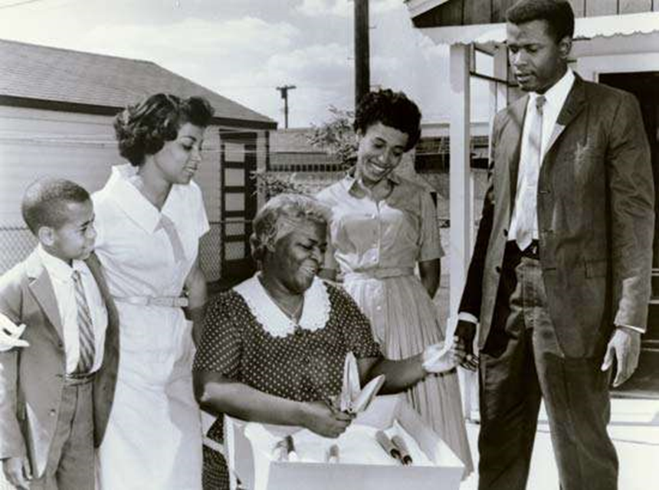
African American Theatre Lorraine Hansberry “A Raisin in the Sun” (March 1959) is a searching portrayal of an African American family confronting the problems of upward mobility and integration.

Slide 20
The Literature Of Civil Rights and the Black Arts movement
Declaring that “all art is ultimately social,” Lorraine Hansberry was one of several African American writers—most prominently James Arthur Baldwin and Alice Walker—to take an active part in the civil rights movement and to be energized, imaginatively and socially, by the freedom struggles of the late 1950s and the ’60s.
Rejecting any notion of the artist that separated him or her from the African American community, the Black Arts movement engaged in cultural nation founding community theatres, creating literary magazines, and setting up small presses (such as in 1968 the landmark anthology Black Fire, edited by Amiri Baraka previously known as LeRoi Jones and Larry Neal.

Slide 21
Reconceptualizing Blackness.
Renaissance in the 1970s.
“The Bluest Eye” (1970) by Toni Morrison - the “Black is beautiful” slogan of the 1970s made it topical.
“Song of Solomon” (1977) blends African American folklore, history, and literary tradition.
Toni Morrison was the leading African American writer of the 1970s, an inspiration to a generation of younger novelists, especially Toni Cade Bambara, whose novel The Salt Eaters (1980) won the American Book Award, and Gloria Naylor, whose novel The Women of Brewster Place (1982) won a National Book Award for best first novel in 1983.

Slide 22
Alice Walker
The Third Life of Grange Copeland (1970), an epic novel that tracks three generations of a black Southern family through internal;
Revolutionary Petunias and Other Poems (1973), a collection of poems that urges its reader to “[b]e nobody’s darling; / Be an outcast”;
Meridian (1976), a novelistic redefinition of African American motherhood.
In 1982 Walker’s most famous novel, The Color Purple won the Pulitzer Prize and the National Book Award.

Slide 23
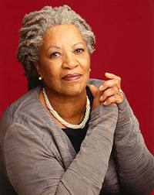
In accepting the Nobel Prize in 1993, Toni Morrison stated: “Word-work is sublime…because it is generative; it makes meaning that secures our difference, our human difference—the way in which we are like no other life.”

