Slide 1

AUSTRALIAN LITERATURE

Slide 2
Plan
1. Aboriginal narrative: the oral tradition.
2. The century after settlement.
3. Nationalism and expansion.
4. Literature from 1940 to 1970.
5. Literature from 1970 to 2000.

Slide 3

The literature of Australia characteristically expresses collective values. Even when the literature deals with the experiences of an individual, those experiences are very likely to be estimated in terms of the ordinary, the typical, the representative. It aspires on the whole to represent integration rather than disintegration. Although it may express a strong ironic disapproval of collective mindlessness, the object of criticism is the mindlessness rather than the conformity.

Slide 4

Aboriginal narrative: the oral tradition
When first encountered by Europeans, the Australian Aboriginals did not have written languages (individual words were collected from first contact, but languages as systems were not written down until well into the 20th century). Their songs, chants, legends, and stories, however, constituted a rich oral literature, and, since the Aboriginal “tribes” had no common language, these creations were enormously diverse. Long unavailable to or misunderstood by non-Aboriginals, their oral tradition appears (from researches undertaken in the last half of the 20th century) to be one of considerable subtlety and complexity.

Slide 5
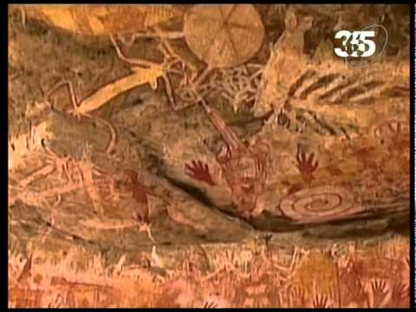
The oral literature of the Aboriginals has an essentially ceremonial function.
It supports the fundamental Aboriginal beliefs that what is given cannot be changed and that the past exists in an eternal present, and it serves to relate the individual and the landscape to the continuing spiritual influence of the Dreaming, or Dreamtime (widely known as the Alcheringa, or Altjeringa, the term used by the Aboriginals of central Australia)—a mythological past in which the existing natural environment was shaped and humanized by ancestral beings.

Slide 6
Aboriginal oral tradition may be public (open to all members of a community and often a kind of entertainment) or sacred (closed to all but initiated members of one or the other sex).
Narratives of the public sort range from stories told by women to young children (mostly elementary versions of creation stories—also appropriate for tourists and amateur anthropologists) to the recitation of song cycles in large gatherings (known as corroborees). Even the most uncomplicated narratives of the Dreaming introduce basic concepts about the land and about what it is that distinguishes right behaviour from wrong. When children are old enough to prepare for their initiation ceremonies, the stories become more elaborate and complex.
Among the sacred songs and stories are those that are men’s business and those that are women’s business; each is forbidden to the eyes and ears of the other sex and to the uninitiated.

Slide 7
The chief subject of Aboriginal narratives is
the land.
As Aboriginals travel from place to place, they (either informally or ceremonially) name each place, telling of its creation and of its relation to the journeys of the Ancestors. This practice serves at least three significant purposes: it reinforces their knowledge of local geography—that is, the food routes, location of water holes, places of safety, places of danger, the region’s terrain, and so on—and it also serves a social function (sometimes bringing large clans together) and a religious or ritual function.

Slide 8
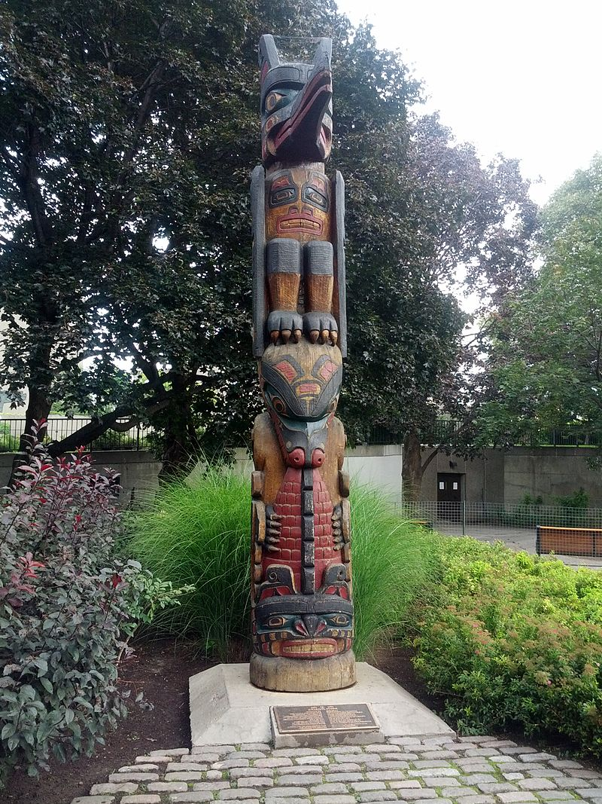
Many of the stories have to do with the journeys of the Ancestors and the “creation sites,” places at which they created different clans and animals. Other stories concern contests between Ancestor figures for power and knowledge. A sequence of stories or songs—a story track or song line—identifies the precise route taken by an Ancestor figure. Knowledge and recitation of the journey of each totemic figure are the responsibility of that figure’s totemic clan.

Slide 9
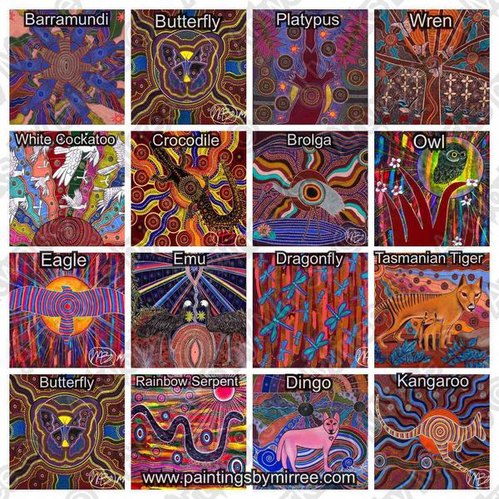
Important stories that deal with the activities of perhaps just one or two of the ancestral figures and belong to adjacent areas and adjacent clans may constitute a song cycle.
Some of these stories do not allow for variation and constitute a formal literature with precise structures and particular language. For example, repetition is an important structural device.
Verb forms and tenses indicate the unchanging yet ongoing relationship between the ancestral past and the present. The persistent theme of transformation, a theme characteristic of many oral literatures, is for the people a way of access to their mythic past, to the eternal present of the Dreaming.

Slide 10
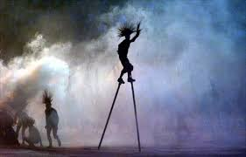
The oral literature of the Aboriginals is involved with performance. It is not simply a verbal performance. Traditional song is very often associated with dance, and storytelling with gesture and mime. Or stories may be accompanied by diagrams drawn in the sand and then brushed away again. Each song, each narrative, is in effect acted out. Storytellers will customarily announce who they are, where they come from, and what their relation to the story is, as though they are its agent. They may provide a frame for their story. They use the common devices of oral literature such as repetition and enumeration and formulaic expression. But they always take care with their songs and stories; they are as careful with imagery and symbolism, with the figures of speech, as they are with other aspects of ceremony.

Slide 11
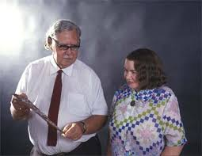
Anthropologists Catherine H. and Ronald M. Berndt were the first to publish traditional narratives and songs in full in the original language (though linguists have still not agreed on how best to represent Aboriginal speech), then with a translation and a commentary. One good example of their work is Three Faces of Love: Traditional Aboriginal Song-Poetry (1976). This approach enables at least an initial appreciation of the subtlety and the artistry of the oral tradition.

Slide 12
Not all Aboriginal song and story is in tribal dialect.
In the 1970s and ’80s, as Aboriginal people began to write in formal English, some began to express themselves in what might be called Aboriginal English, an English that is different from standard English. It is formed in short, simple sentences, and it makes considerable use of repetition with variation. It also conveys a certain dignity—and a rich sense of humour. Some versions of this can be found in the different narratives included in Sally Morgan’s My Place (1987) and, more sensitive still as a transcription, in Paddy Roe’s Gularabulu: Stories from the West Kimberley (1983). In the last decades of the 20th century, the poet and storyteller Maureen Watson helped to maintain the oral tradition by reading on radio and television and by performing at schools.

Slide 13
The century after settlement
Almost as soon as settlement of New South Wales began, in 1788, reports of the “new” country were sent back to England.
The public was interested not in the routine of convict life but in the details of strange new flora and fauna. In the colony itself there was little time for any other than practical considerations.
Early publications were dominated by reports of new lands and rivers, journeys of exploration, summaries of what had so far been discovered in the “new” continent.

Slide 14
Nationalism and expansion
The centenary year 1888 provided the occasion for review and reassessment, and almost inevitably that activity encouraged the growing nationalist sentiment already in evidence in such publications as the weekly (founded 1880).
The last 20 years of the 19th century saw a marked growth of nationalism and the movement toward federation of the separate states. The Bulletin, with its rallying cry of “Australia for the Australians”, was ardently nationalistic. It urged its contributors to “write Australian” and to celebrate above all the virtues of the Australian worker, especially the bush worker.

Slide 15
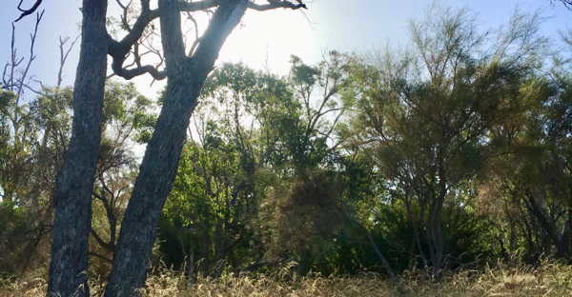
What is it about 'the bush' that is so special to Australians?
"The bush" is a rural, undeveloped country area.
“The bush” is a phrase used to describe land where people do not live, land a long way from cities, or forests.

Slide 16
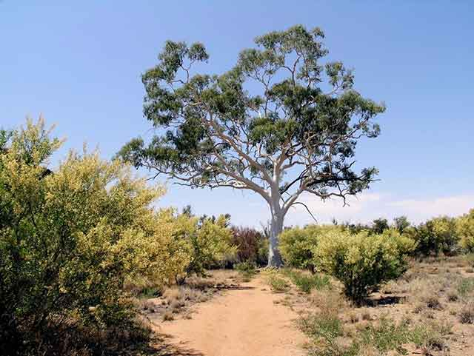
The bush has an iconic status in Australian life and features strongly in any debate about national identity, especially as expressed in Australian literature, painting, popular music, films and foods.
The skills of Indigenous people in 'the bush', especially their tracking abilities, was seen as miraculous and became legendary in the minds of European Australians. Indigenous people's knowledge of the land, at the core of their spiritual beliefs, is expressed in stories, arts and performance - music, songs, dance and ceremony.

Slide 17

By the early decades of the 20th century, the era of bushranging, convictism, and exploration was far enough in the past to be regarded as historical colour. It also was fully expected that the Aboriginal would also pass away—Daisy Bates, who lived for many years among Aboriginal people, used as the title of her book about her experiences the standard phrase The Passing of the Aborigine.

Slide 18
In the 1930s a group of poets led by Rex Ingamells called themselves the Jindyworobaks.
The Jindyworobak Movement was an Australian literary movement of the 1930s and 1940s whose white members, mostly poets, sought to contribute to a uniquely Australian culture through the integration of Indigenous Australian subjects, language and mythology.
The movement's stated aim was to "free Australian art from whatever alien influences trammel it" and create works based on an engagement with the Australian landscape and an "understanding of Australia's history and traditions, primeval, colonial and modern".
The Jindyworobaks wanted to develop a distinctive Australian poetry which described the unique Australian landscape in Australian terms, and which incorporated and appropriated elements of Aboriginal culture and the Aboriginal relationship to the landscape and natural environment.

Slide 19
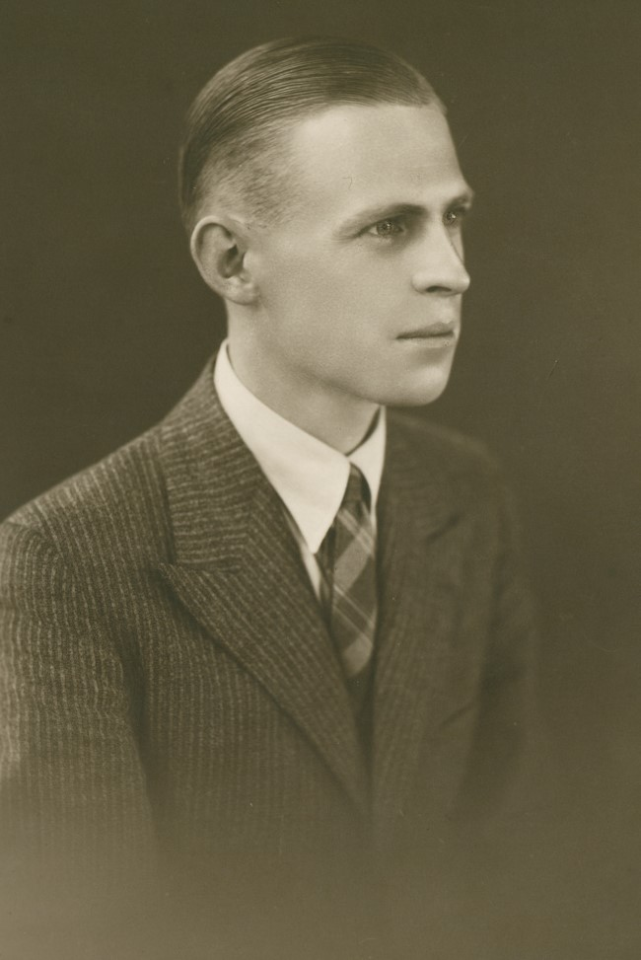
Rex Ingamells is generally considered the founder of the Jindyworobak Movement.

Slide 20
Literature from 1940 to 1970
Patrick White, a Nobel Prize winner (1973) and the most important and influential of the modern Australian novelists, was drawn to Australian themes and the Australian landscape.
White’s imaginative reach, ambitious themes, and elaborate imagery showed him surpassing nationalistic limitations.
His major novels The Tree of Man (1955), Voss (1957), and Riders in the Chariot (1961) had an epic scope.
His short stories and plays and his later novels explored more completely the ambiguity of character and the troubling question of belief. White not only demonstrated the richness of the Australian experience for imaginative writing (“your country is of great subtlety”) but drew the attention of the world to it.

Slide 21
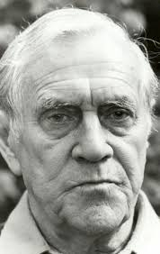
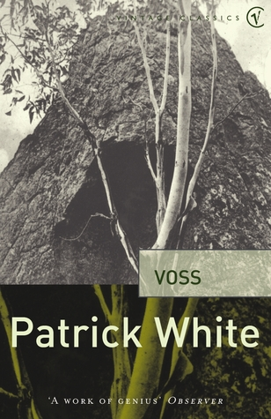
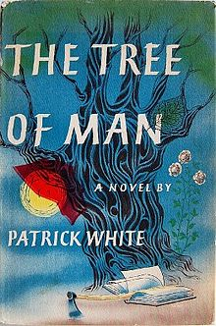
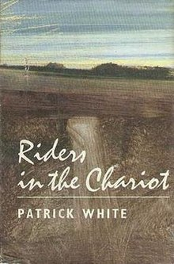
Patrick Victor Martindale White

Slide 22

Literature from 1970 to 2000
Thomas Keneally

Slide 23
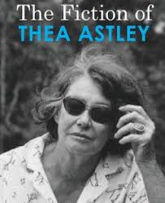
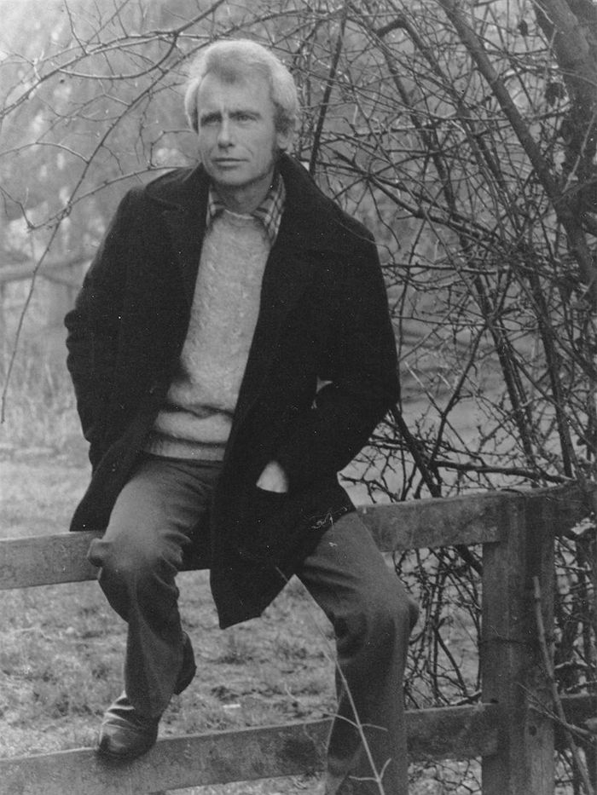
Thea Astley Randolph Stow

Slide 24
The original inhabitants of Australia used the oral tradition, including song and dance with gestural storytelling, to entertain, instruct, guide, and reveal spiritual truths, as well as physical geography and the location of life-sustaining resources.
This tradition, disrupted and more or less destroyed by the arrival of the British, was replaced by a literature that imitated European models. In the mid-19th century, the Australian landscape, flora, and fauna became the setting for many novels, and, soon after, the colonial experience became a popular subject.
Although the bush or Outback loomed large in the national consciousness, Australia has been a characteristically urban society, even from its days as a penal colony.
Writers drew attention to the significance of the suburban ethos in Australian culture.

Slide 25
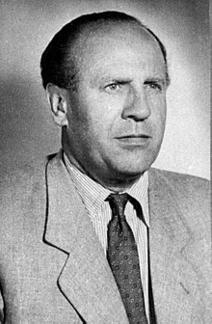
Schindler's Ark by Thomas Keneally
“He who saves one life, saves the World entire”
(from the Jewish Talmud)
“The fact that this story is true has given me so much faith in humanity”
“The list is an absolute good. The list is life”
(the subsequent film adaptation by Steven Spielberg “Schindler’s List”)
Oskar Schindler (28 April 1908 – 9 October 1974) was a German industrialist and a member of the Nazi Party who is credited with saving the lives of 1 200 Jews during the Holocaust by employing them in his factories, which supplied the German army during World War II. He is the subject of the 1982 novel Schindler's Ark and its 1993 film adaptation, Schindler's List, which reflected his life as an opportunist initially motivated by profit, who came to show extraordinary initiative and courage to save the lives of his Jewish employees.

Slide 26
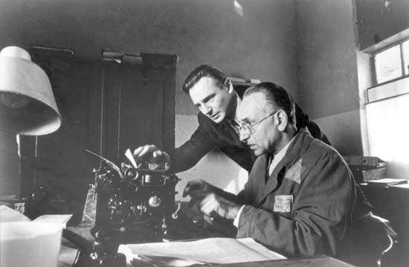
Schindler’s story remained largely the province of Holocaust scholars until the publication in 1982 of Schindler’s Ark, a Booker Prize-winning novelization by Thomas Keneally.
The novel, which became a canonical text of Holocaust literature, was later used as the basis for Steven Spielberg’s film Schindler’s List (1993).

Slide 27
According to a survey undertaken by the Australia Council for the Arts, over half the population of Australia reads at least one work of fiction each year, and those who read novels typically do so at least once a week.
Still, with a geographically isolated population less than one-tenth the size of America’s, Australian writers thirst for a wider overseas readership.
They produce an absorbing array of original novels, short stories and memoirs worthy of our attention.

Slide 28
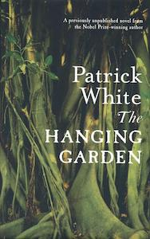
Even Patrick White, the most revered figure in modern Australian literature and the first and only Australian winner of the Nobel Prize, is largely unknown to Americans. After White’s death in 1990, an unfinished manuscript called The Hanging Garden was discovered in his desk drawer. In 2012, his agent finally allowed a transcription to be published in honor of the 100th anniversary of White’s birth.
Patrick White, The Hanging Garden

Slide 29
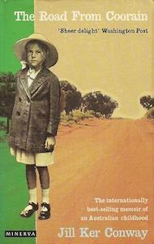
Set in outback New South Wales, Jill Ker Conway’s unforgettable memoir The Road From Coorain explores her childhood on her family’s sheep farm and the upheavals she endured, including nearly a decade of drought and her father’s suicide. It provides an essential narrative of growing up in rural Australia, illuminating the quiet cruelties created by the harshness of the elements and depicting a family’s resignation towards fate—a kind of cynical stoicism that is recognizably Australian.
Ker Conway eventually became Smith College’s first female president.
Jill Ker Conway, The Road from Coorain

Slide 30
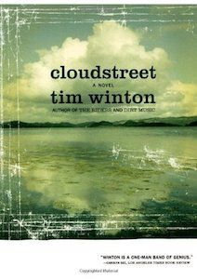
When talking about favorite Australian novels, another tumble-down house comes to mind—the “Cloudstreet” of Tim Winton’s wonderful epic of the same name.
It tells the saga of two rural families who flee to the city, escaping their separate catastrophes, and wash up together in Cloudstreet, a “great, breathing, shuddering” house in the suburbs of Perth. There, they reinvent themselves from scratch. Cloudstreet is a touching, funny, sprawling and memorable novel.
It won both the Miles Franklin and NBC Awards in Australia.
Tim Winton, Cloudstreet

Slide 31

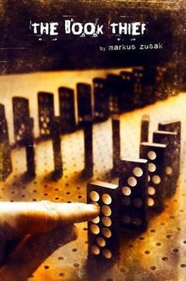
Markus Frank Zusak (born 23 June 1975) is an Australian writer.
He is best known for The Book Thief and The Messenger (US title: I Am the Messenger), two novels for young adults which became international bestsellers.
He won the Margaret A. Edwards Award in 2014 for his contributions to young-adult literature published in the United States.

