Slide 1
American realism (1865 – 1910)
American realism as a literary movement.
American prose fiction: Mark Twain, William Dean Howells, Henry James, Kate Chopin, William Sydney Porter (O.Henry), Jack London.
American Naturalism.

Slide 2
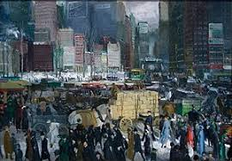
1. American realism
as a literary movement.

Slide 3
Historical background The Great Barbecue, Tragic Era, Age of Excess
The USA grew rapidly after the Civil War
The USA was transformed from an agricultural republic into an industrial nation
The Transcontinental Railroad (1869)
The rapid growth in industrialism and urbanization
The growth of population due to immigration
The increasing rates of democracy and literacy
A relative rise in middle-class
Monopolism
Corruption
Reconstruction

Slide 4
The aim of literature in “the age of negation”
(according to Walt Whitman in his “Leaves of Grass”) to treat each American state and region as equals, to connect an American citizen with the citizens of all nations, to extend readers’ outlook.
Muckrake writers (from to muckrake is to find and expose scandal, esp. concerning public figures).

Slide 5
Principles of realism
The defense of “an experienced commonplace”
A character is more important than a plot
The attack upon Romanticism and romantic writers
The emphasis upon a self-realized morality and an examination of idealism
The concept of realism as a realization of democracy

Slide 6
Characteristics of realistic writing
The philosophy of realism is known as “descendental” or non-transcendental. The purpose of writing is to instruct and entertain.
The subject-matter of realism is drawn from “our experience”.
The morality of realism is relativistic – relations between people and society are explored
The style of realism is the vehicle which carries realistic philosophy and morality. Emphasis is placed upon scenic presentation, deemphasizing authorial comment and evaluation (an omniscient viewpoint).

Slide 7
American Realism began as a reaction to and a rejection of Romanticism, with its emphasis on emotion, imagination, and the individual. The movement began as early as the 1830's but reached prominence and held sway from the end of the Civil War to around the end of the nineteenth century. The movement was centered in fiction, particularly the novel. It attempted fidelity to real life, or "actuality," in its representation. The realist concerns himself with the here and now, centering his work in his own time, dealing with common-place everyday events and people, and with the socio-political climate of his day .
Samuel Clemens' (Mark Twain) "Fenimore Cooper's Literary Offenses"
William Dean Howell's “Criticism and Fiction” (1891)
Henry James "The Art of Fiction"

Slide 8
A reaction against romanticism, an interest in scientific method, the systematizing of the study of documentary history, and the influence of rational philosophy all affected the rise of realism.
According to William Harmon and Hugh Holman:
"Where romanticists transcend the immediate to find the ideal, and naturalists plumb the actual or superficial to find the scientific laws that control its actions, realists center their attention to a remarkable degree on the immediate, the here and now, the specific action, and the verifiable consequence“.

Slide 9
Many critics have suggested that there is no clear distinction between realism and its related late nineteenth-century movement, naturalism.
According to Donald Pizer, the term "realism" is difficult to define, in part because it is used differently in European contexts than in American literature.
Pizer suggests that "whatever was being produced in fiction during the 1870s and 1880s that was new, interesting, and roughly similar in a number of ways can be designated as realism, and that an equally new, interesting, and roughly similar body of writing produced at the turn of the century can be designated as naturalism“.

Slide 10
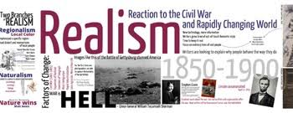
2. American prose fiction:
Mark Twain, William Dean Howells, Henry James, Kate Chopin, William Sydney Porter (O.Henry), Jack London.

Slide 11
American prose fiction
American realism is characterized by “local color” and American writers-realists are called “local colorists”: they used the region’s distinctive ways of speaking and behaving.
Typical American literary characters:
a common hero;
an American girl;
a middle-class family;
businessmen;
citizens of a new international culture.

Slide 12
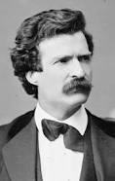
Mark twain (1835 – 1910)
Samuel Langhorne Clemens, known by his pen name Mark Twain, was an American writer, who acquired international fame for his travel narratives The Innocents Abroad (1869), Roughing It (1872), and Life on the Mississippi (1883), and for his adventure stories of boyhood The Adventures of Tom Sawyer (1876) and Adventures of Huckleberry Finn (1885).

Slide 13
Local colour
Local colour is a style of writing derived from the presentation of the features and peculiarities of a particular locality and its inhabitants.
Although the term local colour can be applied to any type of writing, it is used almost exclusively to describe a kind of American literature that in its most-characteristic form made its appearance in the late 1860s, just after the end of the Civil War. For nearly three decades local colour was the single most-popular form of American literature, fulfilling a newly awakened public interest in distant parts of the United States and, for some, providing a nostalgic memory of times gone by.
It concerned itself mainly with depicting the character of a particular region, concentrating especially upon the peculiarities of dialect, manners, folklore, and landscape that distinguish the area.

Slide 14
Local colour
The influence of the local colour story - and the humorist subgenre - is most clearly apparent in Twain’s tall tales (most notably “The Celebrated Jumping Frog of Calaveras County,” 1865) and his books about life on the Mississippi River (culminating in The Adventures of Huckleberry Finn, 1884).

Slide 15
Local colour
Many American authors of the second half of the 19th century achieved success with vivid descriptions of their own localities.
Harriet Beecher Stowe, Rose Terry Cooke, and Sarah Orne Jewett wrote of New England.
George Washington Cable, Joel Chandler Harris, and Kate Chopin described the Deep South.
Frances E.W. Harper used black vernacular for the poems of her Sketches of Southern Life (1872).
Thomas Nelson Page romanticized Virginia plantation life, and Charles W. Chesnutt refuted that vision while also excoriating racial prejudice in the South.
Lafcadio Hearn, before he began his Japanese adventures, wrote of New Orleans.
Edward Eggleston wrote of Indiana frontier days.
Mary Noailles Murfree told stories of the Tennessee mountaineers.

Slide 16
Local colour
Another generation of American writers probed the boundaries of local colour during the last quarter of the 19th century.
Among Paul Laurence Dunbar’s stories and poems are those that describe the pre-Civil War South.
O. Henry chronicled both the Texas frontier and the streets of New York City.
Alice Dunbar Nelson explored Creole culture.
Willa Cather sharply rendered the experience of Plains settlers in her novels.

Slide 17
Local colour
By the turn of the 20th century, local colour had faded as a dominant style, but its legacy within American literature is considerable.
Zora Neale Hurston combined that literary tradition with her own anthropological fieldwork in the South, particularly in Florida.
William Faulkner’s invented Yoknapatawpha county, Mississippi, is indebted to the local colourists of the 19th century.
Toni Morrison and Grace Paley are also among the most-visible inheritors of the tradition.

Slide 18
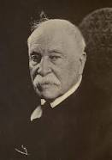
William Dean Howells (1837 – 1920)
an American realist novelist, literary critic, and playwright, nicknamed "The Dean of American Letters“;
the champion of literary realism, and the close friend and adviser of Mark Twain and Henry James.
Their Wedding Journey (1872) and A Chance Acquaintance (1873) were his first realistic novels of uneventful middle-class life.
A Modern Instance (1882), the story of the disintegration of a marriage, which is considered his strongest novel.
His best known work, The Rise of Silas Lapham (1885), deals with a self-made businessman’s efforts to fit into Boston society.

Slide 19
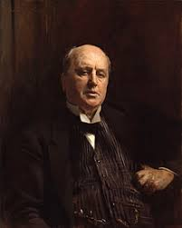
Henry James (1843 – 1916)
an American novelist and a great figure in the transatlantic culture. His fundamental theme was the innocence of the New World in clash with the corruption and wisdom of the Old, as illustrated in such works as Daisy Miller (1879), The Portrait of a Lady (1881), The Bostonians (1886), and The Ambassadors (1903).
He wrote stories, reviews and articles before he attempted a full-length novel. In 1886 James wrote the fullest and most-rounded American social novel of its time “The Bostonians” (1886).
Henry James and William Dean Howells inaugurated the era of American realism.

Slide 20
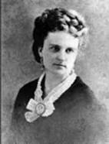
Kate chopin (1851 – 1904)
American novelist and short-story writer (more than 100 short-stories)
Chopin’s work has been categorized within the “local colour” genre.
Her stories were collected in Bayou Folk (1894) and A Night in Acadie (1897).
The novel At Fault (1890).
There was a revival of interest in Chopin in the late 20th century because her concerns about the freedom of women foreshadowed later feminist literary themes.
The Complete Works of Kate Chopin appeared in 1969.

Slide 21
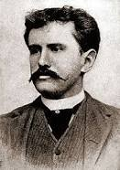
William Sydney Porter (O.Henry) (1862 – 1910)
American short-story writer whose tales romanticized the commonplace - in particular the life of ordinary people in New York City. His stories expressed the effect of coincidence on character through humour, grim or ironic, and often had surprise endings, a device that became identified with his name.
Cabbages and Kings (1904)
The Four Million (1906)
The Trimmed Lamp (1907)
Heart of the West (1907)
The Voice of the City (1908)
The Gentle Grafter (1908)
Roads of Destiny (1909)
Options (1909)
Strictly Business (1910)
Whirligigs (1910)
Sixes and Sevens (1911),
Rolling Stones (1912)
Waifs and Strays (1917).

Slide 22
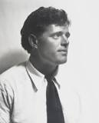
Jack London (1876 – 1916)
Jack London, pseudonym of John Griffith Chaney, an American novelist and a short-story writer whose best-known works - among them The Call of the Wild (1903) and White Fang (1906) - depict elemental struggles for survival. He became the highest-paid writer in the United States at that time.
His autobiographical novels: Martin Eden (1909), The Road (1907) and John Barleycorn (1913); his Alaskan novels The Call of the Wild (1903), White Fang (1906), and Burning Daylight (1910); the novels The Sea-Wolf (1904) and The Iron Heel (1908).
The collection of short stories The Son of the Wolf: Tales of the Far North (1900)

Slide 23
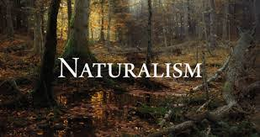
American Naturalism.

Slide 24
Naturalism
Naturalism, in literature and the visual arts, late 19th- and early 20th-century movement that was inspired by adaptation of the principles and methods of natural science, especially the Darwinian view of nature, to literature and art.
In literature it extended the tradition of realism, aiming at an even more faithful, unselective representation of reality, a veritable “slice of life,” presented without moral judgment.
Naturalism differed from realism in its assumption of scientific determinism, which led naturalistic authors to emphasize man’s accidental, physiological nature rather than his moral or rational qualities.
Individual characters were seen as helpless products of heredity and environment, motivated by strong instinctual drives from within and harassed by social and economic pressures from without.

Slide 25
Naturalism in american literature
In American literature, naturalism had a delayed blooming in the work of Hamlin Garland, Stephen Crane, Frank Norris, and Jack London; and it reached its peak in the art of Theodore Dreiser.
James T. Farrell’s “Studs Lonigan” trilogy (1932–35) is one of the latest expressions of true naturalism.

Slide 26
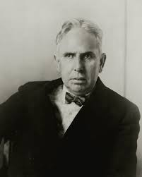
Theodore Dreiser (1871 – 1945)
a novelist who was the outstanding American practitioner of naturalism. He was the leading figure in a national literary movement that replaced the observance of Victorian notions of propriety with the unflinching presentation of real-life subject matter. Among other themes, his novels explore the new social problems that had arisen in a rapidly industrializing America.
The novels «Sister Carrie» (1899), «Jennie Gerhardt» (1911), «The Financier” (1912), “The Titan” (1914), “A Traveler at Forty” (1913), “The Genius” (1915), “An American Tragedy” (1925), “The Bulwark” (1946);
a short-story collection “Free and Other Stories” (1918); a book of sketches “Twelve Men” (1919); philosophical essays “Hey-Rub-a-Dub-Dub” (1920); a rhapsodic description of New York “The Color of A Great City” (1923); works of drama, including “Plays of the Natural and Supernatural” (1916) and “The Hand of the Potter” (1918); and the autobiographical works “A Hoosier Holiday” (1916) and “A Book About Myself” (1922).
Sister Carrie and An American Tragedy are works of literature that display a deep understanding of the American experience around the turn of the century, with its expansive desires and pervasive disillusionments.

