Slide 1
Asian American literature
Plan:
I. Asian immigrants
II. Early Asian American Literature
III. World War II and the 1950’s
IV. Rebellion, Controversy and Success
V. The Immigrant Experience

Slide 2
VIDEO ON ASIAN AMERICAN LITERATURE

Slide 3
WHAT IS ASIAN AMERICAN LITERATURE?

Slide 4
Asian immigrants.
Toward the end of the nineteenth century, Chinese American immigrants were the first Asian Americans to write about their experience in English. Their primary impulse was to combat negative racist stereotypes held about the Chinese by the popular American press and literature of the day.
In his autobiography, When I Was a Boy in China (1887), Yan Phou Lee, who converted to Christianity and immigrated to the United States to study from 1872 to 1875, sought to show that education could turn a young Chinese into a person suitable to fully participate in American society.

Slide 5
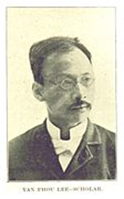
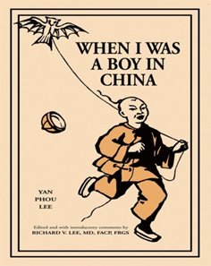
When I Was a Boy in China (1887), Yan Phou Lee

Slide 6
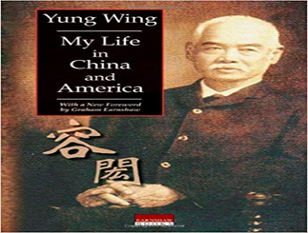
Yung Wing’s autobiography, My Life in China and America (1909).

Slide 7
II. Early Asian American Literature
The Chinese American author Edith Maude Eaton (Sui Sin Far) was the first Asian American writer fiercely sympathetic to common Chinese immigrants in Canada and the United States, the two countries where she lived after her birth in England. Her short stories and articles, first published in 1896, painted an accurate picture of the struggles and aspirations of the first Chinese immigrants in America who worked hard, menial jobs, lived in Chinatown enclaves, and endured racist taunts and violence. Her last collection of short stories, Mrs. Spring Fragrance (1912), was rediscovered and republished in 1995.
Winnifred Eaton (Onoto Watanna) entertained readers with lighthearted romance novels and short stories with Japanese American themes, but without focusing on the darker sides of the immigrant experience. From her first novel, Mrs. Nume of Japan (1899), and including her greatest bestseller, Tama (1910), Onoto Watanna’s Asian-themed fiction proved popular. During the 1920’s, she turned to writing screenplays in New York City.

Slide 8
Etsu Inagaki Sugimoto’s autobiography,
A Daughter of the Samurai (1925),
introduced her readers to the Japanese American immigrant experience, albeit from an upper-class point of view.
Sugimoto’s subsequent fiction chronicled her return to Japan with her two daughters, followed by a return to America for her children’s education, a move not uncommon among some Japanese Americans.

Slide 9
Younghill Kang’s The Grass Roof (1931) was well-received, in part because immigration to America was the goal of the novel’s Korean protagonist.
As the American public came to sympathize with China in its conflict with Japan, Lin Yutang’s work My Country and My People (1935) became a bestseller.
Even H. T. Tsiang’s critical novel And China Has Hands (1936), about the oppressed life of a Chinese laundryman, saw publication.
Mainstream American taste for Asian American literature turned sour when Younghill Kang’s second novel, East Goes West (1937), looked critically at European American society from an educated Korean American immigrant’s point of view.
Decades later, however, the work was considered an early Asian American classic.

Slide 10
III. World War II and the 1950’s
Japan’s attack on the U.S. Navy base at Pearl Harbor on December 7, 1941, not only brought America into World War II but it also brought decisive changes for the Asian American community that Asian American writers reflected in their literature.
Pro-Chinese sentiment led to publication and success of Pardee Lowe’s Father and Glorious Descendant (1943), a story about a Chinese American father and son published during the same year that U.S. Congress repealed the Chinese Exclusion Act.

Slide 11
Jade SnowWong’s Fifth Chinese Daughter (1945, revised 1950) depicted the daughter of immigrant parents finding her place within American society.
Lowe and Wong’s literary popularity paved the way for the success of Chin Yang Lee’s Flower Drum Song (1957), an insider’s humorous look at San Francisco’s Chinatown. The novel was also adapted into a popular Broadway musical in 1958, followed by a 1961 film version that featured an almost exclusively Asian American cast led by Nancy Kwan.
Later Asian American critics faulted Chinese American writers of this era for being too accommodating to mainstream tastes, but most critics eventually acknowledged that these early works provided a non-stereotypical view of Asian American life as written by Asian Americans themselves.

Slide 12
Louis Chu’s Eat a Bowl of Tea (1961) presented a starkly realistic but always sympathetic look at the prewar, urban bachelor Chinese American immigrant community. Chu’s novel initially failed to win a large mainstream readership before becoming a classic.
Japanese American literature was deeply affected by the internment in remote relocation camps of Japanese and Japanese Americans living on the West Coast from early 1942 until 1945. This infamous political event, for which the United States formally apologized many years later, became a key subject of Japanese American literature. It also delayed publication of Toshio Mori’s short-story collection Yokohama, California from 1942 to 1949. Mori’s stories perceptively and gently chronicle mostly prewar Japanese American life in rural California.

Slide 13
The internment camp experience also influenced the work of Hisaye Yamamoto, who began to publish in 1948. Her best stories were republished in Seventeen Syllables and Other Stories (1988). The impact of the camp experience on young Japanese American women was rendered also in Shelley Ota’s Upon Their Shoulders (1951) and Monica Sone’s Nisei Daughter (1953). John Okada’s novel No-No Boy (1957) compared the equally bitter fate of two Japanese American men who said either “no” or “yes” to camp authorities who asked male internees if they were ready to renounce Japan and were willing to join the U.S. armed forces.
Subsequent works of Japanese American authors, such as Jeanne Wakatsuki Houston’s autobiography, Farewell to Manzanar (1972, with James D. Houston), continued to describe the camp experience.

Slide 14
IV. Rebellion, Controversy and Success
During the early 1970’s, a group of young Asian American authors rebelled against style and themes of much classic Asian American literature that they rejected for promoting subservient immigrant assimilation to the point of cultural self-denial. In their anthology Aiiieeee! (1974), writer-editors Frank Chin, Jeffrey Paul Chan, Lawson Fusao Inada, and Shawn HsuWong presented radical short stories, plays, and poems deeply antagonistic to Asian American conformity with mainstream American values.
Chin’s play Chickencoop Chinaman (1974) offered a cynical view of Asian American masculinity threatened by European American racism.

Slide 15
The 1970’s and 1980’s saw a substantial rise of successful Asian American writers, whose focus on immigrant families and first- and second-generation Asian immigrant protagonists captivated an enthusiastic readership.
Maxine Hong Kingston’s The Woman Warrior (1976) became a critically acclaimed bestseller. Readers loved its thinly disguised autobiographical tale of a Chinese American girl growing up in Stockton, California’s Chinatown who overcomes both outside indifference and Chinese misogyny with her belief in a mythic Chinese heroine.
The book won Kingston the National Book Critics Circle Award.

Slide 16
On the stage, David Henry Hwang dramatized the Asian American immigrant experience.
His first play, F.O.B. (pr. 1978, pb. 1983), alluded to the pejorative term “fresh off the boat” (someone of Asian descent who has recently immigrated to a new country, usually the US) for recent immigrants, particularly Asians.
His great critical success, however, came with his play M. Butterfly (pr., pb. 1988), which moved beyond the immigrant experience to dramatize traditional Western views on Asia and Asian femininity.

Slide 17
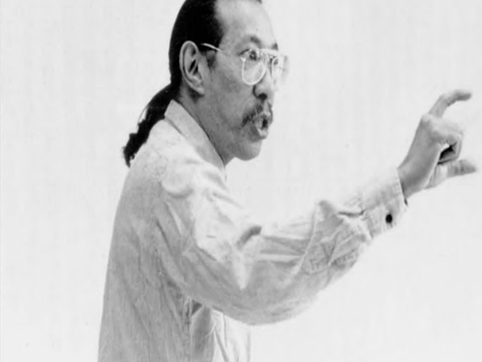
Frank Chin, the author of The Chickencoop Chinaman, the first play by an Asian American to be produced.

Slide 18
Since the 1980’s, the growing ethnic diversity of Asian American writers has offered readers views of Asian immigrant experiences from quite different national backgrounds. Under the pen name Ronyoung Kim, the Korean American author Gloria Hahn wrote Clay Walls (1987), a moving account of a Korean family’s coming to California during the 1920’s.
Le Ly Hayslip’s memoir When Heaven and Earth Changed Places (1989) presented a Vietnamese woman’s view of the Vietnam War and the postwar Vietnamese American immigrant experience.
Bapsi Sidhwa’s novels told of the Pakistani American experience, from The Crow Eaters (Pakistan, 1978; United States, 1982) to A Pakistani Bride (2008).

Slide 19
Amy Tan’s runaway bestseller The Joy Luck Club (1989) told the interwoven tales of four sets of Chinese American mothers and daughters.
The book depicts conflicts between first- and second-generation immigrants, whose families make the transition from China to America.
In 1993, the novel became a successful Hollywood film with an almost entirely Asian cast.

Slide 20
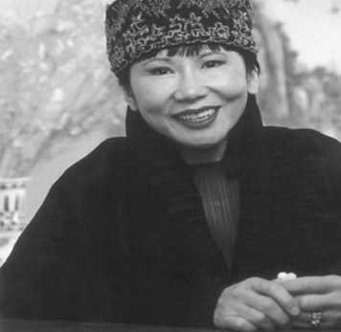
Amy Tan, the author of The Joy Luck Club.

Slide 21
Frank Chin criticized Kingston and Tan for what he called an anti-male bias and pandering to white audiences in their writings.
Kingston and Tan rejected his criticisms by pointing out that their works were fiction about individual characters, not anthropological or literary studies of Asian American immigration.
Both Kingston and Tan continued to enjoy success even as their fiction turned away from immigrant themes to issues of world peace, in the case of Kingston’s writings, and to the inhumanity of the Burmese military dictatorship in
Tan’s Saving Fish from Drowning (2006).

Slide 22
V. The Immigrant Experience
The 1990’s also saw the rise of the poet and critic Shirley Geok-lin Lim, a first-generation immigrant from Malaysia. Her memoir Among the White Moon Faces (1996) won the American Book Award. Lim also brought further critical attention to Asian American literature through her work as a college English professor.
Another Asian American writer and college professor, Bharati Mukherjee, published her first novel, The Tiger’s Daughter, in 1971. Her novel focuses on the vaguely autobiographical journey back to India of a Bengali-born Indian girl educated and married in America. Mukherjee later turned to historical fiction, closing a two-volume tale of Indian rebellion against British colonialism in The Tree Bride (2004).

Slide 23
Many mainstream American readers continued to prefer writings by Asian American authors that focused on Asian American experiences, or at least on Asian topics.
Jhumpa Lahiri’s writings were successful in meeting this demand. Her first collection of short stories about first-generation Bengali immigrants, Interpreter of Maladies (1999), won for her the Pulitzer Prize for Fiction in 2000.
In 2008, her novel about second- and third-generation Asian Indian Americans, Unaccustomed Earth (2008), topped the bestseller list of The New York Times during the week in which it was published.

Slide 24

Jhumpa Lahiri

Slide 25
As Asian American literature has matured, some authors have strived to move beyond immigrant themes and autobiographical works.
In general, however, Asian American writers who have tried to do this have had limited success.
For example, Cynthia Kadohata and Chang-Rae Lee both moved away from celebrated first works that focused on immigrant Asian Americans.

Slide 26
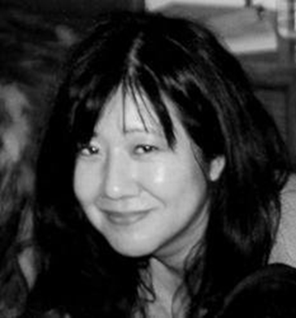

Cynthia Kadohata and Chang-Rae Lee

Slide 27
Kadohata’s The Floating World (1989) and Lee’s Native Speaker (1995) were both successes.
In contrast, Kadohata’s science-fiction novel In the Heart of the Valley of Love (1992) flopped.
However, she regained her audience with Kira-kira (2004), the story of two Japanese American sisters that won the Newbery Medal.
Lee’s novel Aloft (2004), with an Italian American protagonist, failed to attract critics and readers.

Slide 28

Lisa See
Lisa See, who gained literary fame with her family memoir On Gold Mountain (1995), triggered by the rare occurrence of her Chinese great-grandfather marrying an European American, gave her subsequent works Asian—but not necessarily Asian American— themes. Her novel Shanghai Girls (2009) followed her heroines from China to America during the 1950’s.

Slide 29

Laura Joh Rowland
By the early twenty-first century, most Asian American literature still focused strongly on the Asian American immigrant experience and featured many Asian American immigrant characters. Those Asian American authors who sought alternative topics generally retained links to Asia. The crime series of Laura Joh Rowland, whose sleuth Sano Ichiro operates in seventeenth century Japan, was a noticeable example.

Slide 30
Further Reading
Cheung, King-Kok, ed. Words Matter: Conversations with Asian American Writers. Honolulu: University of Hawaii Press, 2000.
Interviews of nineteen Asian American authors who talk about the influence of the immigrant experience on their work.
Huang, Guiyou. The Columbia Guide to Asian American Literature Since 1945. New York: Columbia University Press, 2006.
Comprehensive reference work with narrative overview, six review chapters organized by literary forms and genres, a bibliography of literary criticism, and an overview of periodicals focused on Asian American literature. Readable, accessible, and well researched.

Slide 31
Kim, Elaine H. Asian American Literature: An Introduction to the Writings and Their Social Context. Philadelphia: Temple University Press, 1982. One of the first studies of the subject; still widely available and influential. A good starting point for the study of the emergence of Asian American literature.
Leonard, George J., ed. The Asian Pacific American Heritage: A Companion to Literature and the Arts. NewYork: Garland, 1999.Written for high school students, this volume contains a section on literature that is particularly useful, as it discusses major Asian American authors and places their works in their social and historical contexts.
Oh, Seiwoong, ed. Encyclopedia of Asian American Literature. New York: Facts On File, 2007. Comprehensive work with author entries, bibliography of secondary sources, and list of major literary works. Especially good for the study of individual writers.
Srikanth, Rajini. The World Next Door: South Asian American Literature and the Idea of America. Philadelphia: Temple University Press, 2004. Scholarly analysis of Asian Indian authors that focuses on the interaction of literature and the immigrant experience. The book’s last chapter, “Trust and Betrayal in the Idea of America,” is especially perceptive.

