Slide 1
Romanticism and the American Renaissance (1820 – 1865)
Development of American romantic literature in the 19th century.
The Monroe doctrine.
The American Renaissance of 1836 – 1865. Abolitionism.
American romance and poetry.

Slide 2
1. Development of American romantic literature in the 19th century.

Slide 3
American and European Romanticisms are connected in:
Search for truth,
Development of a harmonious personality,
Celebration of beauty,
Description of life as a struggle between vice and virtue,
Romanticists believed that emotions shape people's experience and their knowledge of the world.

Slide 4
Distinctive features of American Romanticism:
The Romantic Movement was the first major literary movement in a very young America;
The first foundations of American national literature were laid;
the American Romantics celebrate the beauty of American landscape;
It was also a new attitude toward people, promoting the individual, standing against society;
The American Romantics liked to experiment with form and the novel became an important vehicle for expression (unlike the European Romantics who focused mainly on poetry).

Slide 5
New themes and challenges of American Romanticism:
an impulse toward reform (women's rights, abolition of slavery);
a concern with the impact of new technology;
an idealization of women (Edgar Allan Poe's Anabel Lee, for example);
a fascination with death and the supernatural (Nathaniel Hawthorne, Edgar Allan Poe);
the expanding population due to immigration;
the role of government;
The geographical expansion;
the treatment of Native Americans.

Slide 6
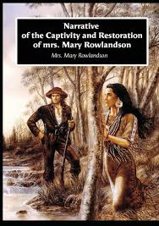
Specific genres of American Romanticism:
Captivity narratives (for ex., “A narrative of the Captivity and Restoration of Mrs. Mary Rowlandson”);
Narratives about Native Americans
(for ex., “The American Savage: how he may
be tamed by the weapons of civilization”);
Tall tale, narrative that depicts the wild
adventures of extravagantly exaggerated folk heroes;
Local color or regional literature is fiction
and poetry that focuses on the characters, dialect, customs, topography, and other features particular to a specific region.

Slide 7
Traditional genres, developed by American Romanticism:
the novel (historical, social, fantastic),
the romance,
the short story,
ballads,
epics,
folk-tales of the Indians.

Slide 8
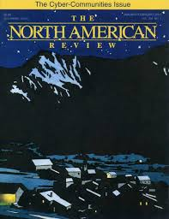
The North American Review
North American Review (NAR) was the first literary magazine in the United States. It was founded in Boston in 1815 by journalist Nathan Hale and others.
It called for American writers to stop imitating British and continental stereotypes.
It printed only American material.

Slide 9
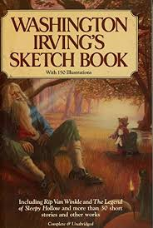
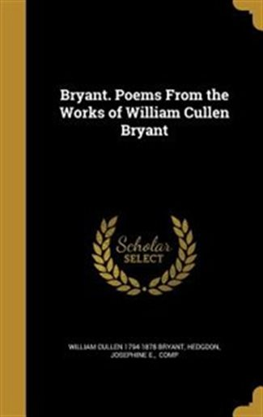
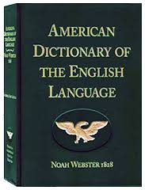
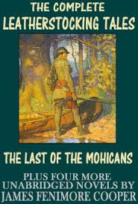
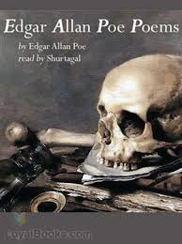
The publications of American writers (by the end of the 1820s ):
Washington Irving “Sketch Book” (1819)
William Cullen Bryant “Poems” (1821)
Noah Webster “American Dictionary” (1828)
James Fenimore Cooper “Leatherstocking Tales” (1823)
Edgar Allan Poe “Poems “ (1827)

Slide 10
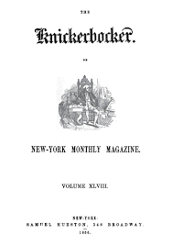
The Knickerbocker school
The group of writers active in and around New York City during the first half of the 19th century. Its most prominent members included Washington Irving, James Fenimore Cooper and William Cullen Bryant. Each were respectively pioneers in general literature; novels, poetry and journalism. Taking its name from Washington Irving’s Knickerbocker’s History of New York (1809), the group sought to promote a genuinely American national culture and establish New York City as its literary centre.
Other writers associated with the group were the abolitionist and woman-suffrage crusader Lydia M. Child, editor and politician G.C. Verplanck, Clement Moore, scholar and author of “’Twas the Night Before Christmas” (1823), and the poet and travel writer Bayard Taylor.
The Knickerbocker Magazine (1833–65), a literary monthly edited by Lewis G. and Willis G. Clark, though not an official organ of the group, published members’ work.

Slide 11
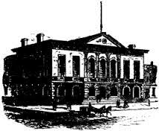
The Bread and Cheese Club
Bread and Cheese Club, also called the Lunch and the Lunch Club, social and cultural conclave created by author James Fenimore Cooper, which held meetings at Washington Hall, on the southeast corner of Broadway and Reade streets in New York City, from its formal beginning in 1824 until at least 1827. Its membership consisted of American writers, editors, and artists, as well as scholars, educators, etc.

Slide 12
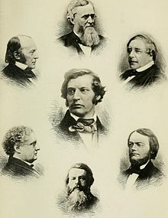
The Saturday Club
The Saturday Club, established in 1855, was an informal monthly gathering in Boston, Massachusetts, of writers, scientists, philosophers, historians and other notable thinkers of the mid-nineteenth century.
The original members of the group included Horatio
Woodman, Louis Agassiz, Richard Henry Dana Jr.
and James Russell Lowell. In the following years
membership was extended to Oliver Wendell Holmes,
Cornelius Conway Felton, Henry Wadsworth Longfellow,
William Hickling Prescott.
Other members included Ralph Waldo Emerson,
Asa Gray, John Lothrop Motley, Benjamin Peirce,
Charles Sumner, John Greenleaf Whittier
and others.
“A Group of the Saturday Club", from Life and Letters of Oliver Wendell Holmes, 1896

Slide 13

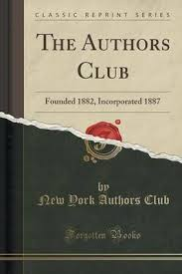
The Authors Club
The Authors Club, an association for literary-minded gentlemen and a support group for younger writers, was formed in New York City in 1882.
Boston Authors Club

Slide 14
Flourishing from 1820 to 1850, Romanticism can be divided into Early Romanticism (the twenties and thirties) and Late Romanticism (the forties and fifties).
The early period began with the romances and short stories of Washington Irving (1783— 1859). These forms were developed later by other American writers. The historical novel began in America with Fenimore Cooper (1789— 1851). Romantic poetry appeared in great variety; most outstanding were the poems of Edgar Allan Рое (1809- 1849).
The Late Romanticism was the years of mature Romanticism in American literature. Characteristic of this period were Cooper's later novels, Edgar Allan Poe's romances and poems written during the last eight years of his life, the works of Henry Wadsworth Longfellow (1807 -1882), and the poems by Walt Whitman (1819 - 1892).

Slide 15
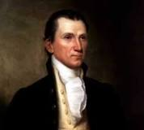
2. The Monroe doctrine.
James Monroe was the fifth president of the United States from 1817 to 1825.

Slide 16
Monroe Doctrine
Monroe Doctrine, (December 2, 1823), cornerstone of U.S. foreign policy enunciated by Pres. James Monroe in his annual message to Congress.
Declaring that the Old World and New World had different systems and must remain distinct spheres, Monroe made four basic points:
(1) the United States would not interfere in the internal affairs of or the wars between European powers;
(2) the United States recognized and would not interfere with existing colonies and dependencies in the Western Hemisphere;
(3) the Western Hemisphere was closed to future colonization;
(4) any attempt by a European power to oppress or control any nation in the Western Hemisphere would be viewed as a hostile act against the United States.

Slide 17
3. The American Renaissance of 1836 – 1865. Abolitionism.

Slide 18
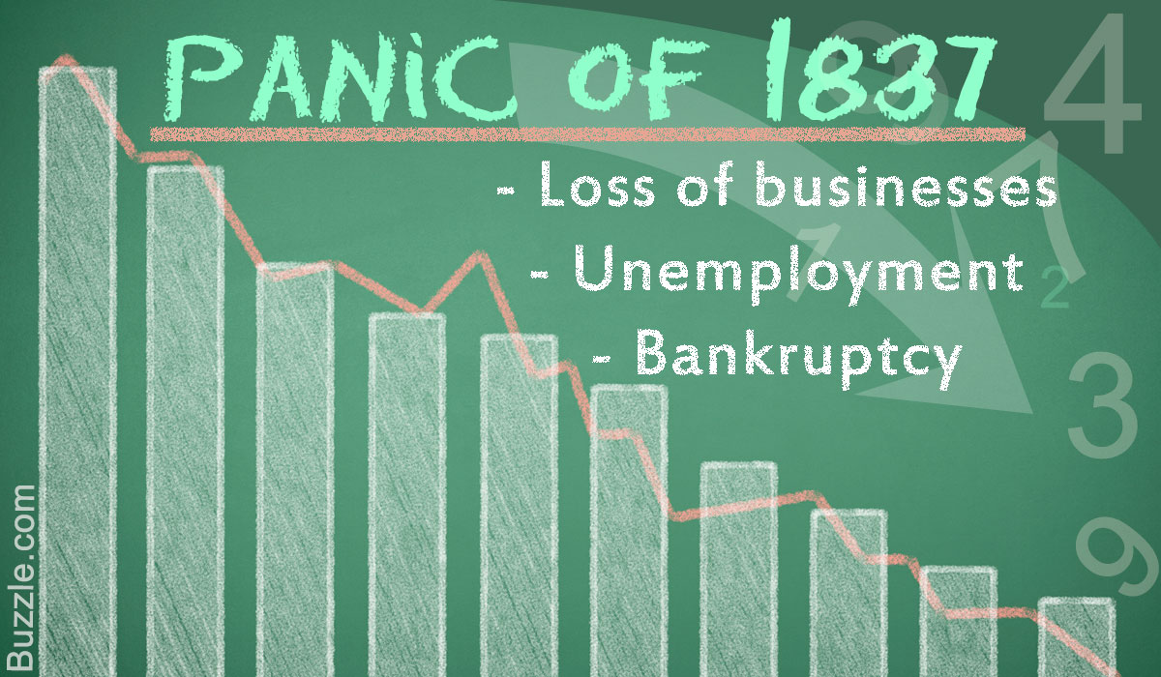
The Panic of 1837
The Panic of 1837 was a major recession in the US economy that began in the spring of 1837 and lasted until the mid-1840s.

Slide 19
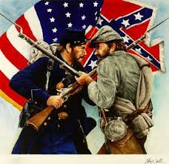
American Civil War
American Civil War, also called War Between the States, four-year war (1861–65) between the United States and 11 Southern states that seceded from the Union and formed the Confederate States of America.

Slide 20
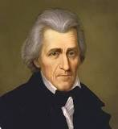
Andrew Jackson
the seventh president of the United States from 1829 to 1837;
an idiomatic western genius;
The Papers of Andrew Jackson is a project to collect and publish Jackson's entire extant literary record.
The Andrew Jackson Papers is one of twenty-three presidential collections in the Manuscript Division of the Library of Congress. The Jackson archival collection contains more than 26,000 items dating from 1767 to 1874, including memoranda, journals, speeches, military records, land deeds, and miscellaneous printed matter, as well as correspondence reflecting Jackson’s personal life and career as a politician, military officer, president, slave holder and property owner from 1785 to 1845).
1767 - 1845

Slide 21
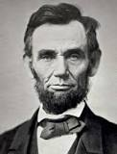
Abraham Lincoln
The 16th president of the United States (1861–65)
The papers of Abraham Lincoln contain approximately 40,550 documents dating from 1774 to 1948, although most of the collection spans from the 1850s through Lincoln’s presidency (1861-1865)
the value of a “plain, native” style, used to characterize speech or writing that is simple, direct
1809 - 1865

Slide 22
Transcendentalism
Transcendentalism is a philosophical movement that developed in the late 1820s and 1830s in the eastern United States, based on a belief in the essential unity of all creation, the innate goodness of humanity, and the supremacy of insight over logic and experience for the revelation of the deepest truths.
It prepared the ground and introduced the American Renaissance in literature.
Representatives:
Ralph Waldo Emerson,
Henry David Thoreau,
Margaret Fuller,
Orestes Brownson,
Elizabeth Palmer Peabody,
James Freeman Clarke,
George Ripley,
Bronson Alcott,
Walt Whitman,
Herman Melville,
Nathaniel Hawthorne.

Slide 23
American Renaissance or New England Renaissance
American Renaissance, also called New England Renaissance, period from the 1830s roughly until the end of the American Civil War in which American literature, in the wake of the Romantic movement, came of age as an expression of a national spirit.
The literary scene of the period was dominated by a group of New England writers, the “Brahmins” : Henry Wadsworth Longfellow, Oliver Wendell Holmes and James Russell Lowell.
The Transcendentalists advocated reforms in church, state, and society, contributing to the rise of free religion and the abolition movement (for ex.: the poet John Greenleaf Whittier and the novelist Harriet Beecher Stowe “Uncle Tom’s Cabin”, 1852) and to the formation of various utopian communities such as “Brook Farm”.

Slide 24
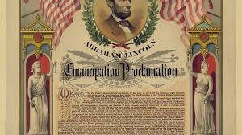
The Abolition Movement
President Abraham Lincoln issued the Emancipation Proclamation on January 1, 1863 (the third year of Civil War). The proclamation declared "that all persons held as slaves" within the rebellious states "are, and henceforward shall be free“.

Slide 25
4. American romance and poetry.

Slide 26
American romance
This genre expresses the American romantic vision;
It is an emotional and symbolic form of a novel;
It is characterized by special techniques used to communicate complex meanings;
The form of an American romance is determined by the absence of traditional community life in America;
This genre is influenced by a history of revolution, wild geography, relatively classless democratic society.

Slide 27
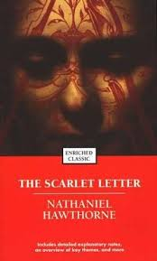
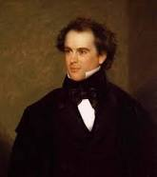
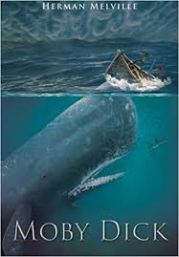
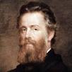
American romance
Nathaniel Hawthorne ( 1806 – 1864)
“The Scarlet Letter”
Herman Melville (1819 – 1891)
“Moby Dick”

Slide 28
American romance
English novels showed poor main characters, rising to prosperity as a result of marriage or the discovery of a hidden aristocratic background.
Such plots didn’t challenge the social structure of English society.
American novelists couldn’t depend on some established tradition.
The main character could find himself alone among cannibal tribes (for ex.: “Typee”, 1846 by Herman Malville).
The tragic note in American literature became dominant in he novels, showing the greater social tragedy od a society at war with itself.

Slide 29
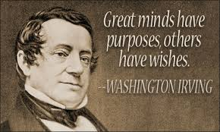
Washington Irving (1783 – 1859)
This writer is called the “first American man of letters.”
He is best known for the short stories “The Legend of Sleepy Hollow” and “Rip Van Winkle.” These tales have been called the first American short stories. They are both Americanized versions of German folktales.
The main character of “Rip Van Winkle” is a henpecked husband who sleeps for 20 years and awakes as an old man to find his wife dead, his daughter happily married, and America now an independent country.

Slide 30
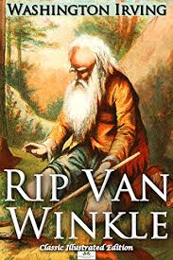
Rip Van Winkle by Washington Irving
Rip Van Winkle is a short story by Washington Irving, published in The Sketch Book in 1819–20. It is set in the Dutch culture of pre-Revolutionary War New York state.
Rip Van Winkle is an amiable farmer who wanders into the Catskill Mountains, where he comes upon a group of dwarfs playing ninepins. Rip accepts their offer of a drink of liquor and promptly falls asleep. When he awakens, 20 years later, he is an old man with a long white beard; the dwarfs are nowhere in sight. When Rip returns to town, he finds that everything is changed: his wife is dead, his children are grown, and George Washington’s portrait hangs in place of King George III’s. The old man entertains the townspeople with tales of the old days and of his encounter with the little men in the mountains.

Slide 31
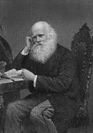
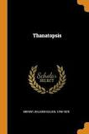
American Poetry
William Cullen Bryant (1794 – 1878),
“an American Wordsworth”,
an American romantic poet, journalist,
and editor for 50 years of the New York
Evening Post. As a man of letters, Bryant
established himself with Poems (1821).
Bryant will be remembered longest as the
poet of his native Berkshire hills and
streams in such poems as “Thanatopsis”
and “To a Waterfowl.”

Slide 32
American Poetry
The New England Brahmins (or The Boston Brahmins)
Originally a reference to the Brahmans, the highest caste of Hindu society, the term came to be applied to a number of prominent New England writers, including Oliver Wendell Holmes, Henry Wadsworth Longfellow, and James Russell Lowell.
All three were educated in Europe and became associated with Harvard University.
They made Boston, Massachusetts, the literary capital of America in their day.
Though they espoused democratic ideals, they remained aesthetically conservative.
In an age that brought forth the masterpieces of Ralph Waldo Emerson, Henry David Thoreau, Nathaniel Hawthorne, Herman Melville, Walt Whitman, Edgar Allan Poe, and Mark Twain, they advocated a genteel, rational humanism.
The Brahmins exerted the main influence on American literary taste until the 1890s.

Slide 33
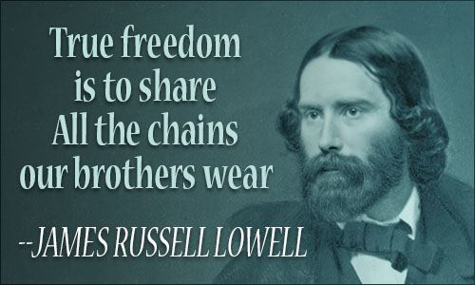
American Poetry
James Russell Lowell (1819 - 1891)
James Russell Lowell was an American poet, critic, essayist, editor, and diplomat whose major significance probably lies in the interest in literature he helped develop in the United States.
He wrote about 50 antislavery articles for periodicals (from 1845 to 1850); satirical verses “Biglow Papers” (1848) used a humorous and original New England dialect; The Vision of Sir Launfal (1848), an enormously popular long poem extolling the brotherhood of man; and A Fable for Critics (1848), a witty and rollicking verse evaluation of contemporary American authors.

Slide 34
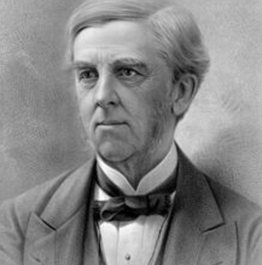
American Poetry
Oliver Wendell Holmes (1809 – 1894)
Oliver Wendell Holmes was a member of the Fireside Poets (The terms “Fireside Poets” or “Schoolroom Poets” are used to designate a group of five poets—William Cullen Bryant, Henry Wadsworth Longfellow, John Greenleaf Whittier, Oliver Wendell Holmes, and James Russell Lowel).
Oliver Wendell Holmes was mainly known for his Harvard University lectures and book The Autocrat of the Breakfast Table (1858), in which some of his poems were featured. Holmes achieved his greatest fame as a humorist and poet. He wrote much poetry (for ex.: “Old Ironsides” (1830)

Slide 35
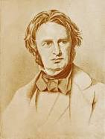
American Poetry
Henry Wadsworth Longfellow
(1807 – 1882)
The most widely known and best-loved American poet of his lifetime, Henry Wadsworth Longfellow achieved a level of national and international prominence previously unequaled in the literary history of the United States.
Poems such as Paul Revere’s Ride (1863); Evangeline, A Tale of Acadie (1847); A Psalm of Life (from Voices of the Night, 1839); The Song of Hiawatha (1855) became mainstays of national culture.
In 1884 he was honoured by the placing of a memorial bust in Poets’ Corner of Westminster Abbey in London, the first American to be so recognized.

Slide 36
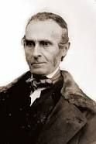
American Poetry
John Greenleaf
Whittier
(1807 – 1892)
American poet and abolitionist.
His first volume of poems Legends of New England was published in 1831.
Famous with numerous volumes of verse: Lays of My Home (1843), Voices of Freedom (1846), Songs of Labor (1850), The Panorama (1856), Home Ballads and Poems (1860), The Tent on the Beach (1867), Among the Hills (1868), and The Pennsylvania Pilgrim (1872).
His best-known poem is “Maud Muller” (1854) with its lines “Of all sad words of tongue and pen/ The saddest are these, ‘It might have been.’ ”

Slide 37
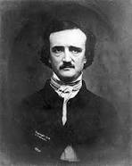
American Poetry
Edgar Allan Poe
(1809 – 1849)
is an American short-story writer, poet, critic, and editor who is famous for his cultivation of mystery. His tale “The Murders in the Rue Morgue” (1841) initiated the modern detective story, and the atmosphere in his tales of horror is unrivaled in American fiction.

Slide 38
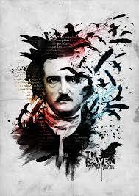
American Poetry
His poem “The Raven” (1845) numbers among the best-known poems in the national literature.

Slide 39
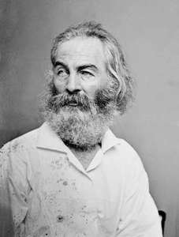
American Poetry
Walt Whitman (1819 – 1892) is an American poet, journalist, and essayist whose verse collection Leaves of Grass, first published in 1855, is a landmark in the history of American literature.
Under the influence of the Romantic movement in literature and art, Whitman held the theory that the chief function of the poet was to express his own personality in his verse.
In Leaves of Grass he addressed the citizens of the United States, urging them to be large and generous in spirit, a new race nurtured in political liberty, and possessed of united souls and bodies.

Slide 40
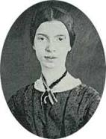
American Poetry
Emily Dickinson
(1830 – 1886)
American lyric poet, he author of nearly 1,800 poems.
With Walt Whitman, Dickinson is widely considered to be one of the two leading 19th-century American poets.
She worked in verse forms suggestive of hymns and ballads, and freely ignored the usual rules of versification and even of grammar.
Dickinson's poetry was heavily influenced by the Metaphysical poets of seventeenth-century England.

Slide 41
American Poetry
Emily Dickinson most often punctuated her poems with dashes. She also capitalized interior words, not just words at the beginning of a line.
Emily Dickinson used the dash to fragment language and to cause unrelated words to rush together.
THE BRAIN IS WIDER THAN THE SKY
The Brain – is wider than the Sky –
For – put them side by side –
The one the other will contain
With ease – and You – beside –
The Brain is deeper than the sea –
For – hold them – Blue to Blue –
The one the other will absorb –
As Sponges – Buckets – do –
The Brain is just the weight of God –
For – Heft them – Pound for Pound –
And they will differ – if they do –
As Syllable from Sound –

